Slide 1
Social Skills Training
Where is the Science and Where is the Practice?

Slide 2
Big Picture
All Work is Social.
Notes:
Consensus in the field of rehabilitation that social skills shape employment outcomes (Phillips et al., 2014, Phillips et al., 2015)

Slide 3
Messy Business
Human interaction is amazing and amazingly complex
A couple of question reflects the heart of the issue: Where and how did you learn to be socially effective?
Do you make judgements of social skills the same way as others?
Can my mother tell the difference after social skills training or is it only measurable by pre-post self-report instruments?

Slide 4
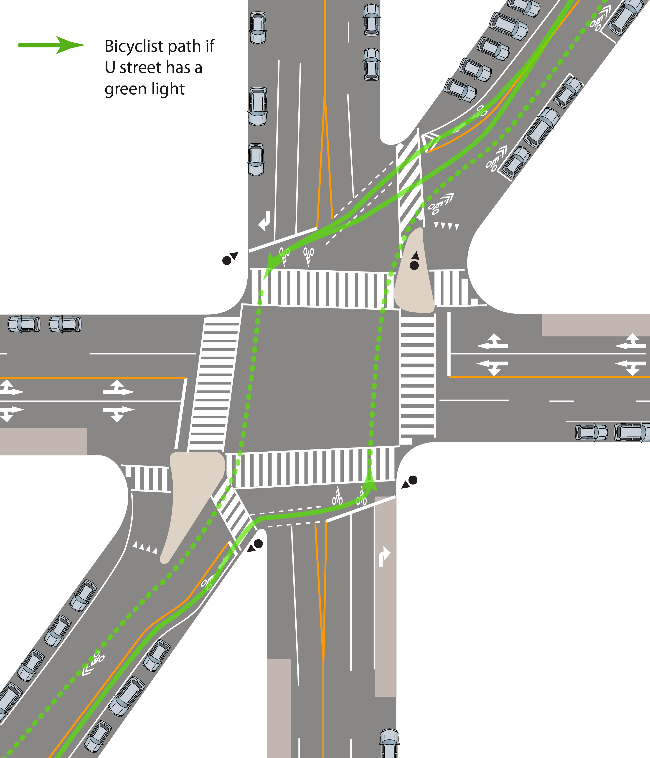
What do we know about the intersection of social skills, employment, and disability?

Slide 5
A Caricature of My Experience
Someone complains in a staff meeting about a clients lack of social skills.
New counselor assigned in same staff meeting to teach social skills.
New counselor tells staff they don’t know how to teach socials skills.
Senior staff member shares previously used training.
Dust off social skills training content.
Invite all clients that we have not enjoyed interacting with to come to social skills group.
Teach social skills training.
Ask clients whether they enjoyed the training.
Put training on shelf to collect dust until the next cycle.

Slide 6
Risk in Moving to Quickly from Complex to Intervention and Lost Opportunity in Focusing Only on Group Social Skills Training
Opportunities in
Assessment
Planning
Using Supports
Leaning on Strengths
Educating Others in addition to the Client
Complex
Intervention

Slide 7
History
Henry George – American political economist argued in 1884 that the increasingly complex society placed a greater demand for interacting well in society.
Thorndike argued in 1920 that social intelligence is the ability to “act wisely in human relations”
The middle of the 20th century saw an increase in social skills research that began to balloon in the 1970s and 80s.
As the literature grew, so did the terms and definitions used to describe social effectiveness.

Slide 8
Historical Baggage
Even before E. L. Thorndike defined social intelligence researchers were associating disability with social deficiency.
Brannick (1918) and Doll (1917) both noted the lack of social competence as one of only two criteria necessary for diagnosing a person with feeblemindedness.
While a direct and indirect relationship exists between some disabilities and social deficiencies, the disability literature has historically limited social skills research to identification of what’s wrong or to removal or minimization of stressors in a person’s life.
For several decades after Thorndike defined what social intelligence is, disability research focused almost exclusively on what it isn’t and on who doesn’t have it.
Notes:
Imagine learning a complex task in which the expert only taught things that should not be done. This type of instruction would be very unlikely to produce competence in that task.

Slide 9
There were four groups I initially wanted to hear from on this question.
People with Disabilities
The Existing Research
Vocational Rehabilitation Professionals
Employers

Slide 10
There were four groups I initially wanted to hear from on this question.
People with Disabilities
The Existing Research
Vocational Rehabilitation Professionals
Employers

Slide 11
Existing Research
Initial Realizations
There is no major river of social skills research, only a multitude of small streams. Not cool for a lazy researcher.
No one as yet had written a review to organize the multitude of small streams. Also not cool for a lazy researcher.
30-Year Review of the Social Effectiveness Research
Searched articles from January 1982 to May 2013
Searched the six primary rehabilitation counseling and rehabilitation psychology journals
Notes:
I didn’t really want to ask to many questions until I knew something about what people had already said. After seeing the state of the rsearch, I was left with no choice but to conduct a review.

Slide 12
Search Terms
Interpersonal Skills
Social Skills
Interpersonal competence
Social competence
Interpersonal intelligence
Social Intelligence
Interpersonal effectiveness
Social effectiveness
Interpersonal functioning
Social functioning
Emotional intelligence
Soft Skills
Political Skill
Notes:
Terms such as social impairment and social deficit were not included as they tend to describe what social skills isn’t and I was interested for this study primarily in what it is.

Slide 13
Insights from the 30-Year Review
175 Articles over the past 30 years that gave prominent attention to social effectiveness
Another 433 articles made passive mention of a social effectiveness construct

Slide 14
Insights from the 30-Year Review
Publications Over Time

Slide 15
Insights from the 30-Year Review

Slide 16
Insights from the 30-Year Review

Slide 17
Insights from the 30-Year Review
Terms Used
Notes:
Soft Skills first used in 1999
Social Problem Solving Skills First used in 2001

Slide 18
Insights from the 30-Year Review
Social Skill(s) – 8 (Different with each use)
Social Problem-Solving – 7
Social Functioning – 5
Social Competence – 4
Soft Skills – 3 (Different with each use)
Interpersonal Skills – 2
Interpersonal Effectiveness, Interpersonal Functioning, and Interpersonal Intelligence – 1 each
Definition Used
Social Skill(s) – 7
Social Problem-Solving – 7
Social Functioning – 5
Social Competence – 4
Soft Skills – 3
Interpersonal Skills – 2
Interpersonal Effectiveness, Interpersonal Functioning, and Interpersonal Intelligence – 1 each
Social Skill(s) – 7
Social Problem-Solving – 7
Social Functioning – 5
Social Competence – 4
Soft Skills – 3
Interpersonal Skills – 2
Interpersonal Effectiveness, Interpersonal Functioning, and Interpersonal Intelligence – 1 each
Social Skill(s) – 7
Social Problem-Solving – 7
Social Functioning – 5
Social Competence – 4
Soft Skills – 3
Interpersonal Skills – 2
Interpersonal Effectiveness, Interpersonal Functioning, and Interpersonal Intelligence – 1 each
Social Skill(s) – 7
Social Problem-Solving – 7
Social Functioning – 5
Social Competence – 4
Soft Skills – 3
Interpersonal Skills – 2
Interpersonal Effectiveness, Interpersonal Functioning, and Interpersonal Intelligence – 1 each
Social Skill(s) – 7
Social Problem-Solving – 7
Social Functioning – 5
Social Competence – 4
Soft Skills – 3
Interpersonal Skills – 2
Interpersonal Effectiveness, Interpersonal Functioning, and Interpersonal Intelligence – 1 each
Notes:
Only about 17% of articles with prominent use of social effectiveness term defined the term (31 out of 175).
Handout can be used to consider the definitions more fully.

Slide 19
Vocational Rehabilitation Professionals
It is unlikely that an human service professional is more frequently faced with challenges of identifying and addressing social skills in the employment process than VR counselors.
What did they think?
Notes:
Using an established qualitative method, we interviewed VR counselors, supervisors, and administrators from five States representing five of the 10 RSA regions. Total of 35 participants broken down as follows: Six Administrators, 11 supervisors, and 18 counselors.

Slide 20
Common Elements
Nonverbal Communication
Ability to Connect
Inappropriate Behaviors
Respecting Authorities & Receiving Feedback
Perception
Verbal Communication
Maintaining Boundaries
Autonomy
Social Anxiety or Avoidance
Self-esteem
Other
Notes:
Terms such as social impairment and social deficit were not included as they tend to describe what social skills isn’t and I was interested for this study primarily in what it is.

Slide 21
Exercise
Using the Two Lists Provided
Provide a definition for workplace social skills
List some of the most critical aspects or elements of workplace social skills

Slide 22
Hopefully a little closer to what the construct of social skills is and what it includes: What can VR Professionals do in regards to social skills?
Notes:
Brian’s Answer: Acknowledge Them, Improve them and Use Them. But how?

Slide 23
Identify
Capitalize
Compensate
Improve

Slide 24
Identify
What?
How?
Cautions

Slide 25
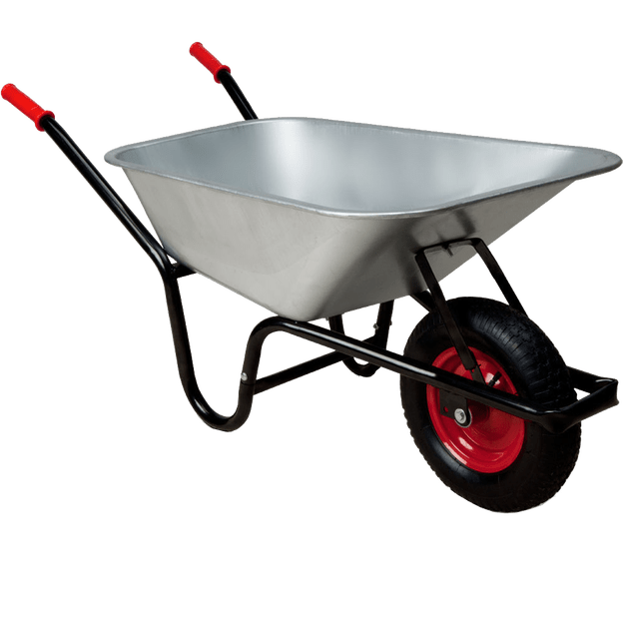
The What
How are social skills like the tire on a wheelbarrow you ask?
Strengths
Deficits
Notes:
Social Skills are like a wheelbarrow tire. I never think about a well functioning wheelbarrow tire, but it is all I can think about when one isn’t functioning well.

Slide 26
How?
Informal Assessment
Interview
Observation
Counseling Sessions
Formal Assessment
Inventories
Using Raters in Controlled Setting
Everything in Between
Notes:
Formal may help you to get in the habit of noticing strengths

Slide 27
Common Paper-and-Pencil Assessments
Inventory of Interpersonal Problems
Inventory of Interpersonal Strengths
Social Self-Efficacy
Social Well-Being
Social Problem-Solving

Slide 28
Cautions
Attribution Bias and considerations of stress
Forgetting that we may be part of the problem or that others could be part of the solution
Notes:
Attribution Bias – We may see someone who is having a terrible set of life circumstances as being grumpy.

Slide 29
Improve
So you identify a social deficit. Now what?
Insight might come from asking the following: How did you learn your first lessons on socially skilled behavior?

Slide 30
Identify
What?
How?
Cautions
Notes:
What requires a consideration of intervening with the person or the environment. We claim to have evolved past the exclusive use of the medical model, but social skills interventions sometimes suggest otherwise.

Slide 31
Insights from the 30-Year Review
Intervention Used or Suggested

Slide 32
Specific Trainings
Skills to Pay the Bills
The Harbor-UCLA “Work Positive Assistance” (WPA) project
Working at Gaining Employment Skills (WAGES)Cognitive Behavioral Therapy
Notes:
Working at Gaining Employment Skills (WAGES) - Targets transition-related social skills - Consistes of self-regulation training, problem solving, teamwork, and communication domains.

Slide 33
Caution
The standard for effective interventions must get beyond changes in pre and post tests.
A gold standard for change would be whether mom can tell a difference
May not be effective to think of all deficits as requiring the same treatment, “She has a social deficit. Enroll her in the social skills training class.”
Social skills change takes time and may be limited.
Difficulty generalizing from workshop to real world or even from one real world context to another.

Slide 34
What Skills to Pay the Bills Covers
💡Six core modules to this experiential training:
Enthusiasm & Attitude
Communication
Teamwork
Networking
Problem Solving
Professionalism
Notes:
90% fidelity rate to the original design

Slide 35
Initial Pilot Studies
💡 Real difficulty recruiting for an 8-week
commitment
💡 Changes in self-reported Social Self-Efficacy
and Social Problem-Solving
Notes:
90% fidelity rate to the original design

Slide 36
Enthusiasm and Attitude

Slide 37
Positivity is Powerful
💡Positivity communicates that you want to work and
that you are competent. It also makes the work more
enjoyable for you and others.
Notes:
90% fidelity rate to the original design

Slide 38
Activities
💡Manual Activity 6 - Never Underestimate the Power of PMA
💡Manual Activity 7 – Life is Full of Hard Knocks
The Road to Success is Paved with Failure
💡Manual Activity 10 – Translating Features to Benefits
40% - Attitude
25% - Image and Appearance
25% - Communication Skills
10% - Job Skills
Notes:
90% fidelity rate to the original design

Slide 39
Communication

Slide 40
Reciprocity
💡Communicating TO others and learning how to
interpret information received FROM others.
Notes:
90% fidelity rate to the original design

Slide 41
Activities
💡Manual Activity 1 – What’s Your Point (journal and extension)
💡Manual Activity 2 – Flipping the Switch
💡Manual Activity 3 – Oh, Puh-leeeze!
Actions Speak Louder Than Words
💡Manual Activity 4 – Listen Hear!!!
💡Manual Activity 5 – Quit Talkin’! I Know What to Do!
Notes:
90% fidelity rate to the original design

Slide 42
Teamwork

Slide 43
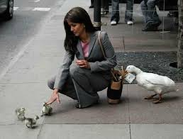
Teamwork
💡Working collaboratively
💡Sense of responsibility
💡Respect for Differences
💡Contributing to groups
💡Working collaboratively
💡Sense of responsibility
💡Respect for Differences
💡Contributing to groups
Notes:
90% fidelity rate to the original design

Slide 44
Activities
💡Manual Activity 11 – There is No “I” in Team
💡Manual Activity 12 – I’ll Give You Some of Mine if You Give Me Some of
Yours
💡Manual Activity 13 – The Good, the Bad, and the Reasonable
Notes:
90% fidelity rate to the original design

Slide 45
Networking

Slide 46
Networking
💡It’s not what you know, it’s who you know.
💡
Notes:
90% fidelity rate to the original design

Slide 47
Activities
💡Manual Activity 16 – An Introduction to Networking
80% of jobs today are NOT advertised
💡Manual Activity 17 – You Expect Me to do What? Talk to People?
💡Manual Activity 18 – Using Social Media to Network
35% of employers say they eliminated a candidate based on social media
💡Manual Activity 19 – Text vs. Email…Does it Really Matter?
💡Manual Activity 20 – It’s a Small World
Notes:
90% fidelity rate to the original design

Slide 48
Problem Solving and Critical Thinking

Slide 49
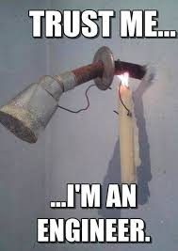
Problem Solving
💡Refers to the ability to use knowledge, facts,
and data to effectively solve problems.
Notes:
90% fidelity rate to the original design

Slide 50
Activities
💡Manual Activity 24 – Perception vs. Reality
💡Manual Activity 25 – Tell Me About a Time When…
Notes:
90% fidelity rate to the original design

Slide 51
Professionalism

Slide 52
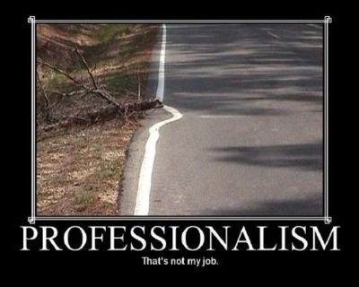
Professionalism
💡Professionalism is not wearing
a suit, it is conducting oneself
with qualities that demonstrate
responsibility, integrity,
accountability, and excellence.
Notes:
90% fidelity rate to the original design

Slide 53
Activities
💡Manual Activity 28 – Teamwork – Essential to Professionalism
💡Manual Activity 30 – Self-Reflection
Imagine you are in your final years of life. You are sitting in a rocking chair reflecting on the life you have lived. You are contemplating the answers to the following questions:
Did you choose a career that you enjoyed?
What accomplishments did you achieve?
What characteristics are you known for among your friends?
What brought you the greatest happiness?
Notes:
90% fidelity rate to the original design

Slide 54
Capitalize
When there is a strength, we have an opportunity to help a client maximize it in her or his job pursuit. But how?
Weak ties & Social capital
Notes:
Someone with many social strengths is likely to have more weak ties and more social capital. These two types of relationship are good for different things.

Slide 55
Weak Ties and Social Capital
Weak Ties – As you might have guessed. Weak ties represent more distant relationships
Advantage = Novel information
Social Capital – Greater social capital refers to closer or more intimate relationships
Greater commitment to your well-being
Notes:
💡Social capital is defined as a person’s or group’s level of empathy for
another person or group, such that “whatever affects one similarly affects
the other” (Robison & Ritchie, 2010, p. 16).

Slide 56
Work in Social Capital

Slide 57
Study Method
💡 The five items in the starting wage survey measured five levels of
relationship, namely:
complete stranger,
close childhood friend
someone they do not get along with
a complete stranger referred by a close childhood friend, and
a complete stranger referred by a local state agency.
💡 Participants were asked to determine the maximum amount they
would be willing to pay a new bookkeeper in a small healthcare
company.
Notes:
Based on the social capital framework, Item 1 provided a neutral relationship where no social capital was expected to exist; Item 2 provided a relationship where the highest levels of social capital were expected; and Item 3 provided a situation in which negative levels of social capital were expected. Item 4 and 5 provided situations where the indirect use of social capital was measured in two different relationships (i.e., a stranger being referred to an employer by a close friend and by a local state agency).
The four forms of the survey were identical except that the bookkeeper in the surveys differed by representing a different combination of disability status and social role.

Slide 58
Social Capital in Real Terms
💡Mean starting wage was statistically higher with higher levels of social capital, F(4, 1,008) = 99.126, p < .001, partial η² = .282 (large effect).
💡 Pairwise comparisons showed significant differences across all levels of social capital at or near p < .001, stranger vs. friend, someone they did not get along with, and someone referred by a friend, referred by a state agency (p = .003)
💡 A friend made $0.79 more an hour than the stranger and $1.15 more than someone they didn’t get along with.
=
$1,643.20
More Per Year for friend vs. stranger

Slide 59
Social Role in Real Terms
💡 Statistical differences were found on mean starting wage with social role consistently resulting in greater starting wage, F(4, 252) = 13.553, p < .001, partial η² = .051 (medium effect).
💡 Results showed that a person holding a valued social role resulted in an average of $0.54 more per hour than the person without a stated social role.
=
$1,123.20
More Per Year for person with social role vs. person without

Slide 60
$18.73
High Social Capital, Social Role, No Disability
Big Picture
Employees without disabilities had a higher ceiling for starting wage while also experiencing a lower floor.
=
$4,097.60
More Per Year
$16.76
Low Social Capital, No Social Role, No Disability
Notes:
Nearly $2.00 an hour difference.

Slide 61
Notes:
Only higher pay for PWOD for close friend when no social role

Slide 62
Compensate
Change the focus or Expectations
Lend your own social skills as needed

Slide 63
Change the Focus or Expectations
Are there social skills less appreciated by capitalism but significant contributors to organization and customer?

Slide 64
Modeling of Workplace Social Effectiveness

Slide 65
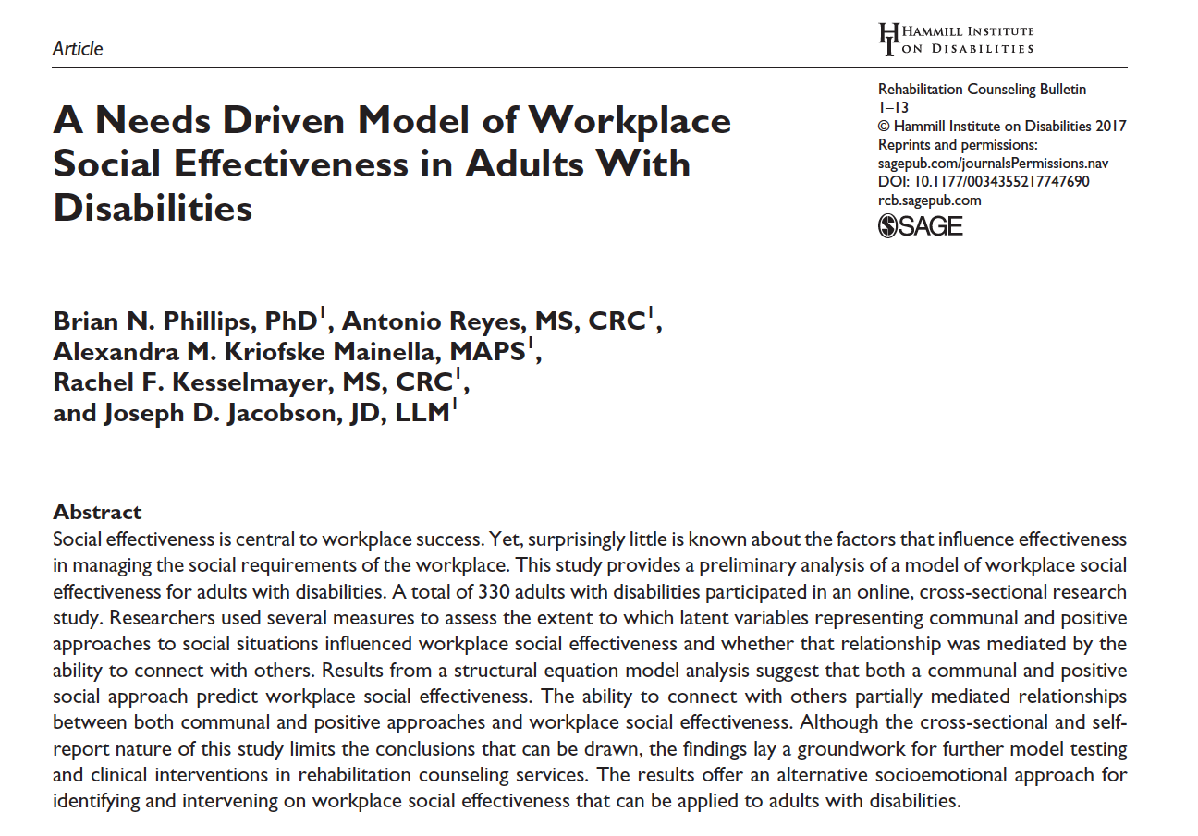

Slide 66
Needs-Driven Model of Workplace Social Effectiveness
💡Purpose: Provide a new model of workplace social effectiveness based on one’s
capacity to meet the socio-emotional needs of others
💡Model development was guided by social capital and relational self theory
Notes:
Social capital theory provides the idea that close relationships (and social capital) are developed through the exchange of socio-emotional goods
Relational self theories provide guidance about specific socio-emotional goods that form the essential socio-emotional goods as well as ideas of how close relations shape behavior and outcomes.

Slide 67
“I’ve learned that people will forget what you said, people will forget what you did, but people will never forget how you made them feel.”
-Carl W. Buehner
Notes:
Social capital theory provides the idea that close relationships (and social capital) are developed through the exchange of socio-emotional goods
Relational self theories provide guidance about specific socio-emotional goods that form the essential socio-emotional goods as well as ideas of how close relations shape behavior and outcomes.

Slide 68
Fundamental Human Needs
💡Competence and Communion have been referred to as Fundamental Human Needs,”
and as ”The Big Two”
💡Hours of effort spent identifying socio-emotional goods (or what we refer to as the
social approach) expected to influence the fundamental needs

Slide 69
Conceptualization of Key Socio-Emotional Goods
Competent or Positive Approach | Communal Approach
💡Positive Mindset 💡Happiness 💡Psychological Capital Hope, Optimism, Resilience, and Self-Efficacy | 💡Sincerity 💡Empathy 💡Reciprocity 💡Humility

Slide 70
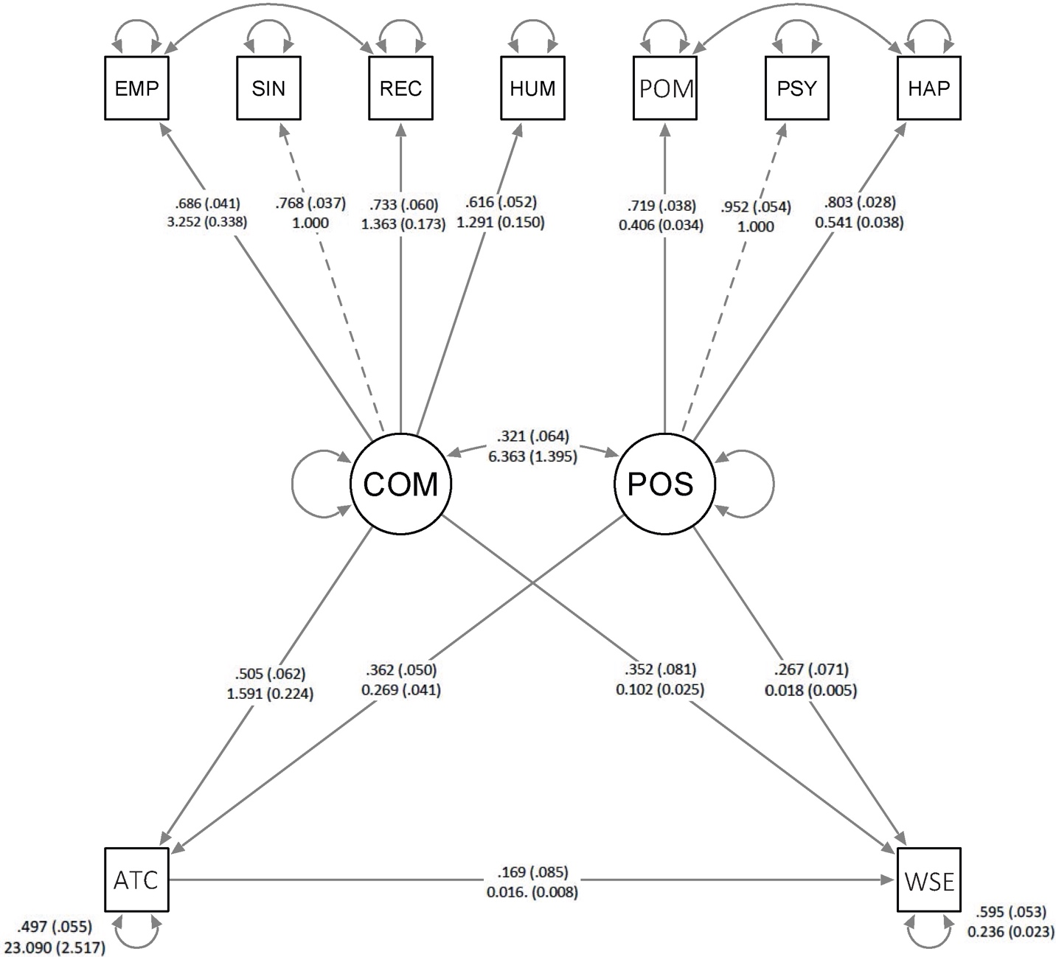
Hypothesized Model & Results

Slide 71
Notes:
Measured 330 Employees with Disabilities (not self-employed)

Slide 72
Implications & Future Directions
💡Initial Study suggests that a social approach that addresses
fundamental needs of others may influence perceptions
of workplace social effectiveness.
💡Practitioners and people with disabilities alike may benefit
from focusing on the extent that they meet the social-
emotional needs of others in the workplace.

Slide 73
Lend Social Capital

Slide 74
Identify
Capitalize
Compensate
Improve

Slide 75
Big Picture
💡All work is social
Consensus in the field of rehabilitation that social skills shape employment outcomes (Phillips et al., 2014, Phillips et al., 2015)
💡Workplace social effectiveness is a complex construct that is
typically framed as, ”I know it when I see it”
To move this line of research forward requires empirically supported means for intervention and outcome measurement
Notes:
Today’s presentation does not capture all of the projects conducted
through this grant.

Slide 76
Summary and Future Directions
💡Through the various efforts, we have learned and
are still learning much about workplace social
effectiveness. This includes information about
What it is
What it does (how it influences employment)
How it can be developed and managed
💡Increased understanding in these areas is sure to
facilitate employment outcomes for people with
disabilities.

