Slide 1
Impression Management Workshop
March 28, 2019

Slide 2
Introduction & Ice Breaker
Name
Location
Years in VR
What do you know about impression management (IM)?
What are you hoping to get from this workshop?
Your favorite way to spend Friday night?

Slide 3
IM can help with these questions!
Should I disclose an invisible disability? If so, how?
How should I respond to interview questions?
Tell me about yourself?
What was the reason for the gap in your work history?
Why should this company hire you?
Behavioral interview questions.

Slide 4
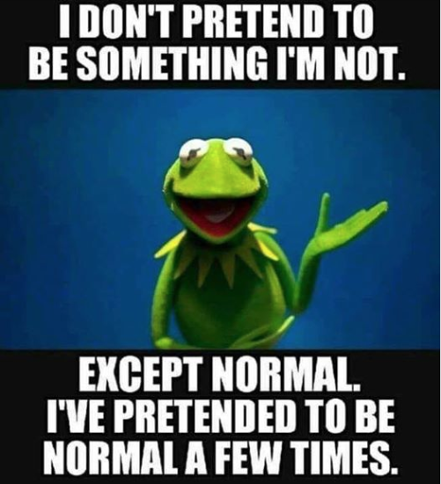
Be yourself

Slide 5
What is Impression Management?
Definition: the process by which individuals control the impression that others form of them
  consciously or unconsciously
  deceptively or authentically

Slide 6
WHY SHOULD WE CARE?
BECAUSE THE PROCESS OF OBTAINING WORK IS NOT OBJECTIVE OR FAIR.

Slide 7
Reality?
Employers often base opinion of suitability for the job on impressions from the resume, the interview, and other interactions rather than academic and work credentials and skills
Employers can be prone to negative bias against applicants from marginalized groups, including those who have disabilities

Slide 8
VR Counselor role?
RCs cannot control the pre-existing biases of employers but impression management may prove to be an effective tool for clients to find success
Notes:
The most common reason for impression management in the workplace is to achieve employment at a company or business.
IM can be used to offset negative employer perceptions about your potential as a productive worker
Another reason for impression management in the workplace is to achieve advancement.
http://www.businessnlpacademy.co.uk/blog/view/impression_management_in_the_workplace/; abilitylinks.org

Slide 9
How do employers view people with disabilities
Notes:
Research indicates that employers remainare reluctant to hire those with disabilities even when their qualifications closely match those of applicants without disabilities (Ameri et al., 2015; Baert, 2014; Hernandez, McDonald, Divilbiss, Horin, Velcoff, & Donoso, 2008).
As has been reported with other disabilities, evidence of the negative attitudes of employers toward those with VI present a significant barrier to employment (Crudden, Williams, McBroom, & Moore, 2002; McDonnall, Zhou, & Crudden, 2013).
According to Goffman (1984), “the stigmatized individual is asked to act so as to imply neither that his burden is heavy nor that bearing it has made him different from us” (pp. 147-148).

Slide 10
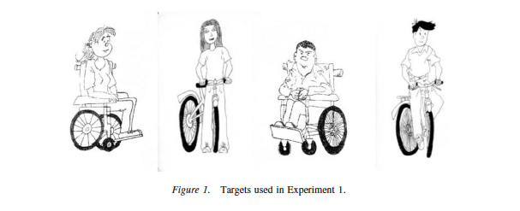
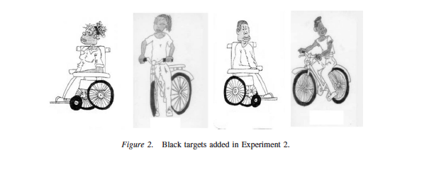
Disability salience
Gender
Ethnicity
Disability
Notes:
In a study by Rohmer and Louvet (2009), they examined the salience of visible disability (person in a wheelchair) compared with salience of gender and ethnicity.
The participants were told that the research concerned “how
people formed impressions about others.” Participants were tested
individually and were randomly assigned to describe one of the
four pictures. They were instructed to “describe the person represented
on the card.” Response time was not limited. The experiment
was conducted by a young White student who did not present
any disability

Slide 11
Disability salience Results
RESULTS:
  Despite the prominence of race and ethnicity, individuals with disabilities were typically described by disability first.
SO WHAT?
  These results suggest that disability is a superordinate attribute for impressions.
Notes:
In Experiment 1, they used four targets: male target with disability, female target with disability, male target without disability, female target without disability.
In Experiment 2, we added ethnicity (Black or White). Again, all targets were young adults.
“This is a disabled woman. She is in a wheelchair. She has got long hair. She seems to be alone.” This description contains three categorical
attributes (disabled, woman, and wheelchair) and two individual attributes (long hair and alone).
Ethnicity was mentioned in 85% of the descriptions of Black targets, whereas it was never mentioned to identify White targets.

Slide 12
How Then is disability perceived?
Knowing the primacy of disability attributes, what do we know about how people with disabilities are perceived?
Chan et al. (2010) found that employers were kind of MEH about hiring people with disabilities.

Slide 13
Stereotype research
Stereotype content model consists of warmth x competence.
Pope & Brambra, 2005, Cuddy et al., 2007
Notes:
We know from stereotype research that PWDs are often devalued in society in ways that impact perceptions of employability.
PWDs are also less likely to be employed.

Slide 14
Warmth & competence
Warmth – reflects traits related to other-profitable intent such as friendliness and trustworthiness
Competence – reflects traits related to self-profitable ability such as intelligence and skill
Both are advantages in impression formation
(Peeters, 2001; Holoien & Fiske, 2013)
Notes:
Although both warmth and competence judgments are essential to person perception, warmth judgments account for a greater portion of the impressions people form of others (Abele & Wojciszke, 2007; Wojciszke, Banzinska, & Jaworski, 1998) and occur prior to competence judgments (Willis & Todorov, 2006)

Slide 15
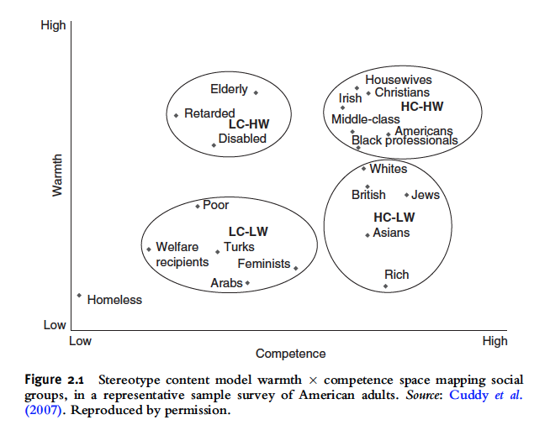
Stereotypes
Cuddy, 2018; Cuddy et al., 2007
Notes:
“The stereotype content model (SCM) terms these two basic dimensions –
perceived warmth (trustworthiness, friendliness) and competence (capability, assertiveness).
Measured reliably and validly, these dimensions converge across survey, cultural, laboratory, and biobehavioral approaches.”
Cuddy et al. (2007)
Sadly, we know from stereotype research that PWDs are often devalued in society in ways that impact perceptions of employability.

Slide 16
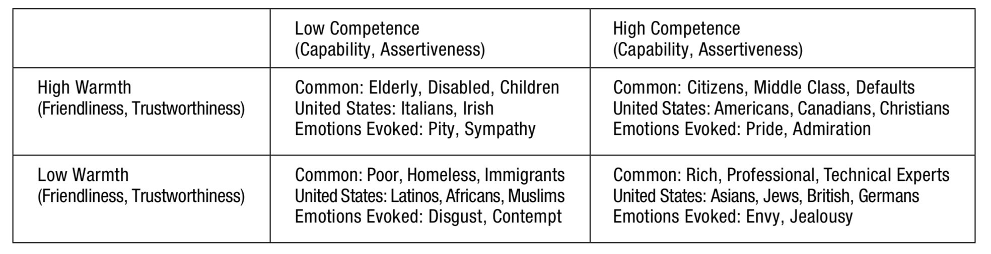
Warmth and competence stereotypes
(Fiske, 2018)

Slide 17
Impression Management Strategies

Slide 18
What is the goal for im?
Impression management is about giving others an impression of your best self and of how you intend to be going forward.
The motivation behind impression management is not to give the impression that you are someone else (that would be lying) or to give the impression that you will act differently than you really plan to just to get what you want (a negative form of manipulation).
The goal is to convey your optimum levels of Warmth & Competence

Slide 19
What are IM Techniques?
Impression management techniques are used to enhance, protect, or alter perceptions of one’s identity

Slide 20
IM Strategies
Examples of Specific IM Strategies include:
Self-Focused | Other-Focused
Self-Promotion Prosocial Behavior Apologies Appearance | Ingratiation Opinion Conformity Basking in Reflected Glory Justification
Notes:
Some impression management techniques work better than others

Slide 21
IM Techniques: Self-promotion
Self-promotion is used to show one’s accomplishments and achievements in order to be seen by others as competent
  Self-promotion (in moderation) can help people with disabilities overcome negative bias and perceptions that they may not be able to meet the demands of employment
  This is a good way for individuals to highlight their strengths and assets and sell themselves as the most qualified applicant
Notes:
How would you suggest a client use self-promotion?

Slide 22
Self-Promotion activity
What qualifications or strengths should I focus on?
Hints can be found in the job description, company website, occupation or industry informational sites and sources, information about the specific people in the company.
With the provided job description in mind, develop a story regarding: Past achievements or Past problems solved that are directly relevant to the job description. Share with a partner and discuss whether it could be an effective strategy.
*****Always try to link stories back to the job descriptions*****

Slide 23
IM Techniques: Ingratiation
The goal of ingratiation is to have the interviewer like or be attracted to the interviewee
  An individual uses ingratiation when they compliment the employer, interviewer, or the company’s products/services
  Someone who does not use ingratiation can be seen as lacking appropriate social skills
  Individuals with disabilities can show that they are aware of social and contextual factors in the work environment by using ingratiation

Slide 24
Ingratiation Activity
Finding Strengths
Hints can be found in the job description, company website, occupation or industry informational sites and sources, information about the specific people in the company.
With the provided job description in mind, write down a compliment regarding the company that you might share with an interviewer. Then turn to a partner and try it out. Discuss for a few minutes how effective you think it may be in an interview.
Notes:
Then turn to a partner and try it out. Discuss for a few minutes how effective you think it may be in an interview.

Slide 25
IM Techniques: Opinion Conformity
Adopting attitudes and beliefs that are consistent with the interviewer or company (We like people similar to ourselves—can increase “fit”)
  Indicate that one’s values are a good fit with the hiring organization
  Describe personal experiences that are similar to the interviewer
  Strong technique for PWDs to help strengthen the bond with the interviewer and organization by stressing similarities rather than differences
Notes:
This technique can be especially important if you are someone with a visible disability because employers are often unaccustomed to working with people with disabilities. By finding common ground, you can eliminate some discomfort for the interviewer; you can demonstrate that you are more the same than different by focusing on similarities rather than differences.

Slide 26
Opinion Conformity Activity:
Remember to our Introductions
Based on the introductions given at the beginning of the workshop, can any of you think of a point of commonality that you have with another person in the group AND that you did not know about before?
Pair up with a person next to you and discuss likes and dislikes until you have three areas of conformity that are shared opinions rather than an agreement about facts.
Notes:
Then turn to a partner and try it out. Discuss for a few minutes how effective you think it may be in an interview.

Slide 27
Im techniques: prosocial behavior
Doing things that are focused on helping others, organizations, or communities. This tactic takes time to use, because it involves being active and engaged in your community. This can convey warmth.
Demonstrates social competence and suggests you are someone who would function well in the workplace.

Slide 28
Prosocial Behavior Activity:
Community participation now and in the future
Look at the list of activities that people often demonstrate their prosocial behaviors through. Following the activity, mark any that you are currently doing or would be interested in doing.
After completing the form, discuss how the inclusion of these activities might be effective in conveying a sense of warmth and of prosocial behavior.
Notes:
Then turn to a partner and try it out. Discuss for a few minutes how effective you think it may be in an interview.

Slide 29
IM Techniques: Basking in Reflected Glory
Attempt to enhance one’s image by claiming association with prestigious figures to show social connection
  Positive: interviewer may see individual as connected, competent, and desirable
    Can be positive for PWDs as a way to reduce stigma
  Negative: can be seen as a name-dropper; unethical

Slide 30
Basking in Reflective Glory Activity: Quality Inspection
Rate the following attempts to bask in reflective glory for their likelihood to be effective.
I love the location of your shop, my favorite bowling alley is just a couple of miles away. I go so often that they give me free games sometimes
I think my Uncle’s boss goes to the same church as you, but I can’t remember his name at the moment.
I got accepted into your alma mater too, but I think the only reason I got in was because my father knew the President of the University really well.
My close friend, John Barrett, told me to tell you hello. He said that he loved working with you before he branched off and started his own company.
I had no idea you grew up in Preston, Idaho. I grew up right next door in Riverdale before moving here to New York. Do you know the principal of the High School there? We are good friends
Notes:
Then turn to a partner and try it out. Discuss for a few minutes how effective you think it may be in an interview.

Slide 31
IM Techniques: Justification
Justification is a defense IM tactic used to save face when your image is threatened. The technique involves acknowledging that a negative outcome occurred while tactfully and clearly explaining why. Most important to justification is communicating that, while acknowledging your actions from the past, the risk or problem area will not occur again in the future.
Notes:
These could include poor grades, gaps in work history, being laid off from a job, working restricted hours or a restricted schedule at a job, a previous criminal background, etc.

Slide 32
Justification Activity: Restoring Confidence
Select one aspect of your work history or skills that may be viewed as a risk by an employer (don’t worry, we all have them). This could include poor grades, gaps in work history, being laid off, restricted hours or schedule needs, previous criminal background, etc.
Using one that you are comfortable sharing, work with a partner to answer why this element should not be a concern to the employer.
  Think about whether you focused too long on the concern, did you come across as defensive or arrogant, did you end positively?
Notes:
Then turn to a partner and try it out. Discuss for a few minutes how effective you think it may be in an interview.

Slide 33
IM Techniques: Apologies
When using this technique, you accept responsibility for a specific negative event and validate the impact of the event.
We all prefer not to need this technique, but things happen and sometimes we have things in our past that we cannot hide during an interview; this could be a criminal record or a poor reference from a previous employer.
Notes:
These could include poor grades, gaps in work history, being laid off from a job, working restricted hours or a restricted schedule at a job, a previous criminal background, etc.

Slide 34
Apologies Activity: Quality Inspection
Do all of these deserve an apology? Are they all effective?
I am sorry for arriving a few minutes early. I just didn’t want to be late.
I am sorry for being late. The bus ran later than usual but I ride the bus often enough to know that I should build in some cushion.
I feel terrible about the burglary. That was long ago, and I was a very different person then.
I felt bad about the way I left my last company. I was under a lot of stress at the time, but it is clear to me that that is no excuse for failing to give sufficient notice for them to find a replacement.
Notes:
Then turn to a partner and try it out. Discuss for a few minutes how effective you think it may be in an interview.

Slide 35
Research

Slide 36
IM Tactics
  Non-verbal IM tactics such as eye-contact and smiling are linked with higher interviewer ratings.
  Using self-focused tactics such as self-promotion may be helpful during the interview, but decrease in helpfulness once on the job.
Notes:
Disclosure of a disability during the interview may be beneficial for some people. Impression management can be used to facilitate disclosure in the interview process.
There is substantial evidence that using IM tactics are related to interviewer and supervisor perceptions of an individual.

Slide 37
Insights From Research
Peck & Levashina (2017) conducted a meta-analysis capturing IM research from 1990-2015.
Findings
  Self-focused tactics are positively related to interview ratings but not performance ratings
  Other-focused tactics are positively related to both interview and performance ratings

Slide 38
Does the Research Support IM for Reducing Discrimination?
Research has shown female leaders to be viewed more positively when described as mothers (Heilman & Okimoto, 2007)
Bendick et al. (1997) showed that discrimination of older applicants was reduced by half when described as “energetic, adaptable to the latest technology and committed to my career.”

Slide 39
Considerations – older consumers (55+)
More recently Gioaba & Krings (2017) showed that older applicants who used self-promotion to counter stereotypes were viewed more favorably, but still not as favorably as young applicants.
Notes:
Despite this positive effect, discrimination persisted: older applicants were consistently rated as less hirable than their younger counterparts when displaying the same IM behavior.

Slide 40
impact of subordinates’ disability status on leader-member exchange
PURPOSE: investigate the impact of subordinates’ disability status on leader-member exchange (LMX) relationships
  How subordinate disability and ingratiation were related to LMX quality

Slide 41
Description of Study
Colella & Varma (2007) hypothesized that supervisors without disabilities will form lower-quality LMX relationships with subordinates with disabilities than they do with nondisabled subordinates.
Hypothesis: Subordinate ingratiation and subordinate disability status interact to influence LMX quality, such that ingratiation will have a stronger positive impact on LMX relationships for subordinates with disabilities than on those relationships formed with nondisabled subordinates.

Slide 42
People with disabilities may have more to gain from IM than people without disabilities.
Notes:
Take home: People with disabilities may have more to gain from IM than people without disabilities.

Slide 43
WHEN is Impression Management most needed for people with disabilities?
When the effects of disability are ambiguous in relation to the work or the social environment
When the employer conveys any of the following about the disability or condition
  Controllability
  Threat (safety concerns or profit loss)
  Spread (notion that the impairment affects more than it does
  Assumes the disability is more of a tragedy than it is
Notes:
We are going to review each of these areas, but before we do, we need to spend a little time describing impression management and what we know about how impressions are formed.

Slide 44
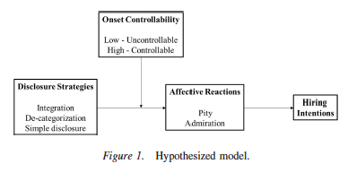
Controllability
Lyons et al. (2017)
  Sought to understand how controllability moderated affective reactions and, ultimately hiring intentions

Slide 45
Controllability: Decategorization
Lyons et al. (2017) Findings
  Decategorization (i.e., distancing oneself from the disability) reduced pity reactions but only when the PWD was perceived as not responsible for the disability. PWDs perceived as responsible got more pity and lower hiring intentions.

Slide 46
Controllability: Integration
Lyons et al. (2017) Findings
  Integration (i.e., highlighting positive aspects of the disability) also reduced pity reactions but only when the PWD was perceived as not responsible for the disability. PWDs perceived as responsible got more pity and lower hiring intentions.

Slide 47
What phase of employment is Impression Management most needed?
Application
Resume
Cover Letter
Public profiles (think Facebook and voicemail messages)
Interview
Notes:
Activity: We are going to break you into five groups and assign you one of the following aspects of obtaining a job.
Talk as a group about how IM might come into play for your designated phase of the job search. What could go wrong with IM? What could be done to ease people’s disability related concerns, what could be done to gain an advantage?

Slide 48
IM and the application
Group Points

Slide 49
IM and the Resume
Group Points

Slide 50
IM and the cover letter
Group Points

Slide 51
Significance of Resume and Cover Letter in IM
Interview IM tactics may include a variety of verbal and non-verbal behaviors while IM use in resume and cover letters is constrained to written, one-way communication.
Ingratiation and lower intensity self- promotion were found to increase perceptions of job and organization fit.
Communicate the benefits of using ingratiation and lower intensity self-promotion, while emphasizing the importance of accurately conveying one’s qualifications.
Waung, McAuslan, DiMambro, & Miegoc, 2016
Notes:
Resumes and cover letters are widely used by organizations to screen large numbers of job applicants, making them an important part of the hiring process (Burns et al. 2014).

Slide 52
Resume & Cover letter
For example, self-promotion involved the use of adjectives: efficient, organized, experienced, creative, articulate, energetic, confident, dependable, results-oriented, professional, motivated, proficient, skilled, knowledgeable, detail-oriented, dedicated, focused, industrious ...
Self-promotion also involved statements like, "Designed, negotiated, and wrote new financing agreements never before done on x, far exceeding the national average." And those old standbys, "My work experience and education uniquely qualify me for the position" and "I am a perfect match for this position."
Waung, McAuslan, DiMambro, & Miegoc, 2016; https://www.inc.com/jeff-haden/research-shows-best-resumes-cover-letters-use-these-words-phrases-in-moderation.html

Slide 53
Ingratiation
You might say, "The university is a renowned institution. Go, (university team nickname)! The campus possesses beautiful natural grounds and extensive facilities for educating students. It is with great pleasure that I'm seeking to explore an employment opportunity within your organization."
Or it could be individual, in which case you might say, "I would very much like the opportunity to discuss, in person, how I might add value to x. It is my sincere hope that we will meet for an interview to discuss this position. Thank you for your time and consideration."
Waung, McAuslan, DiMambro, & Miegoc, 2016; https://www.inc.com/jeff-haden/research-shows-best-resumes-cover-letters-use-these-words-phrases-in-moderation.html

Slide 54
Tips for resumes and cover letters
“If the posting includes a lot of superlatives, feel free to use a few yourself. But don't go too nuts. If the job posting is light on superlatives, go light -- otherwise your "more intense" self-promotion will be seen as manipulative.
And if you're a woman, chances are your natural tendency is to go light on self-promotion, so consider taking it up a notch.
And no matter who you are, say you want the job -- and why you want the job. Explain why you'll be a great cultural fit.”
Waung, McAuslan, DiMambro, & Miegoc, 2016; https://www.inc.com/jeff-haden/research-shows-best-resumes-cover-letters-use-these-words-phrases-in-moderation.html

Slide 55
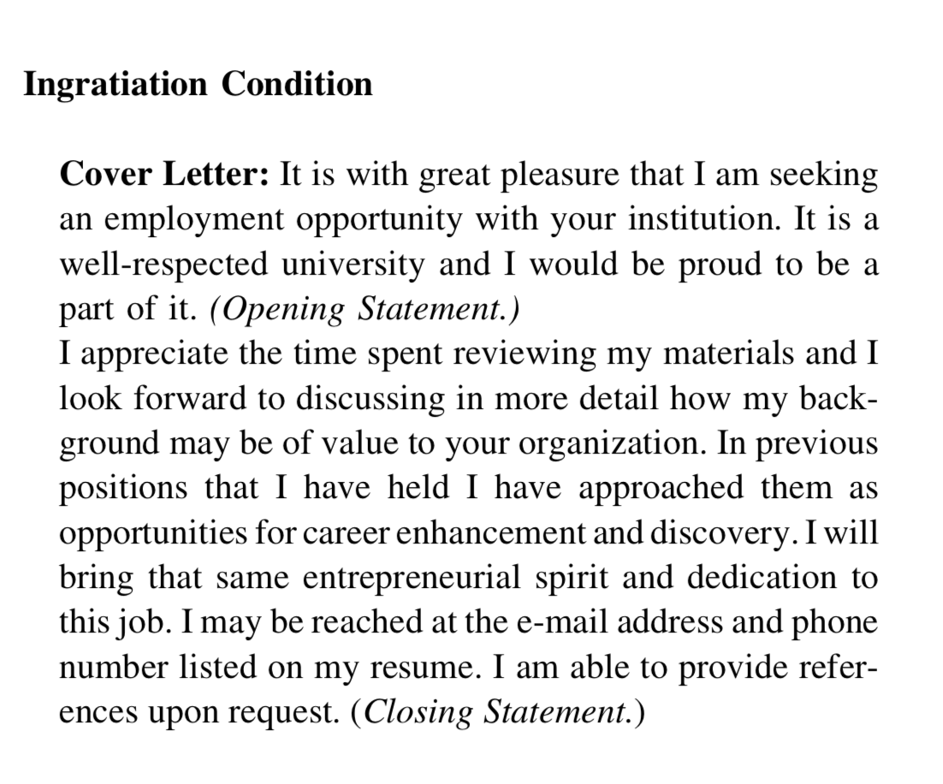
COver Letter
I am seeking an employment opportunity with your
institution. I may be reached at the e-mail address and
phone number listed on my resume. I am able to provide
references upon request.
Waung, McAuslan, DiMambro, & Miegoc, 2016

Slide 56
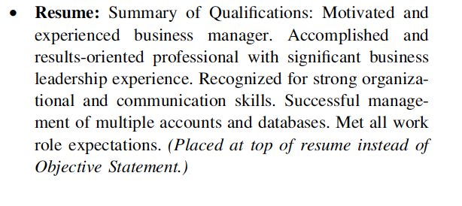
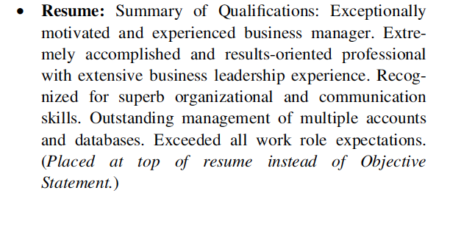
Self-promotion in resume
Waung, McAuslan, DiMambro, & Miegoc, 2016
Notes:
One is weaker and one is stronger. What do you prefer?

Slide 57
IM and the public profiles
Group Points

Slide 58
IM and the interview
Group Points

Slide 59
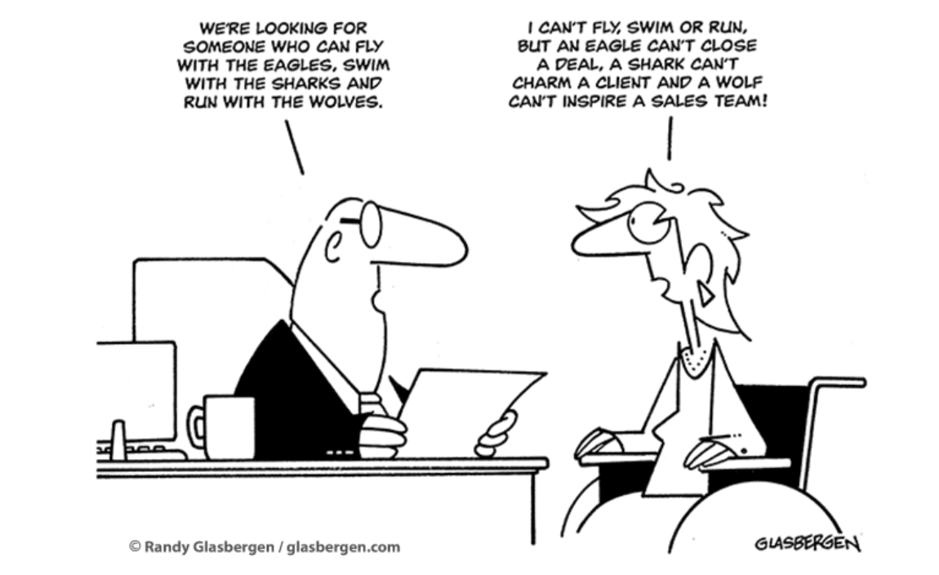
Comic
Notes:
The interviewer states: We’re looking for someone who can fly with the eagles, swim with the sharks, and run with the wolves.
The interviewee in a wheelchair responds: I can’t fly, swim, or run, but an eagle can’t close a deal, a shark can’t charm a client, and a wolf can’t inspire a sales team!

Slide 60
Interview Types
Unstructured/ low structure interviews
    Do not have a set list of questions or structure. Interviews are typically oriented toward obtaining information about the general mental ability, education, training, job experience, and interests of the applicant.
Structured/ high structure interviews
    Interviewers use pre-determined questions that do not vary across interviews- i.e. each job applicant is asked the same questions. Applicant answers are rated on a common metric and compared across interviewees.
    Interviewers focus on obtaining information about applicant job knowledge and skill, organizational fit, interpersonal and social skill, and applied mental skill (executive functioning- planning, problem solving, decision making, etc.)
Structured interviews have higher predictive validity regarding employee job performance than unstructured interviews.
Barrick, Shaffer, & DeGrassi, 2009; McDaniel, Whetzel, Schmidt, & Maurer, 1994; Taylor & Small, 2002

Slide 61
Two Categories of Structured Interviews
Situationally- based interviews
    The interviewer asks interviewee what they would do when faced with a hypothetical situation.
Behaviorally-based interviews
    The interviewer asks questions about how interviewees have handled specific situations in prior work or life situations, i.e. the interviewer requests actual examples of past behavior, or what they have done.
Both appear to show medium/large correlations (.39 - .50) with job performance.
McDaniel, et al., 1994; Taylor & Small, 2002

Slide 62
Things Interviewers Look For: Interview Constructs
Huffcutt et al. (2001) found the most common constructs assessed during the employment interview to include the following 7 constructs:
Personality Traits Applied Social Skills Mental Capability Knowledge & skills | Interests and Preferences Organizational Fit Physical Attributes

Slide 63
Interview Appearance
Utilize verbal and non-verbal skills
  Posture
  Gesture
  Voice
  Eye contact
Notes:
Split the class in half.. One side gets visible and the other invisible. How would you address these issues with someone who has a visible disability, such as muscular dystrophy. How would you address these issues with someone who has a more invisible disability (such as autism) where they struggle more heavily on the eye contact or social cues?

Slide 64
Significance of the Interview in IM
Opening the interview
Interview information categories
Preparing answers to common interview questions
Probing for the whole story
The best predictor of future behavior
Evaluating and information received
Telling and selling

Slide 65
Considerations – older consumers (55+) cont.
Interviewer: Great, then let’s begin, shall we? I see from your CV that you have vast experience in tourism. Can you tell me a bit about yourself?
Applicant: Hmm….Sure. I started out in Tourism 5/20 years ago, when things were quite different, the internet and social media were less widespread and people relied more on the agencies for planning their travels. I have extensive experience with customers and various computer reservations systems, as emphasized in my resume. My most recent experience was with TCE Travel Agency where I advised customers on wide range of holidays including short haul, long haul, package and bespoke holidays. I am passionate about ensuring that customers have a fabulous experience and what I’m looking for now is a company that values my expertise and where I can have a positive impact on customer relations.
(Grioba & Krings, 2017)

Slide 66
LOW IM Answer
Interviewer: Could you also describe me a situation in which a major change occurred in one of your previous jobs and how did you handle it?
Applicant: Hmm yeah… for example one situation in which I had to deal with a change was in my previous job I was suddenly in charge of implementing a new global distribution system. Even though I had previous experience with GDSes…I worked with Amadeus and Apollo for over 4 years… this was by far one of the most difficult tasks…being responsible not only for customer service, but also for but also for budgeting and planning. Plus assisting my other colleagues transitioning to the new tool. It was difficult and often times stressful, but it gave me valuable experience so in the end I glad I had this challenge.
(Grioba & Krings, 2017)

Slide 67
HIGH IM ANSWER
Applicant: Hmm yeah… for example one situation in which I had to deal with a change was in my previous job when I was suddenly in charge of implementing a new global distribution system. Even though I had vast experience and solid knowledge…I worked with Amadeus and Apollo for more than 4 years… this was by far one of the most challenging tasks…being responsible not only for customer service, but also for budgeting and planning. Plus, assisting my other colleagues transitioning to the new tool. But as difficult as it seemed at first, it was also very stimulating and, dealing with such a change and responsibility has given me the confidence that I can handle other changes and new situations as they occur.
(Grioba & Krings, 2017)
Notes:
Higher levels of competence and self-promotion

Slide 68
Face-to-face vs. online interview
Blacksmith et al. (2016) conducted a relatively small meta-analysis that showed interviewer ratings were lower in technology-mediated interviews than face-to-face interviews
  Argued this could be because technology may restrict IM use.

Slide 69
Disclosure

Slide 70
What to do?
Should the client disclose or not?
If so, how should they do it?

Slide 71
Disclosing a disability
Visible vs. non-visible disability
Should you discuss the cause of your disability?
How to present disability in a positive way:
Your narrative regarding overcoming disability/obstacles/adversity. Talk less about how disability was acquired and more about how you have overcome it/how it makes you a better person/worker
Make sure focus of interview is on your qualifications for the job, and not issues regarding your disability.

Slide 72
Activity: The Interview and
Your Client with a Disability
My client has been diagnosed with chronic back pain. He requires a specialized chair as an accommodation. Does the client bring this up in the interview? If so, how might he do it?
My client is currently going through chemotherapy due to breast cancer. She has lost all of her hair, so it is visible to the interviewer. Does the client inform the interviewer of her diagnosis? And her treatment schedule? If so, how might she do it?
My client who struggles with bouts of depression and anxiety was fired from his last place of employment due to multiple and long-term absences. The client has burned his bridges with his previous supervisors and co-workers, thus he has no references to provide the interviewer. How does he handle the situation?

Slide 73
What does ADA say?
An employer may not ask a job applicant disability-related questions or questions likely to solicit information about a disability.
An employer may not ask an applicant to submit to a medical examination before an offer is made.
An employer may, however, ask the applicant questions during the interview about the applicant’s ability to perform specific job functions
Notes:
(Adapted from http://www.abilitylinks.org/docs/doc/IM%20impression%20management%20webinar%20slides.pdf)

Slide 74
What do you say?
You are not obligated to disclose your disability during the job interview or on the job.
However, if you need an accommodation to perform a job or to apply for one, you will need to disclose your disability at some point.
If your employer or interviewer is unaware of your disability, they have no legal obligation to provide you with a reasonable accommodation.
Notes:
(Adapted from http://www.abilitylinks.org/docs/doc/IM%20impression%20management%20webinar%20slides.pdf)

Slide 75
Addressing unspoken concerns
Anticipating the employers concerns specific to your disability. If appropriate, beginning that conversation to alleviate those concerns and educate the employer regarding your ability and needs.
Address potential concerns in a concise and direct way. Be familiar with job description and job requirements so that you can address requirements directly related to the position.
Address assistive technology if necessary.

Slide 76
Impression Management in Action
Next, we are going to watch an impression management video
Think about what we have talked about today and how we might improve the person’s interview
Also think about how you might respond to the same questions in the interview

Slide 77
IM and Disclosing for Individuals With Disabilities
Chan et al. (2008) - 86 business students watched a video clip of a job applicant and then give their general impression of the candidate’s ‘hireability’ rating. Participants watched
  (a) A job applicant without a disability, or
  (b) A job applicant with a spinal cord injury (SCI) who did not use impression management tactics when discussing their disability, or
  (c) A job applicant with SCI who used impression management tactics when discussing their disability.
Results showed that the individual viewed in condition (c) was rated higher on both ‘hireability’ and in general impression than the other two conditions (a) or (b)
Notes:
Therefore, impression management may be a useful tool for addressing stigma in the interview setting

Slide 78
IM and Disclosing for Individuals With Disabilities – Page 2
Sung et al. (2016) - 99 business students watched a video clip of a job applicant and then give their general impression of the candidate’s ‘hireability’ rating. Participants watched
  (a) A job applicant without a disability, or
  (b) A job applicant with epilepsy who did not use impression management tactics when discussing their disability, or
  (c) A job applicant with epilepsy who used impression management tactics when discussing their disability.
Results showed that the individual viewed in condition (c) was rated higher on both ‘hireability’ and in general impression than the other two conditions (a) or (b)
Notes:
Therefore, impression management may be a useful tool for addressing stigma in the interview setting

Slide 79
Limits in Use of IM
IM assumes a pretty high level of interpersonal skills
IM can backfire when misused
There is a need for more evidence of IM related outcomes and disability populations
Sharing things that could be viewed as risks (gaps in employment)
What else?

Slide 80
Summary - where can im be used in the job process?
Basics of job networking and information gathering/informational interviews
IM in job networking and information gathering
IM in application and networks
IM in interviews
IM in the workplace

