Slide 1








Project E3: Educate, Empower, Employ
VOCATIONAL REHABILITATION TECHNICAL ASSISTANCE CENTER: TARGETED COMMUNITIES (VR-TAC-TC)
The Vocational Rehabilitation Technical Assistance Center: Targeted Communities (VR-TAC-TC) is established under a grant from the Department of Education, Rehabilitation Services Administration (RSA) award CFDA 84.264F. The opinions expressed in this presentation are those of VR-TAC-TC, not of RSA.
Notes:
Welcome to the Vocational Rehabilitation Technical Assistance Center for Targeted Communities, or VR-TAC-TC. We call ourselves “Project E3,” and provide technical assistance to State VR agencies so they can better educate, empower, and employ individuals with disabilities within targeted communities.
The Vocational Rehabilitation Technical Assistance Center: Targeted Communities (VR-TAC-TC) is established under a grant from the Department of Education, Rehabilitation Services Administration (RSA) award CFDA 84.264F. The opinions expressed in this presentation are those of VR-TAC-TC, not of RSA.

Slide 2

Project E3 Outcomes
  Increase participation in State VR programs;
For individuals with disabilities in low-income communities:
  Increase the number and percentage who complete their VR program and enter into competitive integrated employment.
  Increase the amount of community support services provided;
  Develop collaborative, coordinated service strategies among State VR programs and community support service agencies to provide more comprehensive services to consumers.
Notes:
Project E3’s desired outcomes for individuals with disabilities in low-income communities are to:
Increase their participation in State VR programs;
Increase the number and percentage served through the State VR programs who complete their VR program and enter into competitive integrated employment;
Increase the amount of support services provided through community agencies and support systems to those who are participating in a VR program; and
Project E3 activities will develop collaborative, coordinated service strategies among State VR programs and community support services agencies and systems to provide more comprehensive services to those who are engaged in a VR program.

Slide 3

High-Leverage Groups of National Applicability
Residents of rural & remote communities
Adjudicated adults and youth
Youth with disabilities in foster care
Individuals with disabilities receiving Federal Financial assistance (TANF)
Culturally diverse populations
High school dropouts and functionally illiterate consumers
Persons with multiple disabilities
SSI and SSDI recipients, including subminimum wage employees
Notes:
What is a high-leverage group with national applicability?
A high-leverage group with national applicability is a group of individuals with disabilities who are frequently identified by State VR agencies as being either underserved or as achieving substandard performance. Examples of high-leverage groups include:
Residents of rural & remote communities
Adjudicated adults and youth
Individuals with disabilities in foster care
Individuals with disabilities receiving Federal Financial assistance
Culturally diverse populations
High school dropouts and functionally illiterate consumers
Persons with multiple disabilities
SSI and SSDI recipients, including subminimum wage employees

Slide 4
Reflect on your experience…
Take a moment to think about the individuals you work with...what percentage would you estimate have annual income at or below the federal poverty level?
Notes:
What do you expect or hope to get from this training?

Slide 5
People with Disabilities and Financial Decision Making
New Hampshire residents with disabilities face unique financial needs or barriers.
  Of those residents age 18-64, 81.6% of those without disabilities are employed; only 40.9% of those with disabilities are employed. (Facts and Figures: 2018 Report on Disability in New Hampshire, Institute on Disability, UNH)
  Of those residents age 25 and older, 67.6% of those without disabilities has some college; 48.6% of those with disabilities had some college. (Facts and Figures: 2018 Report on Disability in New Hampshire, Institute on Disability, UNH)
  27% poverty rate for people with disabilities ages 18-64, compared to 12 percent poverty rate for adults without disabilities.
  (The Disability Statistics Compendium, 2015)
  May not have had substantial prior experience in making financial decisions that affect their lives.

Slide 6
Exercise
Step 1: Share your name, organization, and interest in financial empowerment.
Step 2: Together, create something that represents the people you serve financially capable and empowered. For example:
  A picture
  A billboard
  A song
  A poem
Notes:
Instructions for Presenter:
Prior to this activity, supply each table with markers and flipchart paper.
Depending on the amount of time you have and the number of people in the room, invite participants to introduce themselves to the full group or to their table-mates.
Invite each table to take eight minutes to create “something” that represents the people you serve financially capable and empowered.
Ask each table to appoint a spokesperson and go around the room, with each table presenting their creation.

Slide 7
Exercise: Financial Empowerment Self-Assessment
Part 3: Your Experiences (p. 26, Your Money, Your Goals (YMYG) )
Question | Yes | No | I don’t know
1. I have a savings or checking account at a bank or credit union and I make regular deposits and withdrawals
2. I have applied for, received, and used a credit card
3. I have a loan that helped me to purchase a car or a home
4. I have taken out a payday loan
5. I have requested my own credit report and reviewed it
6. I track my income and spending
7. I have taken a loan from a pawn shop
8. I have used a check cashing business
9. I have had a car or other type of personal property repossessed
10. I have received demands for payment from debt collectors
11. I understand my rights and know what to do if I believe a financial services provider has tried to take advantage of me
12. I receive income via a method other than a paycheck
Notes:
Answer these questions generally for the clients on our caseload

Slide 8
Training purpose
To provide you with:
An orientation to Your Money, Your Goals and Focus on People with Disabilities.
The knowledge and confidence to use the information and tools contained in Focus on People with Disabilities to help people with disabilities that you serve become financially empowered.
Notes:
Instructions for Presenter:
Review the training purpose

Slide 9
CFPB and Financial Empowerment
An Introduction to the Consumer Bureau and Office of Financial Empowerment
DISCLAIMER: This deck includes references to third-party resources or content that consumers may find helpful. The Bureau does not control or guarantee the accuracy of this third-party information. By including these references, the Bureau is not endorsing and has not vetted these third parties, the views they express, or the products or services they offer. Other entities and resources may also meet your needs.
Notes:
Instructions for Presenter:
Introduce section on the overview of the CFPB and Office of Financial Empowerment

Slide 10

Introduction to the CFPB
The Consumer Financial Protection Bureau is an independent federal agency built to protect consumers.
We write and enforce rules that keep banks and other financial companies operating fairly. We also educate and empower consumers, helping them make more informed choices to achieve their financial goals. Learn more at consumerfinance.gov
Notes:
Instructions for Presenter:
Introduce key facts about the CFPB using information from Introduction Part 1 and the slides.
Share additional information about the CFPB: The CFPB is working to ensure that consumers get the information they need to make financial decisions they believe are best for themselves and their families – that prices are clear up front, that risks are visible, and that nothing is buried in fine print.
Explain that a key goal of the training is to connect frontline staff to CFPB resources.
Show the CFPB video: https://www.youtube.com/watch?v=BHMUVfjffhA

Slide 11
Office of Financial Empowerment
Part of the CFPB’s Division of Consumer Education and Engagement
Serves populations who lack full, affordable access to financial services
  Low- to moderate-incomes
  Low wealth
  Otherwise financially underserved or vulnerable
    Includes focus on people with disabilities
Notes:
Instructions for Presenter:
Use the following information to explain the CFPB’s Office of Financial Empowerment:
The Office of Financial Empowerment serves the variety of populations who lack full, affordable access to financial services, including people with low- to moderate-incomes; low wealth, and people who are in other ways financially excluded or vulnerable. By any measure, the numbers of consumers whose income level contributes to financial fragility constitutes a significant portion of the U.S. population.
According to 2016 data from the U.S. Census Bureau, some 46.9 million people, including 15.3 million children, live in households that have incomes below the federal poverty level, while another 57.5 million live between 100 and 200 percent of their poverty threshold.
The CFPB created Your Money, Your Goals to reach these consumers by empowering those that serve them: frontline nonprofit or tribal social service staff, community volunteers, staff in legal aid organizations, and people that serve workers. By providing these intermediaries with high quality information, they have the tools and resources to start the financial conversation with the individuals they already serve. And the training that you will ultimately provide to them helps them gain confidence to use these tools and resources.

Slide 12
Financial empowerment
What is financial empowerment?
How is it different than financial education, financial literacy, financial capacity, or other commonly used terms?
Skill and confidence to use knowledge
Financial empowerment
Financial literacy
=

Slide 13
Your Money, Your Goals
An orientation to the toolkit
Notes:
Instructions for Presenter:
Introduce section on an orientation of the Your Money, Your Goals toolkit

Slide 14
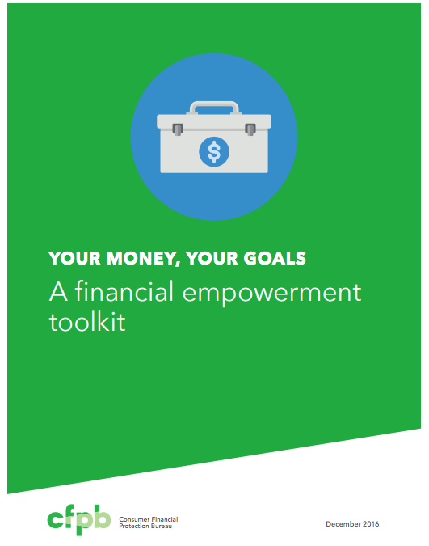
Other Your Money, Your Goals (YMYG) Resources
Your Money, Your Goals Toolkit
Your Money, Your Goals Training
Implementation guide
Focus on Reentry
Focus on Native Communities
Spanish Versions
Behind on bills? (Bear booklet)
Debt getting in your way? (Octopus booklet)
Notes:
Instructions for Presenter:
Explain that the CFPB has developed a robust and growing suite of financial empowerment resources.
Explain that the Your Money, Your Goals toolkit and training is a free and available in English and Spanish.
Explain that the toolkit contains more than 40 practical tools and information on a wide variety of financial topics help them to address the needs of the people they serve.
Explain that all materials are not copyrighted.
Behind on Bills? is a special collection of eight tools. It provides a welcoming and easy-to-understand means of helping clients to address their challenges related to paying bills.
Explain that the Focus on People with Disabilities companion guide can be downloaded as a PDF equipped to work with screen readers.
Explain that the Focus on People with Disabilities contains 11 tools that are available in a dynamic and fillable version on CFPB’s the Your Money, Your Goals webpage consumerfinance.gov
Explain that it is easy to access electronic materials and to place order printed copies online on the CFPB’s Your Money, Your Goals webpage at consumerfinance.gov.

Slide 15
Financial empowerment checklist
The goal is not to cover all of the tools with each person.
Instead, find the right module or tools based on:
  Their most pressing financial empowerment problem
  The area in which they’ve expressed an interest in getting more help

Slide 16
Who can use Focus on People with Disabilities?
Frontline staff members and volunteers in organizations that serve people with disabilities.
Community members who advocate for people with disabilities, such as family members, friends, and volunteers.
Representative payees or others with fiduciary responsibilities for individuals with disabilities, such as family members.
People with disabilities, themselves.
Notes:
Instructions for Presenter:
Focus on People with Disabilities, like the Your Money, Your Goals toolkit, provides information and tools that people can use to make the financial choices that are right for them. There are a few different situations where Focus on People with Disabilities could be used on the slide.
Note: Intermediaries are people with relationships of trust with the people they serve. Intermediaries can serve as sources of financial empowerment by sharing information, tools, and referrals on financial topics. Other slides and speakers notes in this presentation may refer to intermediaries.

Slide 17
People with Disabilities and Financial Decision-Making/Goal-Setting
Notes:
Instructions for Presenter:
Introduce Subsection 1: People with Disabilities and Financial Decision-Making/Goal-Setting
Getting started with the money conversation questionnaire
Module 1: Setting goals and planning for large purchases
Tool: Paying for assistive devices
Module 2: Saving for emergencies, bills and goals
Tool: Setting up an ABLE Account

Slide 18
Values, Choices, and Rights
Values about money may come from life experiences, culture, family, peers, and media.
Rather than judge how people spend or save, it’s important to give them the tools to make decisions and understand the possible results of those decisions.
People with disabilities, like all people, have the right to make choices with how their money is used, and they have the right to take risks.
Even when a person has assistance with paying their bills and other expenses, they should be consulted and involved in the process.
Notes:
Instructions for Presenter:
Present slide content.
With regards to values, “an item that may seem like a “want” or frivolous expenditure to one person may be an important expression of self to someone else.”
“Everyone takes risks with their money. Lessons learned from taking risks and making mistakes can be meaningful.”

Slide 19
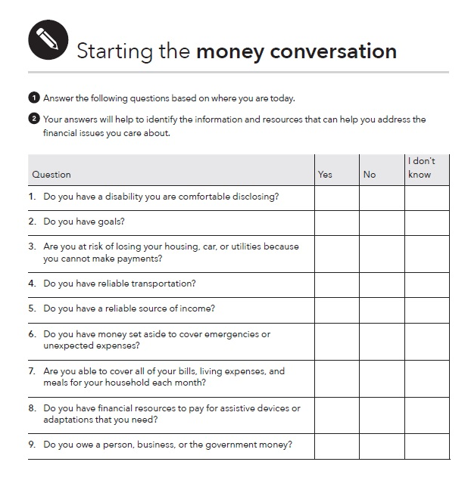
Tool: Starting the money conversation
Page 15 in Focus on People With Disabilities
Help identify financial challenges.
Help zero in on the information and tools that will be most useful to them.
Help you determine where to start the financial empowerment discussion.
Notes:
Instructions for Presenter:
Ask participants to turn to Tool: Starting the Money Conversation in their hard copy guides. Point out that this slide shows the blank version of the tool that includes 13 questions that intermediaries can ask people to complete.
The questionnaire results will help you provide the information, tools, or referrals that are most meaningful.
The questionnaire has many “general” questions that are applicable to people with and without disabilities. Point out that there are two disability-specific questions, listed on the slide. And it is also possible to answer the other questions with more disability-focused answers.
Review the 13 questions that comprise the questionnaire:
Do you have a disability you are comfortable disclosing? [This disability-specific question is included to help providers inform the person they are working with that they may qualify for disability-specific benefits and resources available in their states.]
Do you have goals?
Are you at risk of losing your housing, car, or utilities because you cannot make payments?
Do you have reliable transportation?
Do you have a reliable source of income?
Do you have money set aside to cover emergencies or unexpected expenses?
Are you able to cover all of your bills, living expenses, and meals for your household each month?
Do you have financial resources to pay for assistive devices or adaptations that you need? [This disability-specific question was included to help providers inform the person they are working with that they may be eligible for a federally-funded program that provides assistance to purchase assistive technology.]
Do you owe a person, business, or the government money?
Have you been unable to get a loan, credit card, apartment, car, or job due to a bad credit record?
Do you have an account at a bank or credit union?
Do you think your identity has been stolen? Have you experienced fraud?
Do you make the decisions about your financial resources or feel like you have control over your finances?

Slide 20
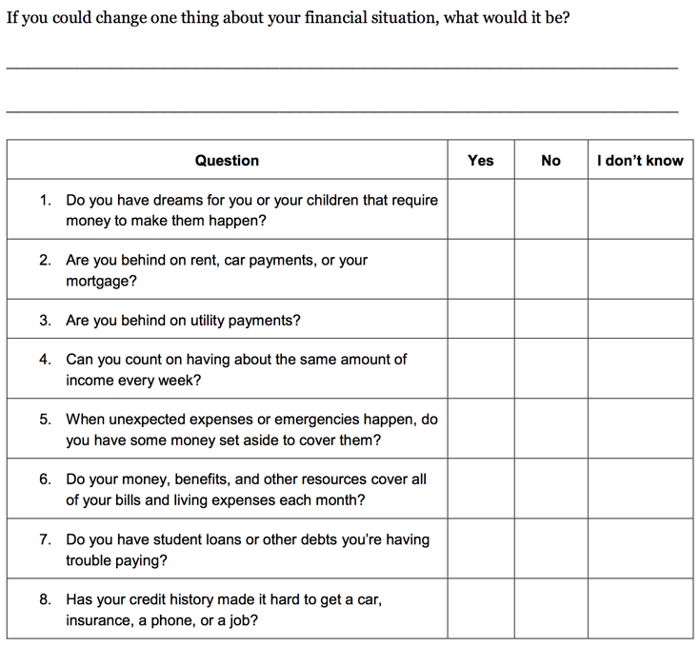
Tool: My money picture
Page 35 – Your Money, Your Goals

Slide 21
Scavenger Hunt: Where would you start if someone…
Question | Module
Felt overwhelmed by debt?
2. Felt like she couldn’t make ends meet?
3. Wants to buy a car and get the best rate she can for the money she must borrow?
4. Wants to understand direct deposit and payroll cards?
5. Has used high-cost credit products in the past and wants to avoid these in the future?
6. Wants to make changes but does not have clear goals?
7. Has no savings but wants to start?
8. Wants to open an account but doesn’t know what kind of account or where?

Slide 22
Setting goals and planning for large purchases
Setting goals is an essential part of the foundation for achieving self-sufficiency. Goals can also help people plan how to use their money.
Examples of large goals:
  Paying for assistive devices
  Buying a car
  Paying for adaptations to vehicles
  Paying medical expenses
  Renovating your home
  Paying for training or post-secondary education
SMART Goals
Notes:
Instructions for Presenter:
Introduce the topic of this module:
Goals can be the foundation for building greater self-determination. They provide direction for how to use resources including money.
You can also use this module to help people plan for both life events and large purchases. Life events are often major milestones or events in a person’s life; for example, graduating from high school, getting married, or getting a job.
Examples of large purchases may include paying for assistive devices, buying a car, adaptations to vehicles, paying medical expenses, renovations to your home, and paying for training or post-secondary education.
In the Your Money, Your Goals toolkit, this module describes and uses the SMART approach to developing goals. SMART is an acronym. SMART goals are Specific, Measurable, Able-to-be-reached, Relevant, and Time bound. The module also suggests ways to talk to people about turning their hopes, wants, and dreams into SMART goals.
Note to trainer: Prior to your training, review the slides on this topic in the Your Money, Your Goals training deck and copy and paste slides that you wish to cover into this PowerPoint file. In particular, consider whether interactive exercises from the Your Money, Your Goals training deck would support your coverage of this topic. Feel free to adapt activities as needed, especially to make them work for everyone, making adjustments to accommodate participants that have disabilities.

Slide 23
SMART goals
Specific
Measurable
Able to be reached
Relevant
Time-framed

Slide 24
Saving for emergencies, bills, and goals
What is saving?
Notes:
Instructions for Presenter:
Facilitated Discussion and Small Group Brainstorm
Ask participants to share their definition of saving.
Note to trainer: Prior to your training, review the slides on this topic in the Your Money, Your Goals training deck and copy and paste slides that you wish to cover into this PowerPoint file. In particular, consider whether interactive exercises from the Your Money, Your Goals training deck fit would support your coverage of this topic. Feel free to adapt activities as needed, especially to make them work for everyone, making adjustments to accommodate participants that have disabilities.

Slide 25
What are examples of unexpected expenses or emergencies?
Notes:
Facilitated Discussion and Small Group Brainstorm, continued
Have participants list examples of unexpected expenses or emergencies in small groups on flip chart paper using marker.
After 3 minutes, ask participants to circle those they think could be handled with $1,000 or less.
Instruct groups to post their flip charts and share cumulatively.
Make summary comments about the number of unexpected expenses that can be managed with $1,000. Contrast to the “conventional wisdom” advocating 3 - 6 months’ worth of living expenses.
Explain that $500 to $1,000 is a possible goal for most—they can imagine it and it can make a very, very big difference.
Explain that having $500 to $1,000 to cover emergencies and unexpected expenses can help avoid debt.
Also explain the following: Once people see they can save this much, then they can work toward 1 month’s living expenses, 3 months’, etc. over the longer term.
Presentation
Module 2: Saving for emergencies, bills, and goals in the Your Money, Your Goals toolkit provides you with information and tools to help you discuss saving with the people you serve.
The module discusses the importance of setting aside money today into a place that is safe and secure for use in the future.
It includes a concrete example of how covering emergency needs with savings can save money.
It provides information on how to build up savings and do so in a stable, worthwhile manner.
It also touches on savings and benefits, and the asset limits that are often important to people with disabilities.

Slide 26
Budgeting
Notes:
Instructions for Presenter:
Introduce Subsection 2: Budgeting
Module 3: Tracking and managing income and benefits and Plan to Achieve Self Support (PASS)
Tool: Income and benefit tracker
Tool: SSI estimator
Module 4: Paying bills and other expenses
Tool: Spending tracker
Module 5: Getting through the month
Tool: Bill calendar
Tool: Budget

Slide 27
Tracking and managing income and benefits
Helping people track their spending and income can help them identify whether they are on track to achieve their financial goals.
For many people with disabilities, tracking income may mean tracking their benefits payments.
Because earnings can offset and reduce benefits, some people with disabilities don’t believe they can work without making themselves worse off financially.
People with disabilities, like people without disabilities, have the right to work free from employment discrimination.
Notes:
Instructions for Presenter:
Present slide content.
Note to trainer: Prior to your training, review the slides on this topic in the Your Money, Your Goals training deck and copy and paste slides that you wish to cover into this PowerPoint file. In particular, consider whether interactive exercises from the Your Money, Your Goals training deck would support your coverage of this topic. Feel free to adapt activities as needed, especially to make them work for everyone, making adjustments to accommodate participants that have disabilities.

Slide 28
Income and Benefits
While work income may mean a reduction in benefits over time, it does not necessarily mean benefits will be stopped immediately.
When a person with a disability wants to work, then it is essential to provide information about income levels that:
  Can make benefits decrease.
  Can make them lose eligibility for benefits.
Income: Regular income, irregular income, seasonal, one-time occurrences
Benefits: SSI, SSDI, others
Notes:
Instructions for Presenter:
Present slide content.

Slide 29
Tool: Income and benefit tracker
A first step to financial empowerment is tracking income and financial resources.
Use this tool to help a person you serve understand the amounts and timing of their financial resources and income.
Encourage the person you serve to track their income and financial resources for a day, a week, two weeks, or a month.
It may be the first time they understand where they get their money and how much they have to work with.
Explain the difference between gross and net income.
Notes:
Instructions for Presenter:
Present slide content.
Note that a very similar tool is also found in Behind on Bills. There is an income and resource tracker that is included in the Your Money, Your Goals toolkit that is different, but that serves a similar function.

Slide 30
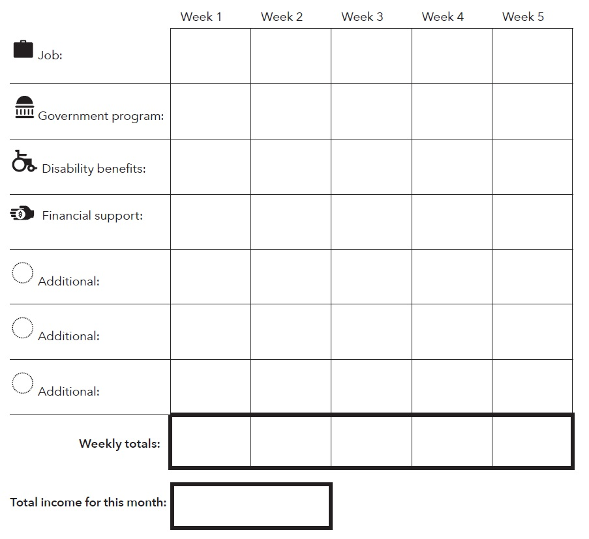
Using the Income and Benefits Tracker
Page 46 – Focus on People With Disabilities
Notes:
Instructions for Presenter:
Use this income and benefit tracker to plan the best times to save and to spend. (Net income is your total take home pay. Take your gross income minus taxes and other deductions to get your net income.)
Write in the names of any income and benefits that apply to you.
Fill in the amounts you receive each week.
Total up each week’s income.
Circle the payments that come at a predictable time and amount. This will show you the income you can count on each month.
A person should use the tracker in an accurate way, but can do it however is most comfortable for them. For example, they could:
Write their income or other financial resource directly into the tracker.
Ask someone to help write their income or financial resources into the tracker.
Record a voice memo each time they receive income or benefits and have that written into the tracker at the end of a day or week.
Take pictures of their income or benefits and have that written into the spending tracker at the end of a day or week.
Use a smart phone application to track income and financial resources.
Categories used in income tracker:
Job: Income from employment, including, self-employment, and seasonal work.
Government program: Any public benefit, including, Temporary Assistance for Needy Families (TANF), Supplemental Nutrition Assistance Program (SNAP), and Medicaid.
Disability benefits: Supplemental Security Income (SSI) or Social Security Disability Insurance (SSDI) .
Financial support: Stipend, allowance, scholarship, child-support, gifts.
Additional: Tax-refunds, gifts, help from family or friends.

Slide 31
Using the Income and benefits tracker
$300 | $300 | $300 | $300 | $0
$177.5
$477.5 | $300 | $300 | $300 | $0
$1377.50
Notes:
Instructions for Presenter:
Here is a simple example of the Income and benefits tracker for somebody who has SSI and earns $300 per week as a cashier. The federal rate for SSI was $735 per month in 2017, but using the SSI calculation (which we’ll show later), SSI goes down to $177.50 for somebody earning $1200 per month. So, in this example:
Somebody would earn $300 in every week of the tracker from their cashier job
They would receive $177.50 in SSI right at the beginning of the month
Weekly totals would be $477.50 in week one, then $300 in week 2, week 3 and week 4
Total income for the month would be $1377.50.
This is a simple example with just one job and SSI, but people may have many sources of income. Regardless of their situation, though, this tool helps people to understand their monthly budget and much may be available at each point in the month.

Slide 32
Tool: SSI Estimator
Use this tool to help a person with a disability understand how earnings from work affect their SSI benefit.
Go through each point in the tool and work out the math with the person you are serving.
First, when a person earns money through a job, they keep the first $85 of their pay without any impact on their SSI. For every dollar they earn after that, SSI drops by 50 cents.
Many people think that getting paid at a job will stop their SSI check, but that’s not necessarily true.
In fact, the more a person works, the more they make overall, even on SSI.
Notes:
Instructions for Presenter:
Present slide content.
Right now, the Federal SSI monthly benefit is $750 per month. In 2017, it was $735 (this is the amount the SSI tool uses). Some states pay more, depending on where you live. When you work, it changes the size of your monthly check – but no matter what, when you work you will have more money in your pocket than if you don’t work at all.

Slide 33
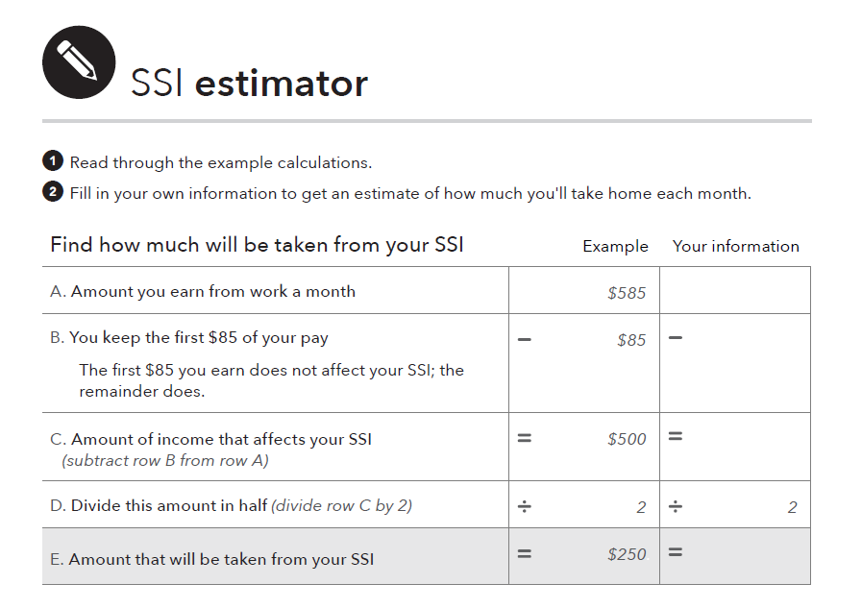
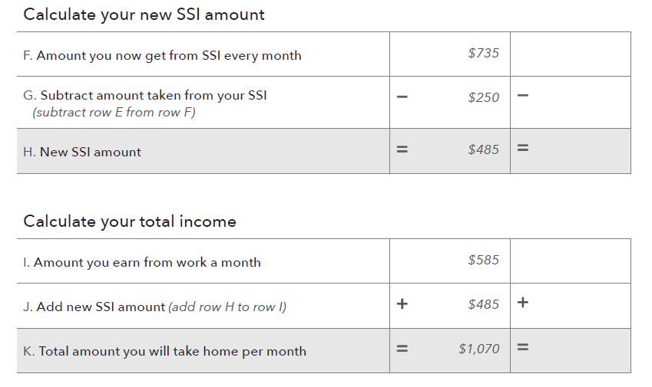
Using the SSI Estimator
Focus on People With Disabilities – Page 48
Notes:
Instructions for Presenter:
Go through each point in the tool and work out the math with the person you are serving.
The Federal SSI monthly benefit was $735 per month in 2017. (it is $750 in 2018) Some states pay more, depending on where you live. Eligible couples receive $1125/month (2018), and blind adults have higher SSI rates for individuals and couples.
First, when you earn money through a job, you keep the first $85 of your pay without any impact on your SSI.
For every dollar you earn after that, SSI drops by 50 cents.
Help them see that even though their benefit is reduced, it’s only reduced by $.50 for every dollar earned.
Note that:
The rules are slightly more complicated, especially if somebody has “unearned income” such as Social Security Disability Insurance (SSDI). This is covered in the SSI estimator tool.
Somebody may be able to keep their SSI benefit even higher if they mark down Impairment Related Work Expenses (IRWEs) or other strategies.
Rules for SSI are different than the rules for SSDI. The SSI estimator only covers SSI.

Slide 34
Using the SSI estimator: Example Part 1
($12/hour x 100 hours a month)
$1200
$85
$1115
$557.50
Notes:
Instructions for Presenter:
There is an example in the SSI estimator, with smaller text. Here is another example from the person that was earning $300/week ($1200/month) in the previous income and benefits tracker (in the right-hand column). This section is the 1st half of the full estimator, which continues on the next slide. Let’s see how it works:
The person earns $1200 from work in a month.
Subtract $85 from $1200 to get $1115. This is the amount of income that affects their SSI.
Divide $1115 by 2, to get $557.50. That is the amount that will be taken from their SSI.
Continue to the next slide…

Slide 35
Using the SSI Estimator: Example Part 2
$735
$557.50
$177.50
$1200
$177.50
$1377.50
Notes:
Instructions for Presenter:
Continuing from the previous slide, where somebody had $557.50 that will be taken from their SSI:
Take their current SSI amount of $735 (the federal amountin 2017)
Subtract the new amount taken from their SSI ($557.50).
This leaves $177.50, which is their new SSI amount.
To calculate their new total income:
Take the amount they earned from work: $1200/month.
Add their new SSI amount: $177.50 .
This is the total amount per month: $1377.50.
You can note that this amount is more than they would originally have, by not working (just the regular SSI rate of $735).

Slide 36
Spending
Depending on circumstances, some people with disabilities may have had limited choices in how to spend their money.
This could be because of age – if the person is a minor, a parent or guardian has made their spending decisions.
In some circumstances, even adults with disabilities may have had very limited opportunities to make decisions about the use of their money.
Use of income may be, or have been, controlled by a trustee, family member, or representative payee.
Notes:
Instructions for Presenter:
Present slide content.
Note that, in the case of others controlling the money:
The lack of opportunity for involvement may often come from a desire to protect a person with disabilities or, in the case of a trustee, from the rules of the trust itself.
In some cases, the family member or representative payee may believe they know what is in the person’s best interest or disagree with how the individual wants to spend their money.

Slide 37
Tool: Monthly Budget
Using a monthly budget can be empowering. It can help a person plan how to use their financial resources to support themselves and their family and save for the future.
This tool can be used to help them manage their income, benefits and plan for their expenses.
Start by asking the person you’re working with about their monthly income, benefits and expenses.
Once these questions are answered, the information can be sued to create a simple monthly budget.

Slide 38
Tool: Monthly Budget continued
Budgeting can help a person with disabilities gain and maintain control over their money.
Module 5 provides information and tools to help people make plans to get through the month – pay for all of their living expenses, bills, financial obligations, and other uses of income or financial resources, including saving.
For a person living on a fixed-income, a monthly budget can help them manage their income, benefits, and plan for their expenses.
Notes:
Instructions for Presenter:
Present slide content.

Slide 39
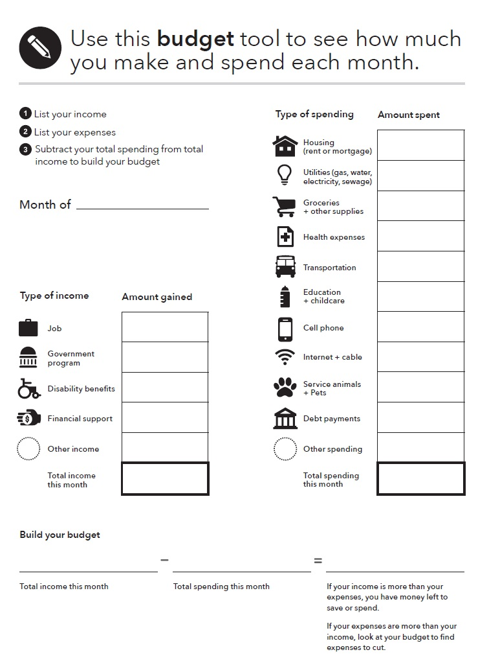
Using the Monthly budget
Page 60 in Focus on People With Disabilities
Notes:
Instructions for Presenter:
Use the responses from the Income and benefit tracker tool and the Spending tracker tool in this guide to identify the total monthly income and expenses of the person you’re working with to create a monthly budget.
Subtract the total spending from total income to build the budget
Note that:
If a person’s income is more than expenses, they have money left to save or spend.
If their expenses are more than their income, look at the budget to find expenses to cut.
This can help somebody understand whether their budget is running short, or how much they have extra in any given month.

Slide 40
Using the Monthly budget
$600
$100
$310
$115
$40
$50
$50
$80*
$1345
$1200
$177.50
$1377.50
*Eating out & entertainment
$1377.50 $1345 $32.50
Notes:
Instructions for Presenter:
This is a sample budget using the numbers from our “example” individual earning $1200/month from work and $177.50 in SSI – for a total income of $1377.50 – and $1345 in expenses. This leaves them with $32.50 left over at the end of the month.
You may want to note that the Monthly budget tool in Focus on People with Disabilities has slightly different categories than the Income and benefit tracker and Spending tracker tools. This may require you to split up or combine some categories. For example, this Budget breaks up housing and utilities, while those are combined in the Spending tracker. It also does not include the “eating out” or “entertainment” categories at the Spending tracker does – so we combined those into the “other spending” category.

Slide 41
Tool: Spending tracker
Use this tool to help a person you serve understand how they spend their money.
Encourage the person you serve to track their spending for a day, a week, two weeks, or a month.
With this information, they may realize where their money goes for the first time.
They can then make changes to how they spend their money.
The way a person tracks how they spend their money and financial resources does not matter. They should use whatever is most comfortable.
Notes:
Instructions for Presenter:
Present slide content.

Slide 42
Using the SSI estimator: Example Part 1
($12/hour x 80 hours a month)
$960
$85
$875
$437.50
Notes:
Instructions for Presenter:
There is an example in the SSI estimator, with smaller text. Here is another example from the person that was earning $300/week ($1200/month) in the previous income and benefits tracker (in the right-hand column). This section is the 1st half of the full estimator, which continues on the next slide. Let’s see how it works:
The person earns $1200 from work in a month.
Subtract $85 from $1200 to get $1115. This is the amount of income that affects their SSI.
Divide $1115 by 2, to get $557.50. That is the amount that will be taken from their SSI.
Continue to the next slide…

Slide 43
Using the SSI Estimator - Example Part 2
$735
$437.50
$297.50
$960
$297.50
$1257.50
Notes:
Instructions for Presenter:
Continuing from the previous slide, where somebody had $557.50 that will be taken from their SSI:
Take their current SSI amount of $735 (the federal amountin 2017)
Subtract the new amount taken from their SSI ($557.50).
This leaves $177.50, which is their new SSI amount.
To calculate their new total income:
Take the amount they earned from work: $1200/month.
Add their new SSI amount: $177.50 .
This is the total amount per month: $1377.50.
You can note that this amount is more than they would originally have, by not working (just the regular SSI rate of $735).

Slide 44
Using the Monthly budget…
$960.00
$297.50
$1257.50
*Eating out & entertainment
$ 1257.50 $ $
Notes:
Instructions for Presenter:
This is a sample budget using the numbers from our “example” individual earning $1200/month from work and $177.50 in SSI – for a total income of $1377.50 – and $1345 in expenses. This leaves them with $32.50 left over at the end of the month.
You may want to note that the Monthly budget tool in Focus on People with Disabilities has slightly different categories than the Income and benefit tracker and Spending tracker tools. This may require you to split up or combine some categories. For example, this Budget breaks up housing and utilities, while those are combined in the Spending tracker. It also does not include the “eating out” or “entertainment” categories at the Spending tracker does – so we combined those into the “other spending” category.

Slide 45
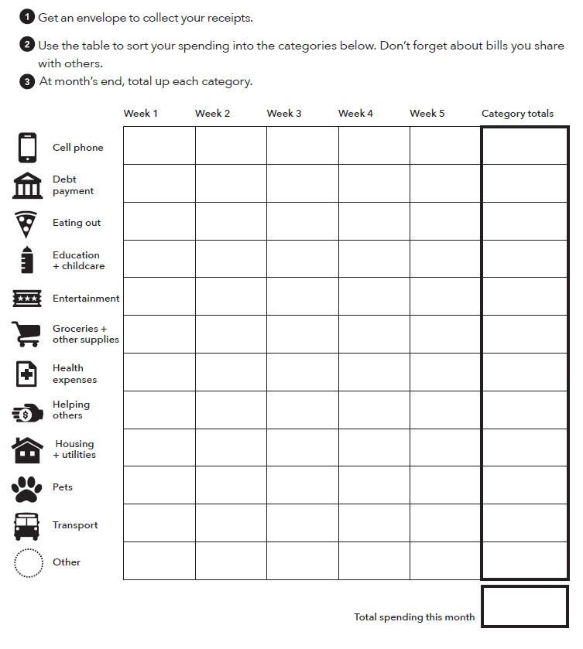
Using the Spending Tracker
Page 53 in Focus On People With Disabilities
Notes:
Instructions for Presenter:
Review how the spending tracker works.
Get an envelope to collect your receipts.
Use the table to sort your spending into the categories below. Don’t forget about bills you share with others.
At month’s end, total up each category
This tracker allows for weekly tracking toward “category totals.” Tracking can happen on a daily, weekly or monthly basis. More detail on each category is available in Focus on People with Disabilities.

Slide 46
Spending tracker: sample strategies
Write your spending into the spending tracker.
Ask someone else to write your spending into the spending tracker.
Keep receipts for every time you use money and then fill in the spending tracker using the information from your receipts.
Record a voice memo each time you spend money and have that written into the spending tracker at the end of a day or week.
Take pictures of what you spend your money on and have that written into the spending tracker at the end of a day or week.
Use a smart phone application to track your spending.
Notes:
Instructions for Presenter:
Present slide content.

Slide 47
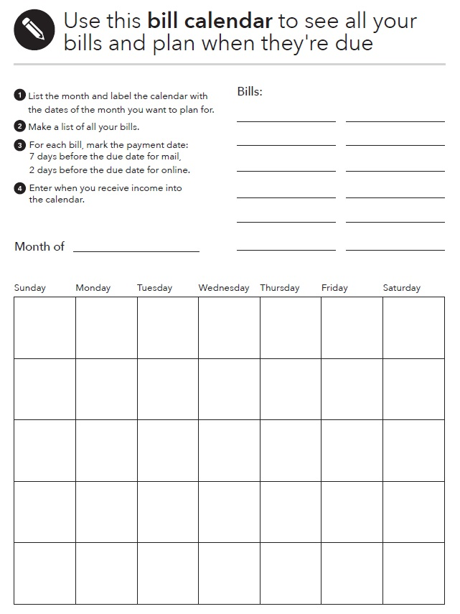
Using the Bill Calendar
Page 57-58 in Focus on People With Disabilities
Notes:
Instructions for Presenter:
Use this bill calendar to see all your bills and plan for when they are due.
1. List the month and label the calendar with the days of the month you want to plan for.
2. Make a list of all your bills.
3. For each bill mark the payment date: 7 days before the due date for mail, 2 days before the due date for online.
4. Enter when you receive income and when your bills are due into the calendar.

Slide 48
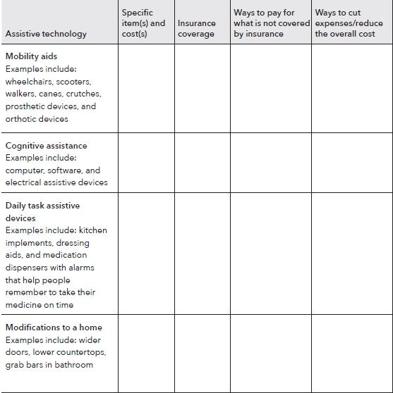
Tool: Paying for Assistive Devices
Pages 26-27 Focus on People with Disabilities
Notes:
Instructions for Presenter:
Introduce the tool:
Focus on People with Disabilities adds general information on setting goals and planning for large purchases. The guide contains a new tool: Paying for assistive devices.
For many people with disabilities, assistive devices may help the person achieve independence so they can reach their other goals. Assistive devices may be large purchases, requiring more money than a person can reasonably expect to have after covering their basic living expenses.
Use this tool to help someone identify the assistive devices they need or want, how to reduce the costs, and how to pay for these items.
“Paying for assistive devices” includes nine categories with examples. The categories are:
Mobility aids
Cognitive assistance
Daily task assistive devices
Modifications to a home
Modifications to a vehicle
Educational assistive devices
Assistive technology for people who are deaf or hearing impaired
Assistive technology for people who are blind or visually impaired
Other
Explain how it works. Working column-by-column, use this tool to:
Read through at the column to the far left and identify all the assistive technology that you need and the cost. If you do not know what you need or what your options are, you may be able to get an assistive technology evaluation. Check with your medical provider for a referral.
In the third column, figure out if your health insurance will pay for part or the entire item. If you have health insurance, prior authorization may be required. The assistive device or service must be medically necessary. You may need a letter of medical necessity or prescription from your doctor.
In the fourth column, identify potential ways to pay for the items.
Finally, in the fifth column, identify ways to keep the costs as low as possible. You may qualify for a federally-funded Alternative Financing Program that provides affordable financing to purchase assistive technology. Contact your local department of rehabilitation for additional support and information.

Slide 49
ABLE Accounts
(Pages 36-38) Focus On People With Disabilities
Important new resource for people with disabilities
Savings in ABLE Accounts do not affect eligibility for:
  Supplemental Security Income (SSI)*
  Medicaid and other federal means-tested benefits*
The maximum total annual contribution is $15,000 (2018)
New Hampshire STABLE Account.
  https://www.stablenh.com/
    Only for New Hampshire residents
ABLE National Resource Center at: https://www.ablenrc.org.
Notes:
Instructions for Presenter:
Present slide content.
Regarding ABLE savings:
Only money in an ABLE Account exceeding $100,000, plus any distributions toward qualified housing expenses and non-qualified disability expenses retained beyond the month of distribution, may be counted as a resource for SSI.
The maximum allowable value of an ABLE Account in a given state is based on the 529 plan limits established by that state. A 529 is an educational savings plan designed to help families’ set-aside money for future college costs. Many states have set this limit at more than $300,000 per plan.
Other rules apply: The maximum total annual contribution to an ABLE Account for a single tax year is subject to the IRS gift tax exclusions, which is $15,000 for 2018.
There are 34 ABLE programs as of March 2018, and most accept out-of-state residents. Potential account-holders will have many opportunities and options.
People with disabilities can switch their program once per calendar year. If they do not like a state’s program, or a better one comes around, they can switch without penalty.

Slide 50
Eligibility For ABLE Accounts
The designated beneficiary is the eligible individual who established and owns the ABLE Account. To be eligible for an ABLE Account, a person must be:
  Eligible for Supplemental Security Income (SSI) based on disability or blindness that began before age 26;
  Entitled to disability insurance benefits (DIB), childhood disability benefits (CDB), or disabled widow’s or widower’s benefits (DWB) based on disability or blindness that began before age 26; or
  Someone who has certified, or whose parent or guardian has certified, that the person has a medically determinable impairment meeting certain statutorily specified criteria, or is blind; and, the disability or blindness occurred before age 26.

Slide 51
Qualified Expenses For ABLE Accounts
Education
Housing
Transportation
Employment training and support
Assistive technology
Personal support services
Health care expenses
Financial management and administrative services and other expenses that help to improve health, independence, or quality of life

Slide 52
New Hampshire ABLE Accounts
MAKE EASY DEPOSITS ONLINE
  Contribute up to $15,000 per year. If employed, you may be able to contribute up to an additional $12,140 of income. Limit of account is $468,000
DIVERSE CHOICES
  Choose from among five different investment options, including four mutual fund based investments and one FDIC-insured investment.
FLEXIBLE CHANGES
  Freedom to change your investment options twice every calendar year.

Slide 53
Setting up an ABLE Account: Main steps
Ask these questions to determine if an ABLE Account is an option for you.
  Do you meet the eligibility requirements?
  Do your goals match the qualified disability expenses allowed that can be paid from an ABLE Account without incurring taxes?
  Do you have the minimum contribution required to open an account?
  Can you continue to make contributions to the ABLE Account once it’s opened?
Notes:
Instructions for Presenter:
Present slide content.
Share the following information from Focus on People with Disabilities if it is of interest to your participants and time permits. Alternatively, let participants know that Focus on People with Disabilities covers ABLE Accounts in detail and that they can use their copies of the guide as a reference following the training.
Additional Detail on ABLE Accounts
Eligibility requirements. To be eligible, people must:
Have a significant disability with the age of onset of the disability that began 26 years of age, and
Are receiving benefits from SSI and/or SSDI, or are eligible to file a disability certification with a qualified ABLE program, or
Meet the Social Security’s definition and criteria being significant functional limitations and receive a letter of certification from a licensed physician.
Do your goals match the qualified disability expenses allowed that can be paid from an ABLE Account without incurring taxes? Qualified disability expenses may include:
Education
Housing
Transportation
Employment training and support
Assistive technology
Personal support services
Health care expenses
Financial management and administrative services and other expenses that help to improve health, independence, or quality of life.
Do you have the minimum contribution required to open an account? This varies based on the requirements of each state program but is generally between $25 and $50.
Can you continue to make contributions to the ABLE Account once it is opened? Regular (monthly) deposits may not be required, but regular contributions to savings can help you grow your account faster. Remember that family and friends can also make contributions to your ABLE Account.
Be sure you find out:
How your money will be invested through an ABLE Account
Fees you may have to pay to open and maintain your account
Whether there are advantages available to in-state residents
Penalties that may be charged
Other benefits the account may provide, such as checks or a debit card
For a list of ABLE Accounts offered by state, visit the ABLE National Resource Center at: www.ablenrc.org

Slide 54
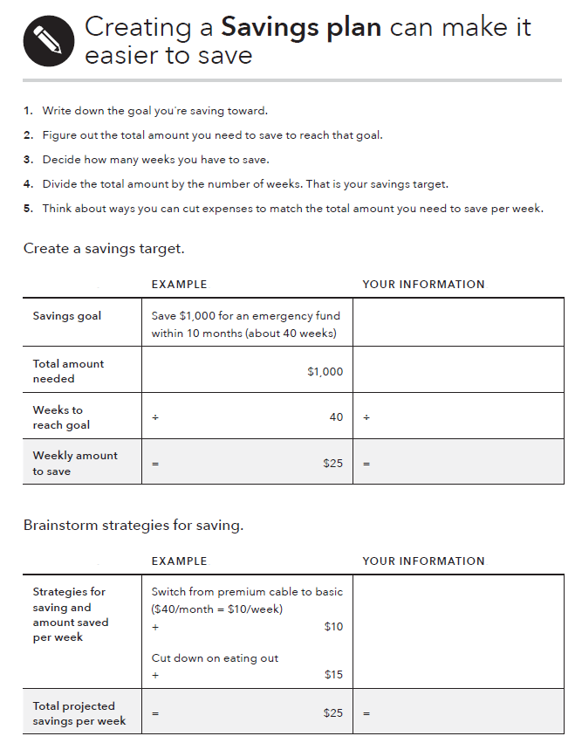
Tool: Savings plan
What to do:
Pick a reason for saving. Consider starting an emergency fund.
Figure out how much money you’ll need to save for that goal and how many weeks you have to save.
Divide the amount of money you want to save by the number of weeks you have to save it. That’s your weekly savings target.
Brainstorm some ways to decrease spending or increase income to meet your weekly savings target.
Notes:
Module 2: Saving
Methodology: Presentation
Corresponding section in toolkit: Module 2, the “Savings plan” tool, pages 45-46
Instructions for facilitator
Explain the components of the “Savings plan” tool.
Review the examples in the tool for setting a savings target and brainstorming strategies for saving.
ASK: When could you see using this tool?
FACILIATION TIP: Download this tool from the CFPB website in advance of your training and demonstrate the automatic calculation feature in the “Create a savings target” section.

Slide 55
Debt, Credit, Financial Services, Consumer Protection
Notes:
Instructions for Presenter:
Introduce Subsection 3: Debt, Credit, Financial Services, Consumer Protection
Module 6: Dealing with debt
Tool: Debt worksheet
Tool: Dealing with debt collectors
Module 7: Understanding credit reports and scores
Module 8: Money services, cards, accounts and loans: finding what works for you
Module 9: Protecting your money
Tool: Identifying financial abuse and exploitation

Slide 56
Dealing with Debt
Understanding debt, how to manage it, and how to reduce or get rid of it are important components of financial empowerment.
Debt, however, is a reality for many people with and without disabilities.
People with disabilities may have debt related to:
  Paying for medical bills and assistive technology
  Buying, rehabilitating, adapting, or repairing a home
  Buying a car or truck or adapting it
  Starting a business
  Getting themselves or their children education and training
  Emergency expenses
Notes:
Instructions for Presenter:
Present slide content.
What is debt?
Money you owe.
Debt is a liability.
Debt may obligate future income.
How is debt different from credit? For our purposes…
Credit is the ability to borrow money.
Debt is the result of using credit.
Debt obligates future resources to cover decisions made today. Understanding debt, how to manage it, and how to reduce and get rid of it, are important components of financial empowerment.
Note that this list is not exhaustive. These are just some of the examples that are especially relevant to people with disabilities.

Slide 57
Tool: Debt worksheet
To make a debt reduction and elimination plan, use the debt worksheet with the person you serve. The debt worksheet can also help someone get on track with paying their debts on time.
The goal with the debt worksheet is to get all of the information about debts someone owes in one place.
Start by helping someone brainstorm all of the debts they owe.
You can also recommend reviewing their credit report to help identity debt—debt that is current, in collections, or resulting from judgments.
Notes:
Instructions for Presenter:
Present slide content.

Slide 58
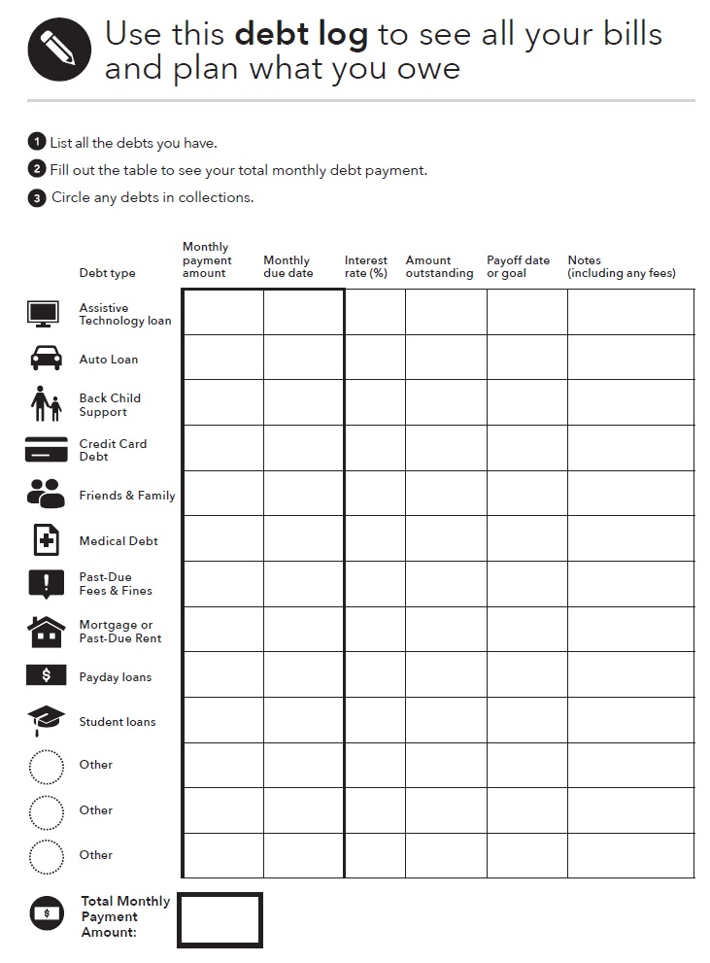
Tool: Debt worksheet
Page 67 – Focus on Persons With Disabilities
Notes:
Instructions for Presenter:
Making a plan to pay debt regularly, reduce debt, or get rid of debt starts with getting a clear picture of what a person owes and who they owe money to. The debt worksheet is designed to help them get all of this information in one place.
The debt worksheet has six columns monthly payment due, monthly due date, interest rate, amount outstanding, payoff date or goal, and notes. There are rows for different debt types including assistive technology loans, auto loans, back child support, credit card debts, and more. At the bottom of the debt worksheet, there is a box for a “total monthly payment amount.” This is part of the debt reduction and elimination plan.
Explain how the Debt worksheet works:
List all the debts you have.
Fill out the table to see your total monthly debt payment.
Circle any debts in collections.
Note that for each debt, you will need to know the:
Person, business, or organization you owe money to
Amount you owe them
Amount of your monthly payment, which includes the principal, interest payments and any fees you may owe
Interest rate you are paying and other important terms.

Slide 59
Using the Debt worksheet
$200 | 1st | 8 | $3k | 01/19 | Fixed rate
$220 | 15th | 17 | $400 | 2 months | $50 min
$150 | 1st | 4 | $10k | 2022 | Fixed rate
$570
Notes:
Instructions for Presenter:
How much is debt an issue with the consumers you serve?
If debt is an issue are these relatively accurate examples of what is done in your area?
Here is a sample Debt worksheet. The person enters the six factors for three different debts: an auto loan, credit card debt, and student loans.
The auto loan and student loans are both fixed-rate and just have money due on the 1st. With the amount due and monthly bill, they will be paid off in 2019 and 2022, respectively. The person can choose to pay off the loans earlier if they want, though.
The person’s credit card debt has an outstanding amount of $400 with a 17% interest rate, and bills due on the 15th. There is a minimum payment of $50/month (this is in the “notes” section). The person has a goal of paying off the debt in two months, so they are paying $220/month. It is more than just $200/month because they are taking into account the 17% interest.
In total, this adds up to $570 per month in total debt payments.

Slide 60
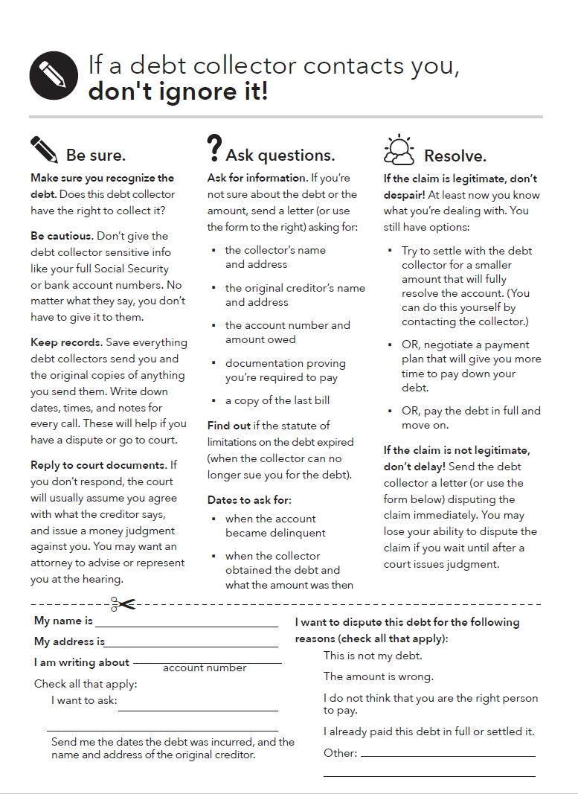
Using the tool on Debt collectors
Page 68-69 in Focus on Persons With Disabilities
This tool summarizes some of the key rights in debt collection and will help a person:
Take actions to verify whether the claim is valid.
Know how to dispute the claim if they do not own the debt.
Know what to do next if they do owe the debt.
Knowing about their rights can help to figure out if a debt collector is violating their rights.
Notes:
Instructions for Presenter:
Present slide content.
The tool on Debt collectors includes these two main sections: information about interacting with debt collectors, and a sample letter to communicate with them or other collection agencies. The full information is available in Focus on People with Disabilities.
A debt collector cannot:
Call repeatedly to harass or abuse you.
Use obscene language.
Threaten you to take action they can’t or don’t really plan to take.
Publish your name for not paying a debt.
Lie to you.

Slide 61
Building Good Credit History
A credit report is a record of an individual’s bill-paying history.
Credit scores are calculated using the information in credit reports. A higher score makes it easier to qualify for a loan or lower interest rates. Many scores range from 300-850.
Having a good credit history is an important part of an overall asset-building strategy that can help people reach their goals, including:
Get and keep a job
Get an apartment
Get lower deposits on utilities and better terms on cell phone purchase plans
Get a credit card
Notes:
Instructions for Presenter:
Present slide content.

Slide 62
Credit discrimination is illegal
Credit discrimination is illegal. Under the Equal Credit Opportunity Act, a creditor can't discriminate in any credit transaction, including mortgages, against any applicant because of these factors:
  Receipt of income from any public assistance program such as Social Security Disability Insurance (SSDI) or the Supplemental Nutrition Assistance Program (SNAP)
  Race
  Color
  Religion
  National origin
  Sex (gender)
  Other
Notes:
Instructions for Presenter:
Present slide content.
Other factors protected against discrimination under the Equal Credit Opportunity Act include:
Marital status
Age, unless the applicant is not legally able to enter into a contract
Your exercising in good faith a right under the Consumer Credit Protection Act (such as disputing information in your credit report)
This does not explicitly mention disability. But fair lending concerns may arise under ECOA and Regulation B when a creditor requires additional documentation beyond that required by lawful applicable agency or secondary market standards and guidelines to demonstrate that SSDI is likely to continue, such as information about the nature of an applicant’s disability or letter from an applicant’s physician.

Slide 63
Getting your credit reports and scores
To order through the website, visit: https://www.annualcreditreport.com
  Complete a form with basic information (name, Social Security number, address, etc.).
  Select the report(s) you want—Equifax, Experian, and/or TransUnion.
  Answer security questions: former addresses, amount of a loan you have, phone numbers that have belonged to you, counties you may have lived in, etc.
If you are unable to answer these questions, you will have to use another method.
  You will save a PDF version of your report, print the report, or both.
Be sure you do this in a safe and secure location. Avoid doing this on public computers (library).
Notes:
Module 7: Understanding Credit Reports and Scores
Presentation (Module 7, Tool 1: Getting your credit reports and scores) (Page 247)
Explain how to order credit reports using Tool 1.
Explain alternative methods for getting a report from AnnualCreditReport.com in case the online report cannot be accessed (security questions are answered wrong or cannot be answered if generated by fraudulent information on the report).
Explain the other times you can get an additional free report. IF:
Are unemployed and plan to look for employment in the next 60 days
Are receiving public assistance
Have reason to believe that your credit file is inaccurate due to fraud
Have had a consumer reporting agency place a fraud alert on your credit file (based on your good faith suspicion that you have been the victim of fraud, including identity theft)
Have had a consumer reporting agency place a fraud alert on your credit file after submitting an identity theft report
Have had adverse action taken (you have been denied credit, employment, insurance, etc.) because of information in your credit report – In this case, you have 60 days to request your report.
BUT, you must request these reports. They don’t just show up for you.
If you are under 18, you should not have a credit report unless:
You are an authorized user or joint owner on an account
You are an emancipated minor
Your state law allows you to enter contracts below the age of 18, and you have done so
You have student loans
You have been the victim of identity theft or credit or financial fraud
Use the following notes from the toolkit to explain getting credit scores:
Free credit scores are offered online.
Will most likely differ from the credit score used by a bank, lender, or other third-party to assess your creditworthiness.
These are approximations of your scores. They are not the actual scores businesses will use to make decisions about you.
Some people find they can be useful for education because you can see if your credit scores are generally moving up or down.
The actual number may not reflect your actual FICO Scores - so this may be confusing for some people.
There are a variety of credit scores you can purchase in the marketplace. The type of credit score most used by lenders is a FICO score. Another score also used by lenders if the VantageScore which you can purchase through Experian or TransUnion.
Explain that while credit scores are important and used, the most important thing to focus on is their credit report.
Ask participants why focusing on the credit report is more important than the credit score?
Following some discussion, if not shared, explain that the score is calculated using information from credit reports.
If the information in the report is strong (and error-free), the scores will reflect this.

Slide 64
Many types of products and services
Module 8 helps people understand how to find and choose financial services, products, and providers that meet their needs.
Many types of financial products and services can help people:
  Protect their money and financial resources.
  Better manage their money.
  More efficiently pay for their current living expenses.
  Set aside money for their goals or for future generations.
Notes:
Instructions for Presenter:
Present slide content.
Note to trainer: The section on Module 8 in the Focus on People with Disabilities does not have any specific text or tools for people with disabilities. For more information on this subject, refer to the Your Money, Your Goals toolkit.

Slide 65
Identifying Financial Exploitation
“Financial exploitation is the illegal or improper use of an individual’s funds, property, or assets.”
While many people are at risk of having their identity stolen, people with disabilities may face a higher risk of identity theft, financial abuse, and financial exploitation.
This can occur through fraud or scams, or when caregivers, family members, or others improperly use an individual’s financial resources.
Notes:
Instructions for Presenter:
Present slide content.

Slide 66
Disability: Risks for financial exploitation
The following circumstances or conditions may make a person at risk for financial exploitation:
Having regular income and accumulated assets
Being trusting and polite
Being lonely and socially isolated
Being reluctant to report exploitation by family member, caregiver, or someone they depend on
Fearing rejection or more retaliation by the exploiter
Being unfamiliar with managing financial matters
Having cognitive impairments that affect financial decision-making and judgment
Notes:
Instructions for Presenter:
Present slide content.
These are presented as disability-specific risks in Module 9.
Other factors may include:
Being dependent on support from a family member or caregivers to remain independent.
Receiving care from a person with substance abuse, gambling or financial problems, or mental health issues.

Slide 67
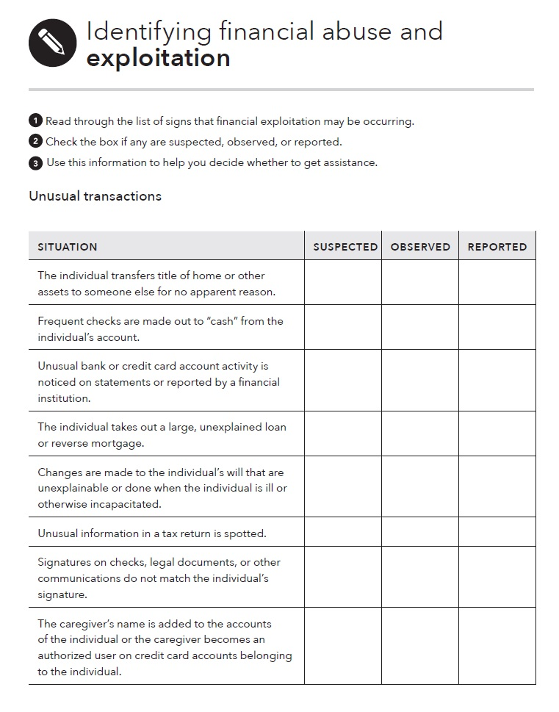
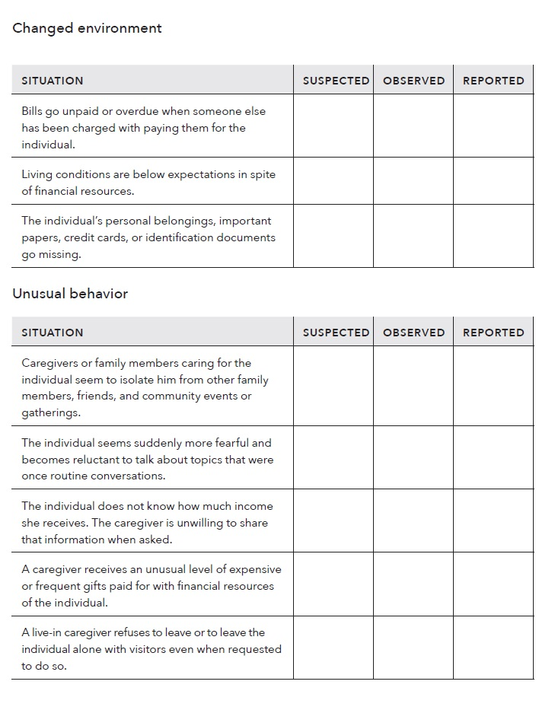
Tool: Identifying financial abuse and exploitation
Pages 83-83 – Focus on Persons With Disabilities
Notes:
Instructions for Presenter:
Present slide content.
Read through the list of signs that financial exploitation may be occurring.
Check the box if any are suspected, observed, or reported.
Use this information to help you decide whether to get assistance.
List sections:
Situation, i.e. The individual takes out a large, unexplained loan or reverse mortgage.
Changed environment, i.e. Living conditions are below expectations in spite of financial resources.
Unusual behavior, i.e. The individual seems suddenly more fearful and becomes reluctant to talk about topics that were once routine conversations.
Note that a full list is available in the guide under the “identifying financial abuse and exploitation” tool of Module 9 in the disability companion guide. The full list has 16 bullet points.
Situation:
The individual transfers title of home or other assets to someone else for no apparent reason.
Checks are frequently made out to “cash” from the individual’s account.
Unusual bank or credit card account activity is noticed on statements or reported by a financial institution.
The individual takes out a large, unexplained loan or reverse mortgage.
Changes are made to the individual’s will that are unexplainable or done when the individual is ill or otherwise incapacitated.
Unusual information in a tax return is spotted.
Signatures on checks, legal documents, or other communications do not match the individual’s signature.
The caregiver’s name is added to the accounts of the individual or the caregiver becomes an authorized user on credit card accounts belonging to the individual.
Changed environment:
Bills go unpaid or overdue when someone else has been charged with paying them for the individual.
Living conditions are below expectations in spite of financial resources.
The individual’s personal belongings, important papers, credit cards, or identification documents go missing.
Unusual behavior
Caregivers or family members caring seem to isolate the individual from other family members, friends, and community events or gatherings.
The individual seems suddenly more fearful and becomes reluctant to talk about topics that were once routine conversations.
The individual does not know how much income they receive. The caregiver is unwilling to share that information when asked.
A caregiver receives an unusual level of expensive or frequent gifts paid for with the financial resources of the individual.
A live-in caregiver refuses to leave or to leave the individual alone with visitors even when requested to do so.

Slide 68
Resources
Financial abuse and exploitation
Financial exploitation often goes unreported because people do not know which steps to take.
List of resources that may help if you suspect financial abuse or exploitation:
  Contact your Adult Protective Services agency.
  Report financial fraud to your state’s attorney general’s office.
  Seek legal assistance for help with getting back money or property that was taken or to get protection from additional exploitation.
  Contact your local Area Agency on Aging if the individual is an older individual.
Notes:
Instructions for Presenter:
Present slide content.
Remember, you do not need to prove that financial exploitation or abuse is occurring to report it. It is up to the professionals to take action if you suspect abuse.
A full list of resources and other details is available in Module 9 of Focus on People with Disabilities.

Slide 69
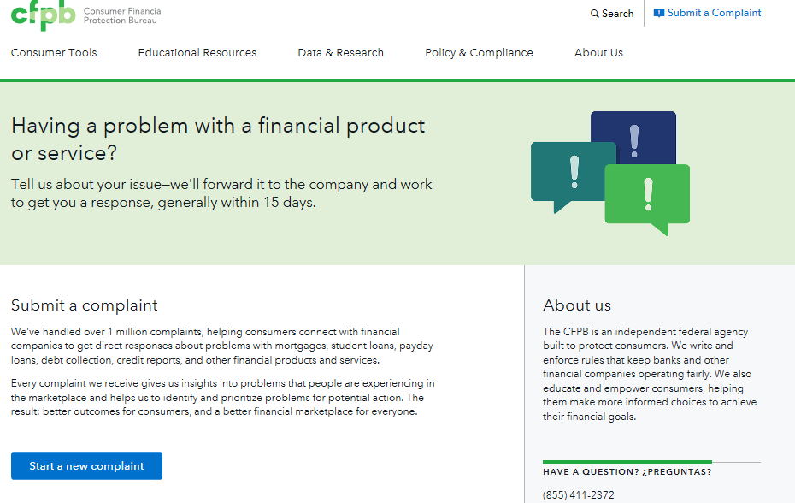
YMYG Module 9, Tool 1: Submitting a complaint
Notes:
Training Section 9: Using and Protecting Your Money CONTINUED
Refer participants to the CFPB complaint contact information on slide and in their toolkit, Module 9, Tool 1.
Explain the following:
An empowered consumer understands their rights. When you know you have rights, you can take steps to protect yourself. There are many laws that protect your rights when it comes to financial products and services. It is the CFPB’s job to enforce these laws and handle consumers’ complaints about financial products and services.
The CFPB has to date handled more than 1,000,000 of consumer complaints about:
Credit cards
Mortgages
Bank accounts and services
Student loans
Vehicle loans or leases
Payday loans
Other consumer loans (including installment loans, pawn loans, and title loans)
Debt collection
Money transfers or virtual currency
Credit reporting
Prepaid cards
Other financial services (including check cashing, money orders, cashier’s checks, credit repair, debt settlement, refund anticipation loans, foreign currency exchange, and traveler’s checks)
Every complaint the CFPB receives gives them insights into problems that people are experiencing in the marketplace and helps them to identify and prioritize problems for potential action.
Explain that you can submit a complaint on behalf of someone else following the directions on the site.
Explain that, you can also submit a complaint over the phone by calling the CFPB at 855-411-CFPB (2372), toll free. U.S.-based call centers can help you in over 180 languages and can also take calls from consumers who are deaf, have hearing loss, or have speech disabilities. Live operators in Spanish are available.

Slide 70
Financial Exploitation – Group Brainstorm
How do you approach this issue with consumers?
What to avoid saying?
What words elicit a non-defensive response?
Use documents?
  Bank statements
  SSI and/or SSDI statements

Slide 71
Integrating Your Money, Your Goals and Focus on People with Disabilities
The strongest integration strategies start with the end user in mind:
Who will you (or others in your organization) use Focus on People with Disabilities and Your Money, Your Goals with?
In which situations will you use the toolkit and how?
What outcomes do you want to help the people you serve achieve though the use of the toolkit? (Outcomes are results that bring about changes or benefits.)
Notes:
Instructions for Presenter:
Exercise (pairs)
Present slide contents.
Have teams of two work through these questions together.
Give teams 5 – 10 minutes to work through this.
Have a subset of the groups report out. Try to select diverse examples.
Thank participants for their contributions.
Explain that now that they have completed an overview of Your Money, Your Goals and Focus on People with Disabilities, the rest of the training will focus on content and tools.

Slide 72
Wrap-up
Post training evaluations
3, 6, and 9 month follow up emails
CRC credits
Final comments from group

Slide 73
Thank you!
Terry Donovan
Senior Outreach Program Manager
Stout Vocational Rehabilitation Institute
donovant@uwstout.edu
Beth Gaertner
Outreach and Training Coordinator
Stout Vocational Rehabilitation Institute
gaertnere@uwstout.edu
Notes:
Instructions for Presenter:
Thank participants and adjourn.

