Slide 1
Financial Empowerment

Slide 2

Office of Financial Empowerment
The Consumer Financial Protection Bureau is an independent federal agency established to protect consumers.
The Office of Financial Empowerment
http://www.consumerfinance.gov/your-money-your-goals.
http://www.consumerfinance.gov/empowerment.
Notes:
Instructions for Presenter:
Use the following information to explain the CFPB’s Office of Financial Empowerment:
Sign up to receive information from the CFPB’s Office of Financial Empowerment on new Your Money, Your Goals releases, training opportunities, and other updates by visiting consumerfinance.gov/your-money-your-goals.
Sign up to receive information on other Office of Financial Empowerment projects, such as Tax-Time Savings initiatives and Financial Coaching by visiting consumerfinance.gov/empowerment.

Slide 3
Financial empowerment
What is financial empowerment?
How is it different than financial education, financial literacy, financial capacity, or other commonly used terms?
Skill and confidence to use knowledge
Financial empowerment
Financial literacy
=

Slide 4
Question | Yes | No | Don’t Know
I have a savings or checking account at a bank or credit union and I make regular deposits/withdrawals
I have applied for, received, and used a credit card
I have a loan that helped me to purchase a car or home
I have taken out a payday loan or auto title loan
I have requested my own credit report and reviewed it
I make and stick to a budget
I have taken a loan from a pawn shop
I have used a check cashing business
I have been contacted by debt collectors
I understand my rights and know what to do if I believe a financial services provider has tried to take advantage of me

Slide 5
Focus on People with Disabilities Contents (2 of 4)
Subsection 1: People with Disabilities and Financial Decision-Making/Goal-setting
Getting started with the money conversation questionnaire.
Module 1: Setting goals and planning for large purchases
  Tool: Paying for assistive devices
Module 2: Savings for emergencies, bills, and goals
  Tool: Setting up an ABLE Account
Notes:
Instructions for Presenter:
Present slide contents and continue on to the next slide which has additional items from the table of contents.

Slide 6
Focus on People with Disabilities Contents (3 of 4)
Subsection 2: Budgeting
Module 3: Tracking and managing income and benefits
  Tool: Income and benefit tracker
  Tool: SSI estimator
Module 4: Paying bills and other expenses
  Tool: Spending tracker
Module 5: Getting through the month
  Tool: Bill calendar
  Tool: Monthly budget
Notes:
Instructions for Presenter:
Present slide contents and continue on to the next slide which has additional items from the table of contents.

Slide 7
Focus on People with Disabilities Contents (4 of 4)
Subsection 3: Debt, Credit, Financial Services, Consumer Protection
Module 6: Dealing with debt
  Tool: Debt worksheet
  Tool: Dealing with debt collectors
Module 7: Understanding credit reports and scores
Module 8: Money services, cards, accounts, and loans: Finding what works for you
Module 9: Protecting your money
  Tool: Identifying financial abuse and exploitation
Notes:
Instructions for Presenter:
Small Group Brainstorm
Present slide contents.
Begin the small group brainstorm by asking people to assemble into groups of 4-6. Ask each group to appoint a note taker.
ASK: Given what you have seen so far, how could you envision using Focus on People with Disabilities?
Instruct groups to be prepared to report what they have discussed.
Write their ideas on flip chart paper or white board.

Slide 8
Who can use Focus on People with Disabilities?
Frontline staff members and volunteers in organizations that serve people with disabilities.
Community members who advocate for people with disabilities, such as family members, friends, and volunteers.
Representative payees or others with fiduciary responsibilities for individuals with disabilities, such as family members.
People with disabilities, themselves.
Notes:
Instructions for Presenter:
Focus on People with Disabilities, like the Your Money, Your Goals toolkit, provides information and tools that people can use to make the financial choices that are right for them. There are a few different situations where Focus on People with Disabilities could be used on the slide.
Note: Intermediaries are people with relationships of trust with the people they serve. Intermediaries can serve as sources of financial empowerment by sharing information, tools, and referrals on financial topics. Other slides and speakers notes in this presentation may refer to intermediaries.

Slide 9
Integrating Focus on People with Disabilities: discuss in pairs...
The strongest integration strategies start with the end user in mind:
Who will you (or others in your organization) use Focus on People with Disabilities and Your Money, Your Goals with?
In which situations will you use the toolkit and how?
What specific tools and information will the people you serve use?
What outcomes do you want to help the people you serve achieve though the use of the toolkit? (Outcomes are results that bring about changes or benefits.)
Notes:
Instructions for Presenter:
Exercise (pairs)
Present slide contents.
Have teams of two work through these questions together.
Give teams 5 – 10 minutes to work through this.
Have a subset of the groups report out. Try to select diverse examples.
Thank participants for their contributions.
Explain that now that they have completed an overview of Your Money, Your Goals and Focus on People with Disabilities, the rest of the training will focus on content and tools.

Slide 10
Subsection 1: People with Disabilities and Financial Decision-Making/Goal-Setting
Notes:
Instructions for Presenter:
Introduce Subsection 1: People with Disabilities and Financial Decision-Making/Goal-Setting
Getting started with the money conversation questionnaire
Module 1: Setting goals and planning for large purchases
Tool: Paying for assistive devices
Module 2: Saving for emergencies, bills and goals
Tool: Setting up an ABLE Account

Slide 11
Getting started
Resources for having the money conversation
Introductory modules to Your Money, Your Goals
  Information on financial empowerment
  Tips and scripts for starting the money conversation
Focus on People with Disabilities, Tool: Starting the money conversation
Notes:
Instructions for Presenter:
Present slide contents.
Many people find the idea of providing financial information overwhelming. Many feel like they don't know enough about it. The truth is, no one knows everything there is to know about financial empowerment.
In addition, people with and without disabilities sometimes find it challenging or awkward to discuss money and financial issues.
Resources for having the money conversation include:
The introductory modules to Your Money, Your Goals. They provide information on financial empowerment and how intermediaries can support financial empowerment without being experts. The toolkit also provides tips and scripts for starting the money conversion.
Focus on People with Disabilities Tool 1: Starting the money conversation. When you feel the time is right, you can simply ask the person to complete the questionnaire in this Focus on People with Disabilities and goal-setting tools in the Your Money, Your Goals toolkit.

Slide 12
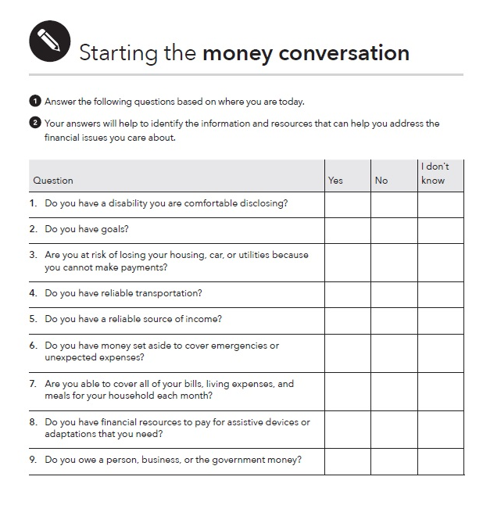
Tool: Starting the money conversation
Help identify financial challenges.
Help zero in on the information and tools that will be most useful to them.
Help you determine where to start the financial empowerment discussion.
Notes:
Instructions for Presenter:
Ask participants to turn to Tool: Starting the Money Conversation in their hard copy guides. Point out that this slide shows the blank version of the tool that includes 13 questions that intermediaries can ask people to complete.
The questionnaire results will help you provide the information, tools, or referrals that are most meaningful.
The questionnaire has many “general” questions that are applicable to people with and without disabilities. Point out that there are two disability-specific questions, listed on the slide. And it is also possible to answer the other questions with more disability-focused answers.
Review the 13 questions that comprise the questionnaire:
Do you have a disability you are comfortable disclosing? [This disability-specific question is included to help providers inform the person they are working with that they may qualify for disability-specific benefits and resources available in their states.]
Do you have goals?
Are you at risk of losing your housing, car, or utilities because you cannot make payments?
Do you have reliable transportation?
Do you have a reliable source of income?
Do you have money set aside to cover emergencies or unexpected expenses?
Are you able to cover all of your bills, living expenses, and meals for your household each month?
Do you have financial resources to pay for assistive devices or adaptations that you need? [This disability-specific question was included to help providers inform the person they are working with that they may be eligible for a federally-funded program that provides assistance to purchase assistive technology.]
Do you owe a person, business, or the government money?
Have you been unable to get a loan, credit card, apartment, car, or job due to a bad credit record?
Do you have an account at a bank or credit union?
Do you think your identity has been stolen? Have you experienced fraud?
Do you make the decisions about your financial resources or feel like you have control over your finances?

Slide 13
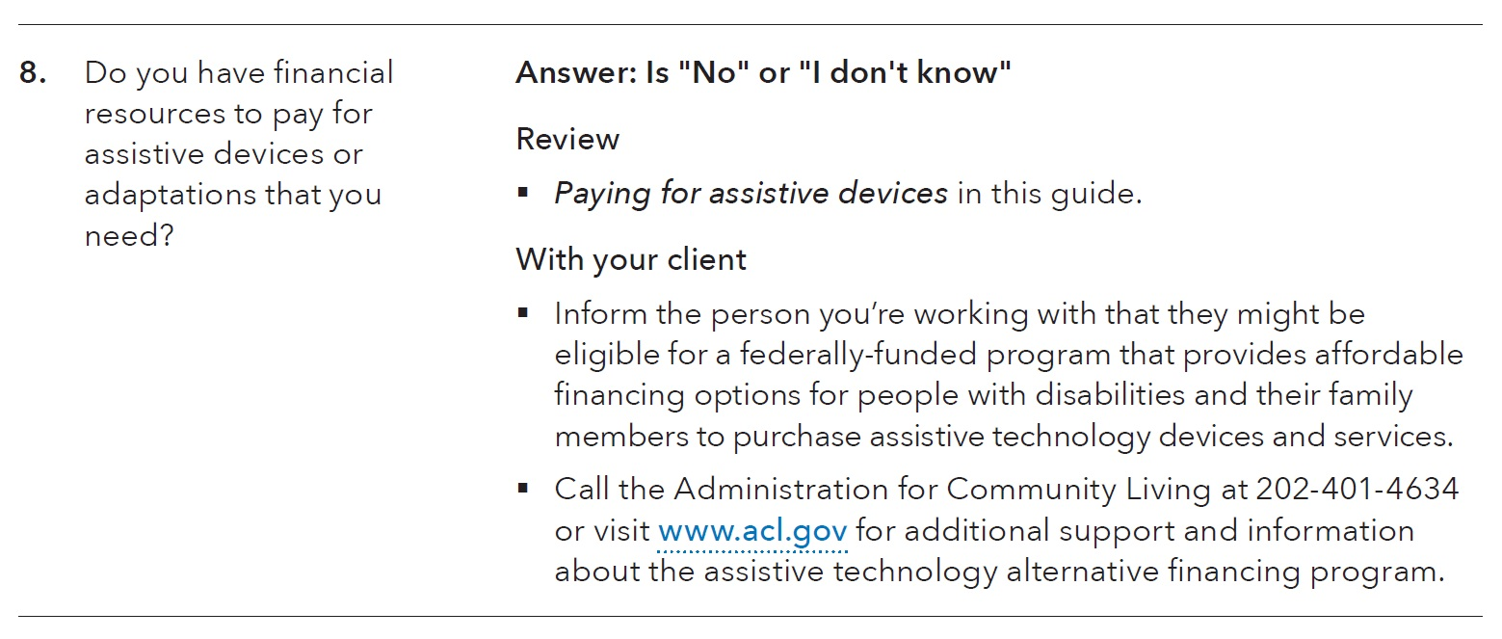
Tool: Starting the money conversation, response key
Use to analyze responses
Determine where to start the financial empowerment discussion.
Notes:
Instructions for Presenter:
This version of the tool has a response column for the intermediary, to use. Based on the answers that people provide, the intermediary can use that response column to connect them to helpful tools and information in both the Your Money, Your Goals toolkit and the Focus on People with Disabilities companion guide.
Provide this example: Suppose a person answers “no” or “I don’t know” to Question 8, which reads, “8. Do you have financial resources to pay for assistive devices or adaptations that you need?” The response key suggests that you respond by reviewing the information and tool on paying for assistive devices in the guide and also sharing information on financing options available through federal, state, and local programs.

Slide 14
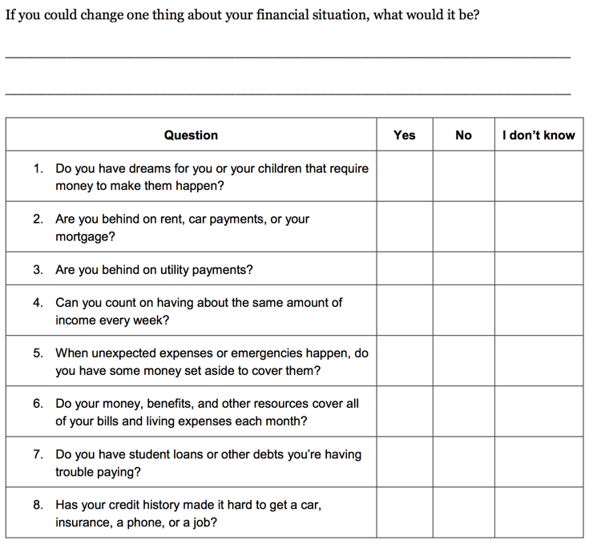
Introduction Part 2, Tool 1: My money picture

Slide 15
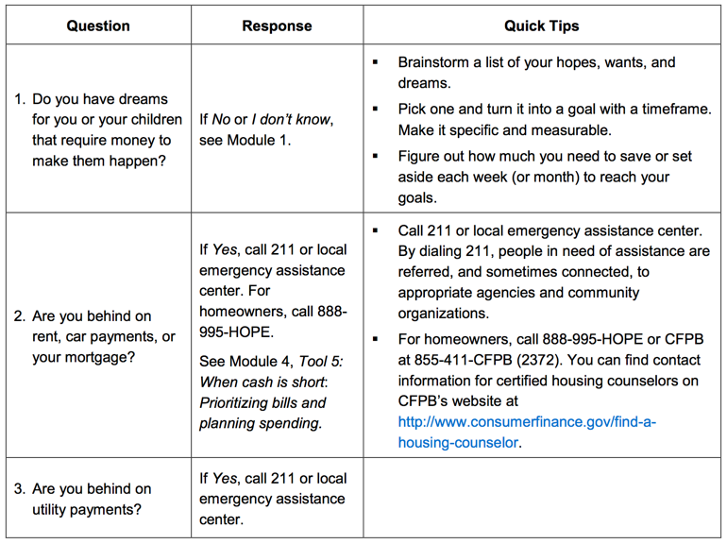
Introduction Part 2, Tool 1: My money picture

Slide 16
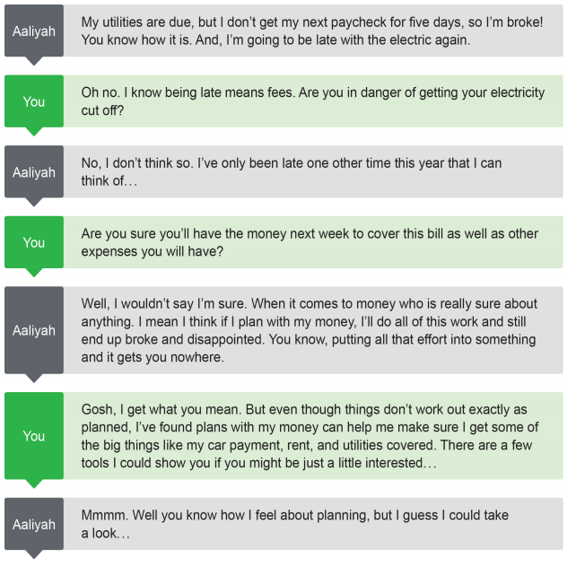
Make the most of short-term contacts
Broaden the conversation
Respond when people initiate - directly or indirectly

Slide 17
Scavenger Hunt: Where would you start if someone...
Felt overwhelmed by debt?
Felt like she couldn’t make ends meet?
Wants to buy a car and get the best rate she can for the money she must borrow?
Wants to understand direct deposit and payroll cards?
Has used high-cost credit products in the past and wants to avoid these in the future?
Wants to make changes but does not have clear goals?
Has no savings but wants to start?
Wants to open an account but doesn’t know what kind of account or where?
Notes:
In Groups of 3 or 4 – what part of the Focus on People with Disabilities or Toolkit would you go to for answers to these questions???

Slide 18
Break

Slide 19
Scavenger Hunt II: What would you do if someone...
Wants to file for bankruptcy?
Wants to know how to respond to a creditor’s threat to sue?
Is facing eviction?
Is facing foreclosure?
Is not able to provide enough food for herself and other members of her household?
Is in danger of losing her car due to nonpayment?
Wants to take out a debt consolidation loan?
Wants to know how to finance her child’s college?

Slide 20
Module 1: Setting goals and planning for large purchases
Setting goals is an essential part of the foundation for achieving self-sufficiency. Goals can also help people plan how to use their money.
Examples of large goals:
  Paying for assistive devices
  Buying a car
  Paying for adaptations to vehicles
  Paying medical expenses
  Renovating your home
  Paying for training or post-secondary education
SMART Goals
Notes:
Instructions for Presenter:
Introduce the topic of this module:
Goals can be the foundation for building greater self-determination. They provide direction for how to use resources including money.
You can also use this module to help people plan for both life events and large purchases. Life events are often major milestones or events in a person’s life; for example, graduating from high school, getting married, or getting a job.
Examples of large purchases may include paying for assistive devices, buying a car, adaptations to vehicles, paying medical expenses, renovations to your home, and paying for training or post-secondary education.
In the Your Money, Your Goals toolkit, this module describes and uses the SMART approach to developing goals. SMART is an acronym. SMART goals are Specific, Measurable, Able-to-be-reached, Relevant, and Time bound. The module also suggests ways to talk to people about turning their hopes, wants, and dreams into SMART goals.
Note to trainer: Prior to your training, review the slides on this topic in the Your Money, Your Goals training deck and copy and paste slides that you wish to cover into this PowerPoint file. In particular, consider whether interactive exercises from the Your Money, Your Goals training deck would support your coverage of this topic. Feel free to adapt activities as needed, especially to make them work for everyone, making adjustments to accommodate participants that have disabilities.

Slide 21
SMART goals
Specific
Measurable
Able to be reached
Relevant
Time-framed

Slide 22
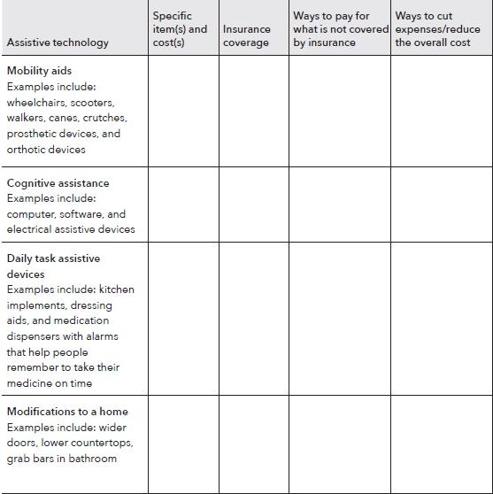
Focus on People With Disabilities Tool: Paying for assistive devices
Notes:
Instructions for Presenter:
Introduce the tool:
Focus on People with Disabilities adds general information on setting goals and planning for large purchases. The guide contains a new tool: Paying for assistive devices.
For many people with disabilities, assistive devices may help the person achieve independence so they can reach their other goals. Assistive devices may be large purchases, requiring more money than a person can reasonably expect to have after covering their basic living expenses.
Use this tool to help someone identify the assistive devices they need or want, how to reduce the costs, and how to pay for these items.
“Paying for assistive devices” includes nine categories with examples. The categories are:
Mobility aids
Cognitive assistance
Daily task assistive devices
Modifications to a home
Modifications to a vehicle
Educational assistive devices
Assistive technology for people who are deaf or hearing impaired
Assistive technology for people who are blind or visually impaired
Other
Explain how it works. Working column-by-column, use this tool to:
Read through at the column to the far left and identify all the assistive technology that you need and the cost. If you do not know what you need or what your options are, you may be able to get an assistive technology evaluation. Check with your medical provider for a referral.
In the third column, figure out if your health insurance will pay for part or the entire item. If you have health insurance, prior authorization may be required. The assistive device or service must be medically necessary. You may need a letter of medical necessity or prescription from your doctor.
In the fourth column, identify potential ways to pay for the items.
Finally, in the fifth column, identify ways to keep the costs as low as possible. You may qualify for a federally-funded Alternative Financing Program that provides affordable financing to purchase assistive technology. Contact your local department of rehabilitation for additional support and information.

Slide 23
More on Setting goals and planning for large purchases
In the Your Money, Your Goals toolkit:
Tool 1: Goal-setting tool
Tool 2: Planning for life events and large purchases
Tool 3: Buying a car
Notes:
Instructions for Presenter:
Share that the Your Money, Your Goals toolkit offers additional tools on this topic:
Use Tool 1: Goal-setting tool to set SMART goals, make plans, and figure out weekly savings target.
Use Tool 2: Planning for life events and large purchases to anticipate and plan for the expenses associated with these events.
Use Tool 3: Buying a car to discuss key considerations before buying a car.

Slide 24
Module 2 in Focus On People With Disabilities: Saving for emergencies, bills, and goals
What is saving?
Notes:
Instructions for Presenter:
Facilitated Discussion and Small Group Brainstorm
Ask participants to share their definition of saving.
Note to trainer: Prior to your training, review the slides on this topic in the Your Money, Your Goals training deck and copy and paste slides that you wish to cover into this PowerPoint file. In particular, consider whether interactive exercises from the Your Money, Your Goals training deck fit would support your coverage of this topic. Feel free to adapt activities as needed, especially to make them work for everyone, making adjustments to accommodate participants that have disabilities.

Slide 25
Module 2, continued
What is saving?
Setting aside resources today so they can be used in the future. It’s about balancing your resources to take care of your family and community.
Finding a safe and secure place for savings
How covering emergency needs with savings can save money
How to build up savings
Savings, benefits, and asset limits
Notes:
Instructions for Presenter:
Facilitated Discussion and Small Group Brainstorm, continued
After you have asked participants to share their definition of savings:
Share definition of savings using slide.
Move to next slide for activity

Slide 26
Module 2, continued
What are examples of unexpected expenses or emergencies?
Notes:
Facilitated Discussion and Small Group Brainstorm, continued
Have participants list examples of unexpected expenses or emergencies in small groups on flip chart paper using marker.
After 3 minutes, ask participants to circle those they think could be handled with $1,000 or less.
Instruct groups to post their flip charts and share cumulatively.
Make summary comments about the number of unexpected expenses that can be managed with $1,000. Contrast to the “conventional wisdom” advocating 3 - 6 months’ worth of living expenses.
Explain that $500 to $1,000 is a possible goal for most—they can imagine it and it can make a very, very big difference.
Explain that having $500 to $1,000 to cover emergencies and unexpected expenses can help avoid debt.
Also explain the following: Once people see they can save this much, then they can work toward 1 month’s living expenses, 3 months’, etc. over the longer term.
Presentation
Module 2: Saving for emergencies, bills, and goals in the Your Money, Your Goals toolkit provides you with information and tools to help you discuss saving with the people you serve.
The module discusses the importance of setting aside money today into a place that is safe and secure for use in the future.
It includes a concrete example of how covering emergency needs with savings can save money.
It provides information on how to build up savings and do so in a stable, worthwhile manner.
It also touches on savings and benefits, and the asset limits that are often important to people with disabilities.

Slide 27
Building savings while receiving public benefits
Benefits payments often come with restrictions that limit options for making money and saving.
There are savings options for individuals with disabilities that do not impact the asset limits associated with SSI, Medicaid, or other benefits.
  ABLE Accounts
  Individual Development Accounts (IDA)
  Plans to Achieve Self-Support (PASS)
  Special needs trusts and pooled trusts
All of these choices are complicated and you may need more information after using this introductory summary.
Notes:
Instructions for Presenter:
If a person decides to make changes in their life and finances, they must follow complex rules to keep essential benefits.
The people you serve may avoid saving for fear of losing their public benefits. Because savings are an asset, the relationship between asset limits and public benefits is addressed within this module.
Focus on People with Disabilities extends that discussion of saving to review four ways people with disabilities can save while receiving public benefits. Note that All of these choices are complicated and you may need more information after using this introductory summary. But this information will get you started.
Those ways to save are:
ABLE Accounts
Individual development accounts (IDA)
Plans to Achieve Self-Support (PASS)
Special needs trusts and pooled trusts
We’ll review the first three in some depth. For special needs trusts and pooled trusts, start by consulting the Social Security Administration website (www.ssa.gov).

Slide 28
ABLE Accounts
Important new resource for people with disabilities
Savings in ABLE Accounts do not affect eligibility for:
  Supplemental Security Income (SSI)*
  Medicaid and other federal means-tested benefits*
The maximum total annual contribution is $15,000 (2018)
ABLE programs are established and maintained by individual states. An eligible person can open an account:
  North Carolina program:
    https://savewithable.com/nc/home.html
  In any state program that accepts out of state residents.
* See Focus on People with Disabilities for details on limitations.
Notes:
Instructions for Presenter:
Present slide content.
Regarding ABLE savings:
Only money in an ABLE Account exceeding $100,000, plus any distributions toward qualified housing expenses and non-qualified disability expenses retained beyond the month of distribution, may be counted as a resource for SSI.
The maximum allowable value of an ABLE Account in a given state is based on the 529 plan limits established by that state. A 529 is an educational savings plan designed to help families’ set-aside money for future college costs. Many states have set this limit at more than $300,000 per plan.
Other rules apply: The maximum total annual contribution to an ABLE Account for a single tax year is subject to the IRS gift tax exclusions, which is $15,000 for 2018.
There are 34 ABLE programs as of March 2018, and most accept out-of-state residents. Potential account-holders will have many opportunities and options.
People with disabilities can switch their program once per calendar year. If they do not like a state’s program, or a better one comes around, they can switch without penalty.

Slide 29
Eligibility for ABLE Accounts
The designated beneficiary is the eligible individual who established and owns the ABLE Account. To be eligible for an ABLE Account, a person must be:
Eligible for Supplemental Security Income (SSI) based on disability or blindness that began before age 26;
Entitled to disability insurance benefits (DIB), childhood disability benefits (CDB), or disabled widow’s or widower’s benefits (DWB) based on disability or blindness that began before age 26; or
Someone who has certified, or whose parent or guardian has certified, that the person has a medically determinable impairment meeting certain statutorily specified criteria, or is blind; and, the disability or blindness occurred before age 26.
Notes:
Instructions for Presenter:
Present slide content.
Regarding age requirement: it does not matter how old somebody is right now – so long as they acquired their disability before age 26.
For example, somebody who had a spinal cord injury when they were 25 would still be able to open an account, even if they are currently 40 years old.
Somebody with a developmental disability could open an account if they are currently 22, or any later age.
Somebody does not need to be an adult. A parent or legal guardian can establish an ABLE Account on behalf of a child or adolescent.

Slide 30
Qualified disability expenses for ABLE Accounts
ABLE savings funds can be spent on “qualified disability expenses.” These may include:
Education
Housing
Transportation
Employment training and support
Assistive technology
Personal support services
Health care expenses
Financial management and administrative services and other expenses that help to improve health, independence, or quality of life
Notes:
Instructions for Presenter:
Present slide content.
When savings from an ABLE Account are used for something that is not a qualified disability expense, a portion of the withdrawal that is attributable to earnings will be treated as income for tax purposes. It will be taxed at the person’s tax rate, and will be subject to a 10% federal tax penalty as well as applicable state taxes.

Slide 31
Individual Development Accounts (IDAs)
An IDA is a matched savings account that the account owner uses to acquire a designated type of asset: their “asset goal.”
Common asset goals include:
  Home
  Post-secondary education
  Capital for a small business
IDA holders earn a “match” each time they deposit funds into their IDA.
Some programs will match only up to a certain dollar amount (say, $500) on an annual basis or during the course of the program.
Notes:
Instructions for Presenter:
Present slide content.
Ask participants if they are aware of local IDA programs and to share the names of those programs with the group.

Slide 32
IDAs and SSI Benefits
A federally-funded IDA program enables a person to save without reducing SSI benefits, and IDA savings are not subject to that program’s “asset test.”
Any IDA included in an SSA-approved Plan to Achieve Self-Support (PASS) will not affect SSI benefits.
If a person saves in an IDA that is not federally-funded or part of their PASS, then it could be counted as a resource when determining eligibility for public benefits such as SSI.
Notes:
Instructions for Presenter:
Present slide content.
If a person saves in an IDA that is not federally-funded or part of their PASS, then it could be counted as a resource when determining eligibility for public benefits such as SSI.

Slide 33
IDA Programs
IDA programs funded through the Assets for Independence (AFI) program are federally funded: http://idaresources.acf.hhs.gov.
Although IDA programs’ eligibility criteria can vary, many require that:
  Participants have low-income, commonly defined as being at or below 200% of the Federal Poverty Guidelines.
  Participants have earned income to use toward deposits into their IDAs.
In many programs, participants complete financial education before or during enrollment in the IDA program.
Notes:
Instructions for Presenter:
Present slide content.

Slide 34
Plan to Achieve Self-Support (PASS)
A PASS is for people who are already receiving SSI or would be eligible by having a PASS, and want to save for a work-related goal.
“The objective of a PASS is to help a person with disabilities find employment that reduces or eliminates SSI or SSDI benefits.” – Social Security Administration
Ordinarily, monthly benefits would be reduced if the person has other countable income.
However, with a PASS, a person can set aside money for work goals that could involve starting a business, going to school, or getting training for a job.
Notes:
Instructions for Presenter:
Present slide content.

Slide 35
Other potentially eligible uses for PASS funds:
Transportation to and from school or work
Tuition, books, fees, and supplies needed for school or training
Child care
Attendant care
Employment services, such as job coaching and resume writing
Assistive technology used for employment-related purposes
Supplies to start a business
Equipment and tools to do the job
Uniforms, special clothing, and safety equipment
Notes:
Instructions for Presenter:
Present slide content.

Slide 36
PASS work and vocational goals
The person’s work goals must include earning income that will partially or completely reduce their SSI benefits.
They can also be currently employed and use a PASS to reduce or end their dependence on disability benefits.
If the plan is for self-employment, meaning starting a business, the person must create a detailed business plan as part of PASS.
The vocational goals must be “reasonable,” given any disability-related limitations. This will be determined during the application process.
Notes:
Instructions for Presenter:
Present slide content.

Slide 37
Tool: Setting up an ABLE Account
For many people with disabilities, saving may not seem to be an option that’s available to them.
This is because when people receive public benefits, some benefit programs may have “asset limits.”
There are savings options, however, that do not count against these asset limits.
This tool can be used to help people with disabilities understand what an ABLE Account is and some of the things they may want to consider if they want to open one.
Notes:
Instructions for Presenter:
Present slide content.
Asset limits cap the amount of savings and other resources you can have and still maintain eligibility for certain public benefits. When a program has asset limits, savings may impact a person’s eligibility for that type of assistance.

Slide 38
Setting up an ABLE Account: Main steps
Ask these questions to determine if an ABLE Account is an option for you.
  Do you meet the eligibility requirements?
  Do your goals match the qualified disability expenses allowed that can be paid from an ABLE Account without incurring taxes?
  Do you have the minimum contribution required to open an account?
  Can you continue to make contributions to the ABLE Account once it’s opened?
Fill in the worksheet on the next page to compare features of different plans if you determine you would like to open an ABLE Account.
Notes:
Instructions for Presenter:
Present slide content.
Share the following information from Focus on People with Disabilities if it is of interest to your participants and time permits. Alternatively, let participants know that Focus on People with Disabilities covers ABLE Accounts in detail and that they can use their copies of the guide as a reference following the training.
Additional Detail on ABLE Accounts
Eligibility requirements. To be eligible, people must:
Have a significant disability with the age of onset of the disability that began 26 years of age, and
Are receiving benefits from SSI and/or SSDI, or are eligible to file a disability certification with a qualified ABLE program, or
Meet the Social Security’s definition and criteria being significant functional limitations and receive a letter of certification from a licensed physician.
Do your goals match the qualified disability expenses allowed that can be paid from an ABLE Account without incurring taxes? Qualified disability expenses may include:
Education
Housing
Transportation
Employment training and support
Assistive technology
Personal support services
Health care expenses
Financial management and administrative services and other expenses that help to improve health, independence, or quality of life.
Do you have the minimum contribution required to open an account? This varies based on the requirements of each state program but is generally between $25 and $50.
Can you continue to make contributions to the ABLE Account once it is opened? Regular (monthly) deposits may not be required, but regular contributions to savings can help you grow your account faster. Remember that family and friends can also make contributions to your ABLE Account.
Be sure you find out:
How your money will be invested through an ABLE Account
Fees you may have to pay to open and maintain your account
Whether there are advantages available to in-state residents
Penalties that may be charged
Other benefits the account may provide, such as checks or a debit card
For a list of ABLE Accounts offered by state, visit the ABLE National Resource Center at: www.ablenrc.org

Slide 39
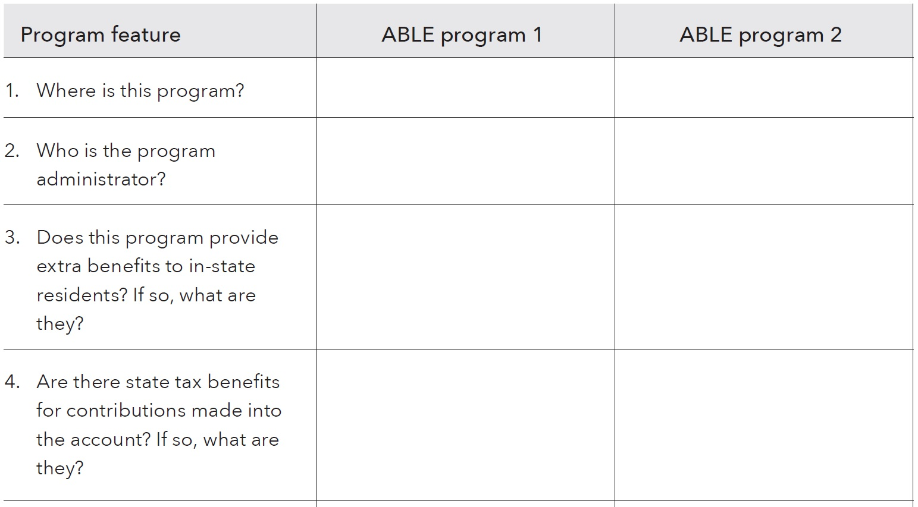
ABLE tool worksheet
Notes:
Instructions for Presenter:
A person can use this worksheet to compare the details of different ABLE programs to help find the program that meets their needs and goals. For a list of available programs and program features, visit: https://www.ablenrc.org.
States’ programs have many features ranging from investment options to program fees, and individuals can compare program features to decide which one is best for them.
The ABLE Tool Worksheet provides a table to compare program features in a way that can help individuals make those decisions. As of 2018, there are over 30 active programs – so individuals may choose to compare many programs instead of just 2, side-by-side.
The Tool Worksheet is a table that includes 11 questions to consider when opening an ABLE Account. Here is a sample section of the Worksheet.
In this slide, explain the format and how the table can help compare programs. The left column includes a series of questions to compare each program: this screenshot has 4 of them, but there are 11 overall. The 2nd column can help lay out the program features for one state’s program, and the 3rd column lays out features for another state’s program.
Individuals fill these out to compare programs, then review the features to decide which they would prefer.
On this slide, read through each of the program features on the left and why it may be important to somebody opening an ABLE Account. The full set of questions on the worksheet are:
Where is this program?
Who is the program administrator?
Does this program provide extra benefits to in-state residents? If so, what are they?
Are there state tax benefits for contributions made into the account? If so, what are they?
Does this program offer various saving and investing options? If so, what are they?
Are there fees for keeping the account open? What are they?
Are there limits on disbursements from the account? If so, what are they?
Does this program offer a debit card? If so, what is the fee to use it?
Does the program offer check writing?
Are there other features that are important to you?

Slide 40
ABLE tool worksheet example
Iowa | Illinois
Ascensus | Office of the Illinois State Treasurer
Yes: State tax deduction for contributions by in-state residents. | No
Yes: $3,319 of contributions are deductible for Iowa individual income tax purposes | No
Notes:
Instructions for Presenter:
Explain that this table is filled in comparing two ABLE programs: Ohio and Illinois. A person can find this information through their own research, and most is also available at www.ableNRC.org. As you move through the Worksheet, read aloud the text that is in the table. Start with the information in the left-hand column (“program feature”), then the info in the 2nd column (“ABLE program 1”), and then the info in the 3rd column (“ABLE program 2”). So, for example:
“The worksheet asks “where is this program?” The first program we will look at is Iowa, and the 2nd is Illinois.
Another feature to consider is “who is the program administrator?” For Iowa, it is Ascensus. And for Illinois, it is the Office of the Illinois State Treasurer.
And so on. If you feel comfortable, you may elaborate on why these are important factors to consider.

Slide 41
Other ABLE program features
ABLE Tool Worksheet also includes:
Does this program offer various savings and investing options? If so, what are they?
Are there fees for keeping the account open? If so, what are they?
Are there limits or fees on disbursements from the account? If so, what are they?
Does this program offer a debit card? If so, what is the fee to use it?
Does the program offer check writing?
Are there other features that are important to you?
For a list of ABLE Accounts offered by state, visit the ABLE National Resource Center at: https://www.ablenrc.org.
Notes:
Instructions for Presenter:
These are the other program features that are included in the ABLE Account Tool in Focus on People with Disabilities. Different programs have many features, so a person may not prefer every feature in one program over another. This tool simply provides the option to compare programs and decide which works best overall.
There are also over 30 state programs as of 2018, with more on the way. With that in mind, it may be wise to explore many states to find the best program for a person’s needs.
It is possible to change programs once per calendar year, and many programs are changing their features (such as adding debit cards) while other new programs are opening up. So although somebody may feel stress about picking the perfect program, they will have the opportunity to switch their account in the future if they choose to.

Slide 42
More on saving for emergencies, bills, and goals
In the Your Money, Your Goals toolkit:
Tool 1: Savings plan
Tool 2: Savings and benefits
Tool 3: Finding a safe place for savings
Tool 4: Increasing your income through tax credits
Notes:
Instructions for Presenter:
Share that the Your Money, Your Goals toolkit offers additional tools on this topic:
Use Tool 1: Savings plan to help you plan for and build your savings.
Use Tool 2: Savings and benefits to better understand how benefits may impact ability to save.
Use Tool 3: Finding a safe place for savings to better understand the benefits and risks of different places to put your savings so you can make the best choice for you.
Use Tool 4: Increasing your income through tax credits to learn more about tax credits that may increase your income.

Slide 43
Subsection 2: Budgeting
Notes:
Instructions for Presenter:
Introduce Subsection 2: Budgeting
Module 3: Tracking and managing income and benefits and Plan to Achieve Self Support (PASS)
Tool: Income and benefit tracker
Tool: SSI estimator
Module 4: Paying bills and other expenses
Tool: Spending tracker
Module 5: Getting through the month
Tool: Bill calendar
Tool: Budget

Slide 44
Module 3: Tracking and managing income and benefits
Helping people track their spending and income can help them identify whether they are on track to achieve their financial goals.
For many people with disabilities, tracking income may mean tracking their benefits payments.
Because earnings can offset and reduce benefits, some people with disabilities don’t believe they can work without making themselves worse off financially.
People with disabilities, like people without disabilities, have the right to work free from employment discrimination.
Notes:
Instructions for Presenter:
Present slide content.
Note to trainer: Prior to your training, review the slides on this topic in the Your Money, Your Goals training deck and copy and paste slides that you wish to cover into this PowerPoint file. In particular, consider whether interactive exercises from the Your Money, Your Goals training deck would support your coverage of this topic. Feel free to adapt activities as needed, especially to make them work for everyone, making adjustments to accommodate participants that have disabilities.

Slide 45
Module 3 in Focus on People with Disabilities
While work income may mean a reduction in benefits over time, it does not necessarily mean benefits will be stopped immediately.
When a person with a disability wants to work, then it is essential to provide information about income levels that:
  Can make benefits decrease.
  Can make them lose eligibility for benefits.
Income: Regular income, irregular income, seasonal, one-time occurrences
Benefits: SSI, SSDI, others
Notes:
Instructions for Presenter:
Present slide content.

Slide 46
“A Closer Look” sections in Focus on People With Disabilities
A CLOSER LOOK: Workforce Investment Opportunity Act (WIOA)
The Workforce Investment Opportunity Act (WIOA) provides new opportunities for people with disabilities because key provisions of the Act strengthen services to youth and adults with disabilities.
A CLOSER LOOK: Representative payee
A representative payee is a person or an organization. The Social Security Administration appoints a payee to receive the Social Security or SSI benefits for anyone who can’t manage or direct the management of their benefits.
Notes:
Instructions for Presenter:
Present slide content.
For the representative payee section, you can note that “A trusted family member or friend can be nominated to be a representative payee, but is subject to the Social Security Administration’s approval. “
Much more content on WIOA and representative payee is available in the “A Closer Look” sections in Focus on People with Disabilities

Slide 47
Tool: Income and benefit tracker
A first step to financial empowerment is tracking income and financial resources.
Use this tool to help a person you serve understand the amounts and timing of their financial resources and income.
Encourage the person you serve to track their income and financial resources for a day, a week, two weeks, or a month.
It may be the first time they understand where they get their money and how much they have to work with.
Explain the difference between gross and net income.
Notes:
Instructions for Presenter:
Present slide content.
Note that a very similar tool is also found in Behind on Bills. There is an income and resource tracker that is included in the Your Money, Your Goals toolkit that is different, but that serves a similar function.

Slide 48
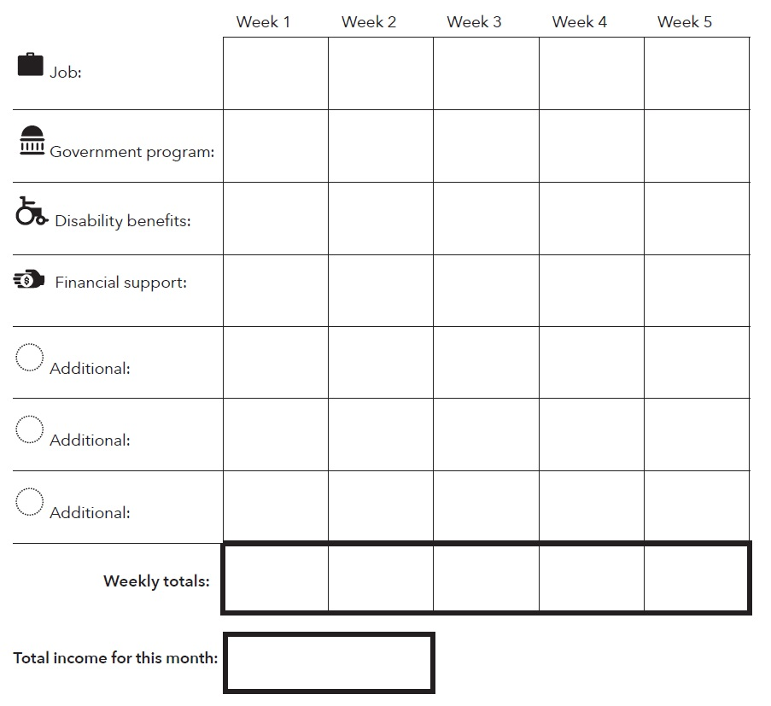
Using the Income and benefits tracker in Focus on People With Disabilities – p.44
Notes:
Instructions for Presenter:
Use this income and benefit tracker to plan the best times to save and to spend. (Net income is your total take home pay. Take your gross income minus taxes and other deductions to get your net income.)
Write in the names of any income and benefits that apply to you.
Fill in the amounts you receive each week.
Total up each week’s income.
Circle the payments that come at a predictable time and amount. This will show you the income you can count on each month.
A person should use the tracker in an accurate way, but can do it however is most comfortable for them. For example, they could:
Write their income or other financial resource directly into the tracker.
Ask someone to help write their income or financial resources into the tracker.
Record a voice memo each time they receive income or benefits and have that written into the tracker at the end of a day or week.
Take pictures of their income or benefits and have that written into the spending tracker at the end of a day or week.
Use a smart phone application to track income and financial resources.
Categories used in income tracker:
Job: Income from employment, including, self-employment, and seasonal work.
Government program: Any public benefit, including, Temporary Assistance for Needy Families (TANF), Supplemental Nutrition Assistance Program (SNAP), and Medicaid.
Disability benefits: Supplemental Security Income (SSI) or Social Security Disability Insurance (SSDI) .
Financial support: Stipend, allowance, scholarship, child-support, gifts.
Additional: Tax-refunds, gifts, help from family or friends.

Slide 49
Using the Income and benefits tracker
$300 | $300 | $300 | $300 | $0
$177.5
$477.5 | $300 | $300 | $300 | $0
$1377.50
Notes:
Instructions for Presenter:
Here is a simple example of the Income and benefits tracker for somebody who has SSI and earns $300 per week as a cashier. The federal rate for SSI was $735 per month in 2017, but using the SSI calculation (which we’ll show later), SSI goes down to $177.50 for somebody earning $1200 per month. So, in this example:
Somebody would earn $300 in every week of the tracker from their cashier job
They would receive $177.50 in SSI right at the beginning of the month
Weekly totals would be $477.50 in week one, then $300 in week 2, week 3 and week 4
Total income for the month would be $1377.50.
This is a simple example with just one job and SSI, but people may have many sources of income. Regardless of their situation, though, this tool helps people to understand their monthly budget and much may be available at each point in the month.

Slide 50
Tool: SSI estimator in Focus on People With Disabilities pp. 47-48
Use this tool to help a person with a disability understand how earnings from work affect their SSI benefit.
Go through each point in the tool and work out the math with the person you are serving.
First, when a person earns money through a job, they keep the first $85 of their pay without any impact on their SSI. For every dollar they earn after that, SSI drops by 50 cents.
Many people think that getting paid at a job will stop their SSI check, but that’s not necessarily true.
In fact, the more a person works, the more they make overall, even on SSI.
Notes:
Instructions for Presenter:
Present slide content.
Right now, the Federal SSI monthly benefit is $750 per month. In 2017, it was $735 (this is the amount the SSI tool uses). Some states pay more, depending on where you live. When you work, it changes the size of your monthly check – but no matter what, when you work you will have more money in your pocket than if you don’t work at all.

Slide 51
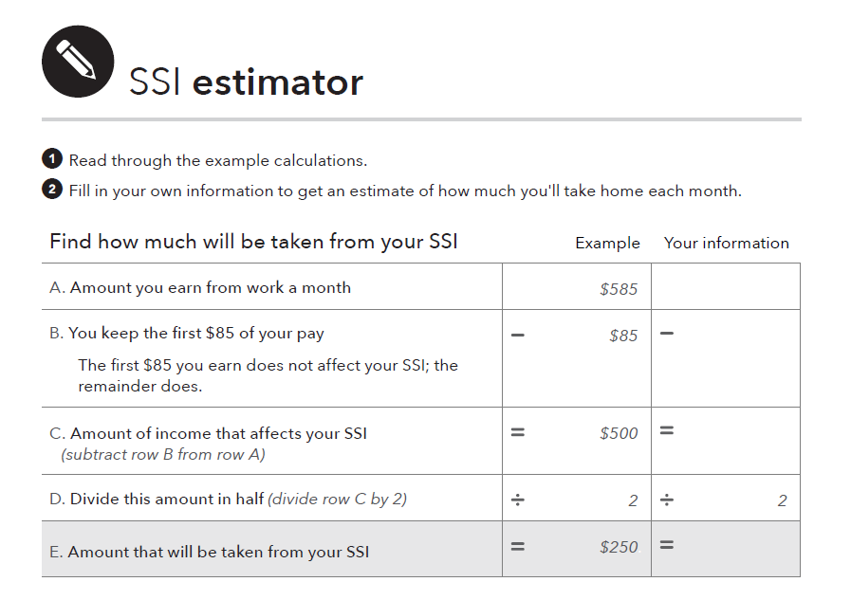
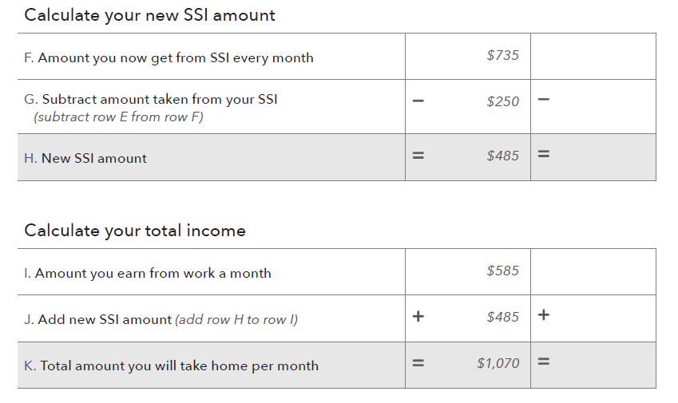
Using the SSI estimator
Notes:
Instructions for Presenter:
Go through each point in the tool and work out the math with the person you are serving.
The Federal SSI monthly benefit was $735 per month in 2017. (it is $750 in 2018) Some states pay more, depending on where you live. Eligible couples receive $1125/month (2018), and blind adults have higher SSI rates for individuals and couples.
First, when you earn money through a job, you keep the first $85 of your pay without any impact on your SSI.
For every dollar you earn after that, SSI drops by 50 cents.
Help them see that even though their benefit is reduced, it’s only reduced by $.50 for every dollar earned.
Note that:
The rules are slightly more complicated, especially if somebody has “unearned income” such as Social Security Disability Insurance (SSDI). This is covered in the SSI estimator tool.
Somebody may be able to keep their SSI benefit even higher if they mark down Impairment Related Work Expenses (IRWEs) or other strategies.
Rules for SSI are different than the rules for SSDI. The SSI estimator only covers SSI.

Slide 52
Using the SSI estimator: Example Part 1
$1200
$85
$1115
$557.50
Notes:
Instructions for Presenter:
There is an example in the SSI estimator, with smaller text. Here is another example from the person that was earning $300/week ($1200/month) in the previous income and benefits tracker (in the right-hand column). This section is the 1st half of the full estimator, which continues on the next slide. Let’s see how it works:
The person earns $1200 from work in a month.
Subtract $85 from $1200 to get $1115. This is the amount of income that affects their SSI.
Divide $1115 by 2, to get $557.50. That is the amount that will be taken from their SSI.
Continue to the next slide…

Slide 53
Using the SSI estimator: Example Part 2
$735
$557.50
$177.50
$1200
$177.50
$1377.50
Notes:
Instructions for Presenter:
Continuing from the previous slide, where somebody had $557.50 that will be taken from their SSI:
Take their current SSI amount of $735 (the federal amountin 2017)
Subtract the new amount taken from their SSI ($557.50).
This leaves $177.50, which is their new SSI amount.
To calculate their new total income:
Take the amount they earned from work: $1200/month.
Add their new SSI amount: $177.50 .
This is the total amount per month: $1377.50.
You can note that this amount is more than they would originally have, by not working (just the regular SSI rate of $735).

Slide 54
More on Tracking and managing income and benefits
In the Your Money, Your Goals toolkit:
Tool 1: Income and resource tracker
Tool 2: Ways receive income and benefits
Tool 3: Ways to increase cash and financial resources
Notes:
Instructions for Presenter:
Share that the Your Money, Your Goals toolkit offers additional tools on this topic:
Use Tool 1: Income and resource tracker to help you understand when and how much income and benefits you receive.
Use Tool 2: Ways receive income and benefits to better understand the benefits and risks of different ways of receiving income and benefits.
Use Tool 3: Ways to increase cash and financial resources to identify ways to possibly increase your income or financial resources.

Slide 55
Module 4: Paying bills and other expenses
Spending
Money you use to pay for a wide range of basic needs, your financial obligations, and other things you may want.
The way people use their money is often a reflection of their values. When it comes to how the people you serve spend their money, it helps to avoid implying your own personal values and judgement.
Notes:
Instructions for Presenter:
Present slide content.
Note to trainer: Prior to your training, review the slides on this topic in the Your Money, Your Goals training deck and copy and paste slides that you wish to cover into this PowerPoint file. In particular, consider whether interactive exercises from the Your Money, Your Goals training deck fit would support your coverage of this topic. Feel free to adapt activities as needed, especially to make them work for everyone, making adjustments to accommodate participants that have disabilities.
Optional Exercise: Needs, Wants, and Obligations
Review the definition of spending.
Review the definitions of needs, wants, and obligations:
Needs are things you must have to live.
Wants are things you can survive without.
Obligations are things you must pay because you owe someone money (a car loan) or have been ordered to pay someone (child support).
Tell people you are going to read off a list of items that you could spend money on. Use the list of example expenses below or use others that may be more contextually or culturally relevant to the people you are training. Limit the number of examples to 4 – 6.
Ask participants to “vote” for the what best represents the category they would put that item in: need, want, or obligation. Depending on the preferences of your group—especially any issues related to a disability—choose a voting method that works for everyone. Options include:
Making the noise of a different barnyard animal (e.g., pig = want, cow = need, goat = obligation).
A poll facilitated by one of the free online polling services that are available. People vote using their phone and the results appear on the screen or wall you are projecting on.
Raised hands. This requires that, for each example expense (see below), you ask the group “How many of you think this is a want?” “How many think it is a need?” “How many think it is an obligation?”
After you read each item, facilitate a discussion to uncover the reasons people have voted the way they have.
Be sure to ask questions like:
What are some of the reasons you see the item as a need? Want? Obligation?
What could be some of the reasons people see the same item so differently?
How does this relate to your work with people?
Example expenses:
Rent
Savings for vacation
Cell phone including data plan
Paper towels
Personal grooming related expenses
Bottled water
Coffee (the kind you make at home)
Pet food
Credit card payment
Home-based Internet connection
Baby formula

Slide 56
Module 4: Focus on People with Disabilities
Depending on circumstances, some people with disabilities may have had limited choices in how to spend their money.
This could be because of age – if the person is a minor, a parent or guardian has made their spending decisions.
In some circumstances, even adults with disabilities may have had very limited opportunities to make decisions about the use of their money.
Use of income may be, or have been, controlled by a trustee, family member, or representative payee.
Notes:
Instructions for Presenter:
Present slide content.
Note that, in the case of others controlling the money:
The lack of opportunity for involvement may often come from a desire to protect a person with disabilities or, in the case of a trustee, from the rules of the trust itself.
In some cases, the family member or representative payee may believe they know what is in the person’s best interest or disagree with how the individual wants to spend their money.

Slide 57
Values, choices, and rights
Values about money may come from life experiences, culture, family, peers, and media.
Rather than judge how people spend, it’s important to give them the tools to make decisions and understand the possible results of those decisions.
People with disabilities, like all people, have the right to make choices with how their money is used, and they have the right to take risks.
Even when a person has assistance with paying their bills and other expenses, they should be consulted and involved in the process.
Notes:
Instructions for Presenter:
Present slide content.
With regards to values, “an item that may seem like a “want” or frivolous expenditure to one person may be an important expression of self to someone else.”
“Everyone takes risks with their money. Lessons learned from taking risks and making mistakes can be meaningful.”

Slide 58
Tool in Focus On People With Disabilities (p.53): Spending tracker
Use this tool to help a person you serve understand how they spend their money.
Encourage the person you serve to track their spending for a day, a week, two weeks, or a month.
With this information, they may realize where their money goes for the first time.
They can then make changes to how they spend their money.
The way a person tracks how they spend their money and financial resources does not matter. They should use whatever is most comfortable.
Notes:
Instructions for Presenter:
Present slide content.

Slide 59
Spending tracker: sample strategies p.51
Write your spending into the spending tracker.
Ask someone else to write your spending into the spending tracker.
Keep receipts for every time you use money and then fill in the spending tracker using the information from your receipts.
Record a voice memo each time you spend money and have that written into the spending tracker at the end of a day or week.
Take pictures of what you spend your money on and have that written into the spending tracker at the end of a day or week.
Use a smart phone application to track your spending.
Notes:
Instructions for Presenter:
Present slide content.

Slide 60
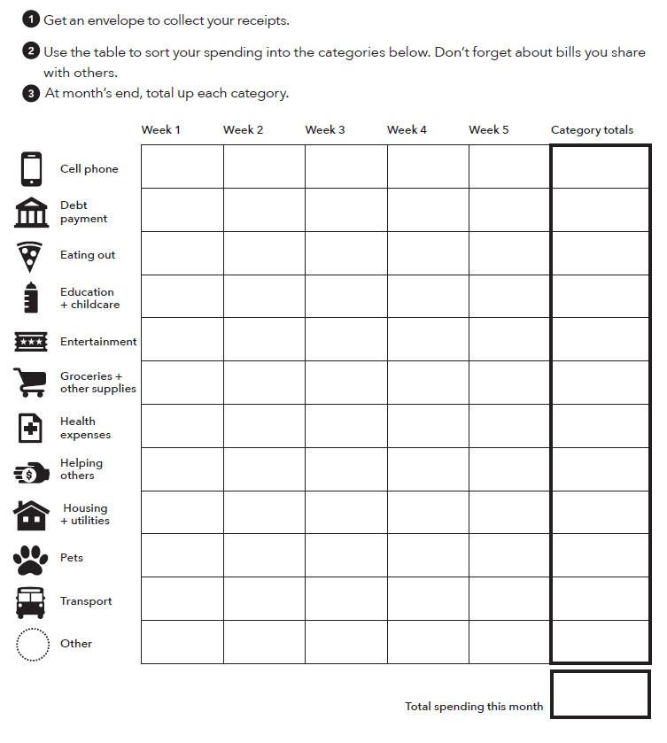
Using the Spending tracker
Notes:
Instructions for Presenter:
Review how the spending tracker works.
Get an envelope to collect your receipts.
Use the table to sort your spending into the categories below. Don’t forget about bills you share with others.
At month’s end, total up each category
This tracker allows for weekly tracking toward “category totals.” Tracking can happen on a daily, weekly or monthly basis. More detail on each category is available in Focus on People with Disabilities.

Slide 61
Using the Spending tracker
$50 |  |  |  |  | $50
$10 | $10 | $15 | $10 | $15 | $60
$10 |  |  | $10 |  | $20
$70 | $50 | $60 | $70 | $60 | $310
$60 | $15 | $20 | $10 | $10 | $115
$750 |  |  |  |  | $750
$40 |  |  |  |  | $40
 |  |  |  |  | $1,345
Notes:
Instructions for Presenter:
This example shows the screenshot with the numbers filled in for each category, per week and as a total for the month. It all adds up to $1,345. Even though Week 5 might include a few days that fall in the next calendar month, we're including the whole week in the Spending tracker for the purposes of getting handle on spending. [Depending on their goals, some people may choose to only include the expenses in the month that they are tracking.]
Explain that expenses happen on different schedules. For example,
The cell phone payment, bus pass, housing & utilities are all paid at the beginning of the month.
Otherwise, expenses might be paid out on a weekly basis.
Some things, such as groceries, might be more stable each week.
Other things, i.e. health expenses, might change without somebody having much control over them and might have a large premium at the beginning of the month, for example.
Other expenses, such as eating out and entertainment, are choices that can vary week by week.
People may not have expenses in some categories. For example, the sample person doesn’t have any debt to repay, doesn’t have any education or childcare expenses, is not “helping others,” and does not have any pets. If they have random expenses that don’t fit into the pre-set categories, though, they can create a new one in the “other” section or create a whole new row.

Slide 62
More on paying bills and other expenses
In the Your Money, Your Goals toolkit:
Tool 1: Spending tracker
Tool 2: Bill calendar
Tool 3: Ways to pay bills: Know your options
Tool 4: Strategies for cutting expenses
Tool 5: When cash is short—prioritizing bills and planning spending
Notes:
Instructions for Presenter:
Share that the Your Money, Your Goals toolkit offers additional tools on this topic:
Use Tool 1: Spending tracker to understand how you use your money now. This is similar to the tracker that is used in the Focus on People with Disabilities
Use Tool 2: Bill calendar to create a visual reminder of when your bills are due and how much is due.
Use Tool 3: Ways to pay bills: Know your options to better understand the advantages and disadvantages of different methods for paying bills.
Use Tool 4: Strategies for cutting expenses to identify ways to cut spending.
Use Tool 5: When cash is short—prioritizing bills and planning spending to help you develop a short-term plan to get through times when you do not have enough income to cover your needs, wants, and obligations.

Slide 63
Module 5: Getting through the month
Module 5: Getting through the month in the Your Money, Your Goals toolkit brings together the income and spending trackers from Modules 3 and 4 to help create a cash flow budget.
The cash flow budget tools let individuals see how much money comes in and where it goes out in spending.
The tools also demonstrate how people can make changes in the timing of spending to ensure financial resources and spending are balanced.
Notes:
Instructions for Presenter:
Explore what participants know about cash flow by asking: “What is a cash flow budget?”
After participants offer some ideas, share definition: A projection of how you will get and use your cash and other financial resources.
Contrast cash flow to regular budget by asking: “How is a cash flow budget different from a regular budget?”
After participants offer some ideas, share definition: A cash flow budget tracks the timing of income and spending. This is key.
ASK: What do you think may be the benefit of this approach for your clients?
Note to trainer: Prior to your training, review the slides on this topic in the Your Money, Your Goals training deck and copy and paste slides that you wish to cover into this PowerPoint file. In particular, consider whether interactive exercises from the Your Money, Your Goals training deck fit would support your coverage of this topic. Feel free to adapt activities as needed, especially to make them work for everyone, making adjustments to accommodate participants that have disabilities.

Slide 64
Module 5: Focus on People with Disabilities
Budgeting can help a person with disabilities gain and maintain control over their money.
Module 5 provides information and tools to help people make plans to get through the month – pay for all of their living expenses, bills, financial obligations, and other uses of income or financial resources, including saving.
For a person living on a fixed-income, a monthly budget can help them manage their income, benefits, and plan for their expenses.
Notes:
Instructions for Presenter:
Present slide content.

Slide 65
Tool: Bill calendar
Use this tool to help the people you serve avoid late fees and other consequences of late or nonpayment.
Helping them to list their bills and set up a bill calendar can help them see when bills are due.
Most people have reoccurring bills and expenses like rent, utilities, a car payment, and medical and insurance payments.
Most of these bills have a fixed cost due date, and paying late will likely result in an extra fee or a negative entry on a person’s credit history.
Notes:
Instructions for Presenter:
Present slide content.
Figuring out which to bills to expect throughout the month helps a person plan to have enough money or other financial resources to pay them.
It can also help a person think of ways to reduce your expenses over the course of the month.
A person you serve may find that thinking ahead helps reduce the stress when bills arrive in the mail.
A person should use whatever is most comfortable for then to keep track of their bills.

Slide 66
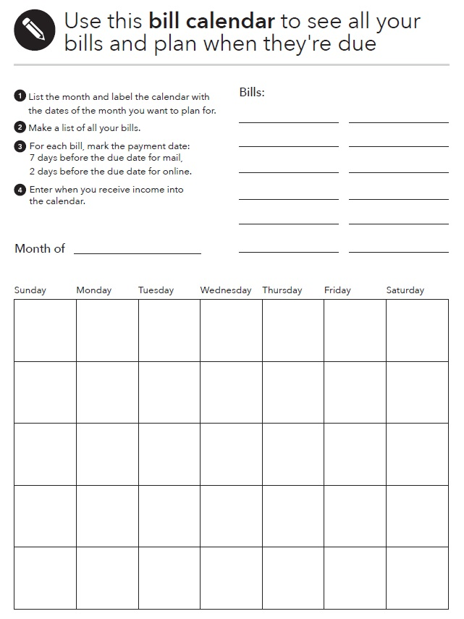
Using the Bill calendar
Notes:
Instructions for Presenter:
Use this bill calendar to see all your bills and plan for when they are due.
1. List the month and label the calendar with the days of the month you want to plan for.
2. Make a list of all your bills.
3. For each bill mark the payment date: 7 days before the due date for mail, 2 days before the due date for online.
4. Enter when you receive income and when your bills are due into the calendar.

Slide 67
Tool: Monthly budget in Focus On People With Disabilities p. 59
Using a monthly budget can be empowering. It can help a person plan how to use their financial resources to support themselves and their family and save for their future.
This tool can be used to help them manage their income, benefits and plan for their expenses.
Start by asking the person you’re working with about their monthly income, benefits, and expenses.
Once these questions are answered, the information can be used to create a simple monthly budget.
Notes:
Instructions for Presenter:
Present slide content.

Slide 68
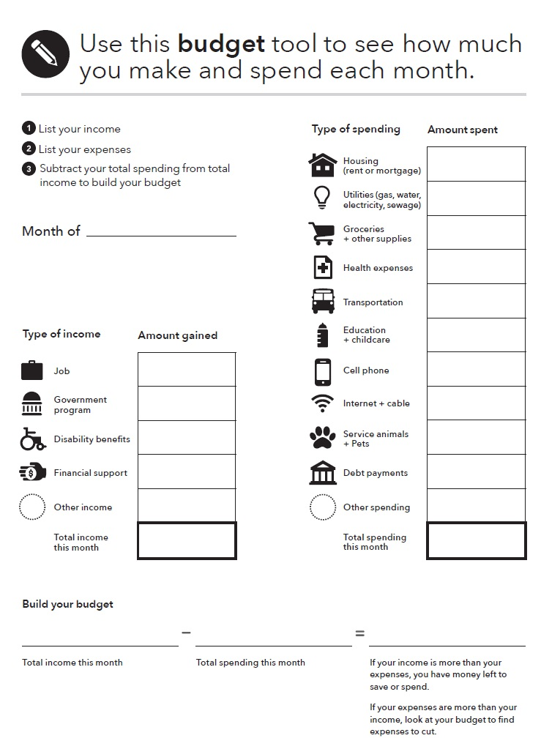
Using the Monthly budget
Notes:
Instructions for Presenter:
Use the responses from the Income and benefit tracker tool and the Spending tracker tool in this guide to identify the total monthly income and expenses of the person you’re working with to create a monthly budget.
Subtract the total spending from total income to build the budget
Note that:
If a person’s income is more than expenses, they have money left to save or spend.
If their expenses are more than their income, look at the budget to find expenses to cut.
This can help somebody understand whether their budget is running short, or how much they have extra in any given month.

Slide 69
Using the Monthly budget
$600
$100
$310
$115
$40
$50
$50
$80*
$1345
$1200
$177.50
$1377.50
*Eating out & entertainment
$1377.50 $1345 $32.50
Notes:
Instructions for Presenter:
This is a sample budget using the numbers from our “example” individual earning $1200/month from work and $177.50 in SSI – for a total income of $1377.50 – and $1345 in expenses. This leaves them with $32.50 left over at the end of the month.
You may want to note that the Monthly budget tool in Focus on People with Disabilities has slightly different categories than the Income and benefit tracker and Spending tracker tools. This may require you to split up or combine some categories. For example, this Budget breaks up housing and utilities, while those are combined in the Spending tracker. It also does not include the “eating out” or “entertainment” categories at the Spending tracker does – so we combined those into the “other spending” category.

Slide 70
More on getting through the month
In the Your Money, Your Goals toolkit:
Tool 1: Cash flow budget
Tool 2: Cash flow calendar
Tool 3: Improving cash flow checklist
Notes:
Instructions for Presenter:
Share that the Your Money, Your Goals toolkit offers additional tools on this topic:
Use Tool 1: Cash flow budget to help people create their own cash flow.
Use Tool 2: Cash flow calendar as an alternative format for creating a cash flow.
Use Tool 3: Improving cash flow checklist to identify specific strategies for improving cash flow.

Slide 71
Break

Slide 72
Subsection 3: Debt, Credit, Financial Services, Consumer Protection
Focus on People with Disabilities – Page 61
Notes:
Instructions for Presenter:
Introduce Subsection 3: Debt, Credit, Financial Services, Consumer Protection
Module 6: Dealing with debt
Tool: Debt worksheet
Tool: Dealing with debt collectors
Module 7: Understanding credit reports and scores
Module 8: Money services, cards, accounts and loans: finding what works for you
Module 9: Protecting your money
Tool: Identifying financial abuse and exploitation

Slide 73

Module 6: Dealing with debt
What is debt?
How is debt different from credit? For our purposes…
Notes:
Instructions for Presenter:
Facilitated Discussion
ASK: What is a debt?
ASK: How is debt different from credit?
Note to trainer: Prior to your training, review the slides on this topic in the Your Money, Your Goals training deck and copy and paste slides that you wish to cover into this PowerPoint file. In particular, consider whether interactive exercises from the Your Money, Your Goals training deck fit would support your coverage of this topic. Feel free to adapt activities as needed, especially to make them work for everyone, making adjustments to accommodate participants that have disabilities.

Slide 74
Module 6: Dealing with debt
What is debt?
  Money you owe.
  Debt is a liability.
  Debt may obligate future income.
How is debt different from credit? For our purposes…
  Credit is the ability to borrow money.
  Debt is the result of using credit.
  Debt obligates future resources to cover decisions made today. Understanding debt, how to manage it, and how to reduce and get rid of it, are important components of financial empowerment.
Notes:
Instructions for Presenter:
Facilitated Discussion, Continued
ASK: What is a debt?
After participants offer some ideas, share definition: Money you owe to another person or business. Debt is a liability. Debt may obligate future income.
ASK: How is debt different from credit?
Credit means you can borrow money. Debt is the result of using credit. Credit is not a liability. When you use it, though, you create a liability.

Slide 75
Module 6: Focus on People with Disabilities
Understanding debt, how to manage it, and how to reduce or get rid of it are important components of financial empowerment.
Debt, however, is a reality for many people with and without disabilities.
People with disabilities may have debt related to:
  Paying for medical bills and assistive technology
  Buying, rehabilitating, adapting, or repairing a home
  Buying a car or truck or adapting it
  Starting a business
  Getting themselves or their children education and training
  Emergency expenses
Notes:
Instructions for Presenter:
Present slide content.
Note that this list is not exhaustive. These are just some of the examples that are especially relevant to people with disabilities.

Slide 76
Disability and student loan debt
There are two general kinds of student loans: federal student loans and private student loans:
Federal student loans are loans that are made or guaranteed by the federal government.
Private student loans are nonfederal loans made by a lender such as a bank, credit union, state agency, or a school.
There are many options for paying back federal student loans, including:
Standard repayment
Graduated repayment
Extended repayment
Income-Based Repayment
Pay as you earn
Consolidation loan
Notes:
Instructions for Presenter:
Present slide content.

Slide 77
Deferment and forbearance
Deferments are a temporary pause to student loan payments for specific situations, such as active duty military service and reenrollment in school.
Forbearance is a temporary postponement or reduction of student loan payments for a period of time because a person is experiencing financial difficulty.
People may also apply for loan forgiveness, cancellation, or discharge in situations including:
  Total and permanent disability
  Death (someone would apply on your behalf)
  Closed school
  Others
Notes:
Instructions for Presenter:
People may also qualify for deferment or forbearance.
Deferments are a temporary pause to student loan payments for specific situations such as active duty military service and reenrollment in school. Deferments are only granted for specific circumstances including:
Enrollment in college or a trade school (at least have time), a graduate fellowship, or a rehabilitation program for people with disabilities
Unemployment
Military service
Economic hardship, including Peace Corps service
Forbearance is a temporary postponement or reduction of student loan payments for a period of time because a person is experiencing financial difficulty. Borrowers can receive forbearance if they’re not eligible for a deferment. A loan holder can grant forbearance in intervals of up to 12 months at a time for up to three years. Unlike deferment, with forbearance interest accrues whether the loans are subsidized or unsubsidized, and the person is responsible for repaying it even while in forbearance.

Slide 78
Total and Permanent Disability (TPD) Discharge – Page 65
Based on a person’s total and permanent disability, a TPD discharge relieves them from having to:
Repay a William D. Ford Federal Direct Loan (Direct Loan) Program loan.
Repay a Federal Family Education Loan (FFEL) Program loan.
Repay a Federal Perkins Loan (Perkins Loan) Program loan.
Complete a TEACH Grant service obligation.
Before the federal student loans or TEACH Grant service obligation can be discharged, a person with a disability must provide information to the U.S. Department of Education to show that they’re totally and permanently disabled.
Notes:
Instructions for Presenter:
Present slide content.
People with disabilities must continue to pay their student loans while awaiting approval of your application. This is essential.
A person can show that they’re totally and permanently disabled in one of the following three ways:
Veterans can submit documentation from the U.S. Department of Veterans Affairs (VA) showing that the VA has determined that they are unemployable due to a service-connected disability.
People receiving Social Security Disability Insurance (SSDI) or Supplemental Security Income (SSI) benefits, can submit a Social Security Administration (SSA) notice of award for SSDI or SSI benefits stating that their next scheduled disability review will be within five to seven years from the date of their most recent SSA disability determination.
People with disabilities can submit certification from a physician that they are totally and permanently disabled. The physician must certify that they are unable to engage in any substantial gainful activity by reason of a medically determinable physical or mental impairment that:
Can be expected to result in death.
Has lasted for a continuous period of not less than 60 months.
Can be expected to last for a continuous period of not less than 60 months.

Slide 79
Tool: Debt worksheet
To make a debt reduction and elimination plan, use the debt worksheet with the person you serve. The debt worksheet can also help someone get on track with paying their debts on time.
The goal with the debt worksheet is to get all of the information about debts someone owes in one place.
Start by helping someone brainstorm all of the debts they owe.
You can also recommend reviewing their credit report to help identity debt—debt that is current, in collections, or resulting from judgments.
Notes:
Instructions for Presenter:
Present slide content.

Slide 80
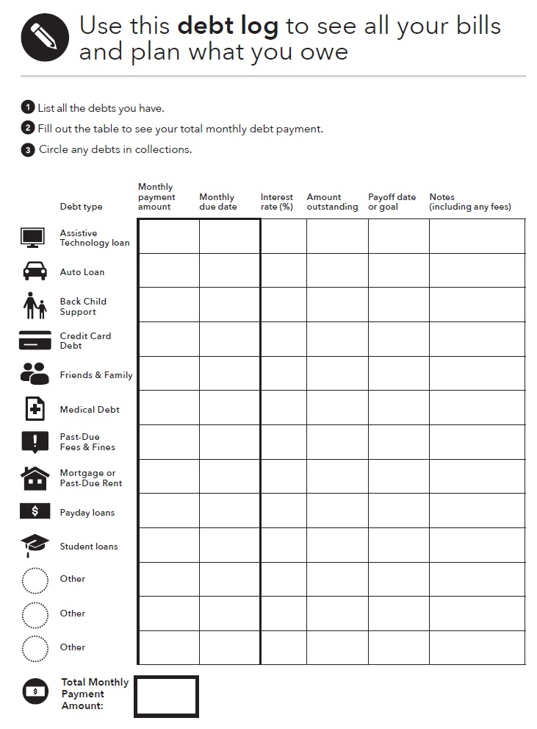
Using the Debt worksheet
Notes:
Instructions for Presenter:
Making a plan to pay debt regularly, reduce debt, or get rid of debt starts with getting a clear picture of what a person owes and who they owe money to. The debt worksheet is designed to help them get all of this information in one place.
The debt worksheet has six columns monthly payment due, monthly due date, interest rate, amount outstanding, payoff date or goal, and notes. There are rows for different debt types including assistive technology loans, auto loans, back child support, credit card debts, and more. At the bottom of the debt worksheet, there is a box for a “total monthly payment amount.” This is part of the debt reduction and elimination plan.
Explain how the Debt worksheet works:
List all the debts you have.
Fill out the table to see your total monthly debt payment.
Circle any debts in collections.
Note that for each debt, you will need to know the:
Person, business, or organization you owe money to
Amount you owe them
Amount of your monthly payment, which includes the principal, interest payments and any fees you may owe
Interest rate you are paying and other important terms.

Slide 81
Using the Debt worksheet
$200 | 1st | 8 | $3k | 01/19 | Fixed rate
$220 | 15th | 17 | $400 | 2 months | $50 min
$150 | 1st | 4 | $10k | 2022 | Fixed rate
$570
Notes:
Instructions for Presenter:
Here is a sample Debt worksheet. The person enters the six factors for three different debts: an auto loan, credit card debt, and student loans.
The auto loan and student loans are both fixed-rate and just have money due on the 1st. With the amount due and monthly bill, they will be paid off in 2019 and 2022, respectively. The person can choose to pay off the loans earlier if they want, though.
The person’s credit card debt has an outstanding amount of $400 with a 17% interest rate, and bills due on the 15th. There is a minimum payment of $50/month (this is in the “notes” section). The person has a goal of paying off the debt in two months, so they are paying $220/month. It is more than just $200/month because they are taking into account the 17% interest.
In total, this adds up to $570 per month in total debt payments.

Slide 82
Tool: Debt collectors
When companies decide they no longer want to try to collect debts that are delinquent and defaulted, they may assign or sell those debts to third party debt collectors.
A person you serve has rights when their debts have been sold to debt collectors. They may not know that they have rights.
Use this tool to with a person you serve to review their rights from the Fair Debt Collections Practices Act when their debt has been sold to a debt collector.
Notes:
Instructions for Presenter:
Present slide contents.

Slide 83
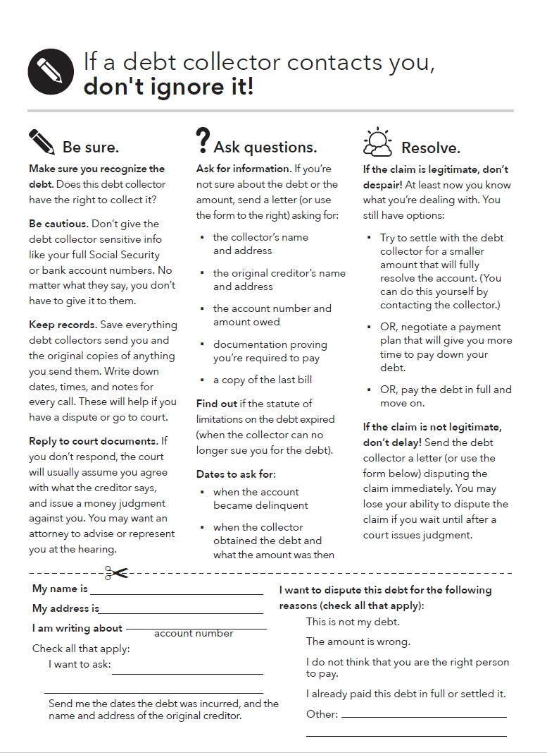
Using the tool on Debt collectors
This tool summarizes some of the key rights in debt collection and will help a person:
Take actions to verify whether the claim is valid.
Know how to dispute the claim if they do not own the debt.
Know what to do next if they do owe the debt.
Knowing about their rights can help to figure out if a debt collector is violating their rights.
Notes:
Instructions for Presenter:
Present slide content.
The tool on Debt collectors includes these two main sections: information about interacting with debt collectors, and a sample letter to communicate with them or other collection agencies. The full information is available in Focus on People with Disabilities.
A debt collector cannot:
Call repeatedly to harass or abuse you.
Use obscene language.
Threaten you to take action they can’t or don’t really plan to take.
Publish your name for not paying a debt.
Lie to you.

Slide 84
More on dealing with debt
In the Your Money, Your Goals toolkit:
Tool 1: Debt worksheet
Tool 2: Debt-to-income worksheet
Tool 3: Reducing debt worksheet
Tool 4: Repaying student loans
Tool 5: When debt collectors call: Steps you can take
Notes:
Instructions for Presenter:
Share that the Your Money, Your Goals toolkit offers additional tools on this topic:
Use Tool 1: Debt worksheet to make a list of your debts and the details associated with each debt—this is the foundation of a debt reduction plan.
Use Tool 2: Debt-to-income worksheet to figure out how much of your income is going to cover your debts on a monthly basis.
Use Tool 3: Reducing debt worksheet to identify a strategy for reducing or eliminating your debts.
Use Tool 4: Repaying student loans to understand some of the key terms related to student loans as well as repayment options.
Use Tool 5: When debt collectors call: Steps you can take to help you understand your rights in debt collection.

Slide 85
Module 7: Understanding credit reports and scores
A credit report is a record of an individual’s bill-paying history, public record information (such as a filing for bankruptcy), and prior inquiries by a creditor into the individual’s credit history at the time a consumer applies for credit.
Credit scores are calculated using the information in credit reports. A credit score is typically a number. A higher score makes it easier to qualify for a loan or lower interest rates. Many scores range from 300-850, but different scoring models may use different ranges of scores.
Notes:
Instructions for Presenter:
Present slide content.
Note to trainer: Prior to your training, review the slides on this topic in the Your Money, Your Goals training deck and copy and paste slides that you wish to cover into this PowerPoint file. In particular, consider whether interactive exercises from the Your Money, Your Goals training deck fit would support your coverage of this topic. Feel free to adapt activities as needed, especially to make them work for everyone, making adjustments to accommodate participants that have disabilities.

Slide 86
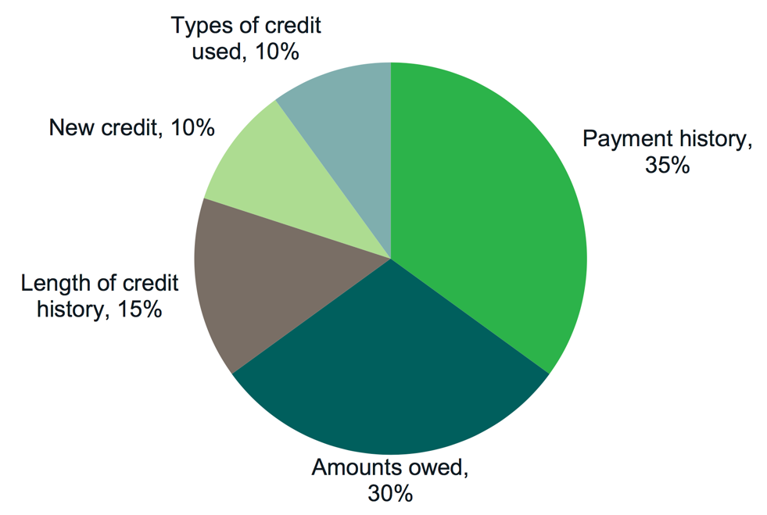
Credit scores: Example based on FICO score
These percentages reflect how much each category determines a typical FICO score.
Notes:
Module 7: Understanding Credit Reports and Scores
Presentation (Module 7)
Note: Only present this information if you have time. (see Page 240 - 245 for more information).
Explain: Credit scores are calculated based on the information in your credit report. Even though different credit scores have different mathematical formulas, they all use the information from your credit report. So, while some pieces of information in your credit reports may be more important or less important, depending on which company is calculating your score, the key is to understand the information in your credit reports
Use the following information from the toolkit to explain the composition of the FICO Scores. Be sure to explain that this is general information; FICO produces many scores.
“Payment history” tracks whether you are paying your bills on time and as agreed. This is the biggest factor in your FICO Scores.
Paying bills late, not paying bills at all, and having bills that go to collections will cause your scores to drop.
The older this information is, the less impact it has on your scores.
“Amounts owed” includes whether you are paying down your loan balances as agreed.
It also includes your credit utilization rate. Your credit utilization rate is how much of your available credit you are using.
If you use more than 20 - 30% of your credit limits, your scores may drop. The lower your credit utilization rate, the better from the perspective of scoring models.
“Length of credit history” is the next factor that impacts your scores. Your score increases the longer you have a credit history.
“New credit” tracks your inquiries. If you have too many inquiries, the model interprets this to mean you have a high demand for credit, which may be an indicator of risk, and your scores may drop.
When you are shopping for a loan, however, most models give you a short window of time (generally 14-45 days) when multiple inquiries can be made for some types of credit without causing your score to drop.
Finally, “types of credit used” is considered.
Your FICO scores increase if you have both credit cards (revolving credit) and loans (installment credit such as a mortgage or car loan).
Generally, it is considered a positive to have a mortgage, an auto loan, and not too many credit cards.
Source: FICO website: www.myfico.com.

Slide 87
Module 7: Focus on People with Disabilities
Having a good credit history is an important part of an overall asset-building strategy that can help people reach their goals, including:
Get and keep a job
Get an apartment
Get insurance coverage
Get lower deposits on utilities and better terms on cell phone purchase plans
Get a credit card
Get and keep a security clearance for a job, including a military position
Notes:
Instructions for Presenter:
Present slide content.

Slide 88
Legal representatives and credit denials
If a person has a legal representative or court-appointed guardian, credit reports can be ordered by mail.
  Representatives must present certain information.
  Full list in Focus on People with Disabilities
If a lender or other institution denies a person a credit card or loan application, the lender or other institution is required under Equal Credit Opportunity Act (ECOA) to:
  Explain the specific reasons the application was rejected.
  Explain that the applicant has the right to learn the reasons if asked within 60 days.
Notes:
Instructions for Presenter:
Present slide content.
Requests should include:
Legal name of the individual with a disability
Address
Birth date
A copy of the individual’s birth certificate
A copy of the individual’s Social Security card
And information about the legal representative’s or court-appointed guardian’s status:
Proof of legal representation or guardianship
A copy of driver’s license or other government-issued identity card with current address
A copy of a current utility bill

Slide 89
Credit discrimination is illegal
Credit discrimination is illegal. Under the Equal Credit Opportunity Act, a creditor can't discriminate in any credit transaction, including mortgages, against any applicant because of these factors:
  Receipt of income from any public assistance program such as Social Security Disability Insurance (SSDI) or the Supplemental Nutrition Assistance Program (SNAP)
  Race
  Color
  Religion
  National origin
  Sex (gender)
  Other
Notes:
Instructions for Presenter:
Present slide content.
Other factors protected against discrimination under the Equal Credit Opportunity Act include:
Marital status
Age, unless the applicant is not legally able to enter into a contract
Your exercising in good faith a right under the Consumer Credit Protection Act (such as disputing information in your credit report)
This does not explicitly mention disability. But fair lending concerns may arise under ECOA and Regulation B when a creditor requires additional documentation beyond that required by lawful applicable agency or secondary market standards and guidelines to demonstrate that SSDI is likely to continue, such as information about the nature of an applicant’s disability or letter from an applicant’s physician.

Slide 90
More on understanding credit reports and scores
In the Your Money, Your Goals toolkit:
Tool 1: Getting your credit reports and scores
Tool 2: Credit report review checklist
Tool 3: Improving your credit reports and scores
Tool 4: Keeping records to show you’ve paid your bills
Notes:
Instructions for Presenter:
Share that the Your Money, Your Goals toolkit offers additional tools on this topic:
Use Tool 1: Getting your credit reports and scores to help people get their credit reports and scores.
Use Tool 2: Credit report review checklist to help people read and review their credit reports and file disputes for inaccurate or incomplete information identified on reports.
Use Tool 3: Improving your credit reports and scores to provide people with steps to improve both credit reports and scores.
Use Tool 4: Keeping records to show you’ve paid your bills to provide people with a simple system to keep records so they have evidence for disputes on credit reports.

Slide 91
Tool 1: Getting your credit reports and scores
To order through the website, visit: https://www.annualcreditreport.com
  Complete a form with basic information (name, Social Security number, address, etc.).
  Select the report(s) you want—Equifax, Experian, and/or TransUnion.
  Answer security questions: former addresses, amount of a loan you have, phone numbers that have belonged to you, counties you may have lived in, etc.
If you are unable to answer these questions, you will have to use another method.
  You will save a PDF version of your report, print the report, or both.
Be sure you do this in a safe and secure location. Avoid doing this on public computers (library).
Notes:
Module 7: Understanding Credit Reports and Scores
Presentation (Module 7, Tool 1: Getting your credit reports and scores) (Page 247)
Explain how to order credit reports using Tool 1.
Explain alternative methods for getting a report from AnnualCreditReport.com in case the online report cannot be accessed (security questions are answered wrong or cannot be answered if generated by fraudulent information on the report).
Explain the other times you can get an additional free report. IF:
Are unemployed and plan to look for employment in the next 60 days
Are receiving public assistance
Have reason to believe that your credit file is inaccurate due to fraud
Have had a consumer reporting agency place a fraud alert on your credit file (based on your good faith suspicion that you have been the victim of fraud, including identity theft)
Have had a consumer reporting agency place a fraud alert on your credit file after submitting an identity theft report
Have had adverse action taken (you have been denied credit, employment, insurance, etc.) because of information in your credit report – In this case, you have 60 days to request your report.
BUT, you must request these reports. They don’t just show up for you.
If you are under 18, you should not have a credit report unless:
You are an authorized user or joint owner on an account
You are an emancipated minor
Your state law allows you to enter contracts below the age of 18, and you have done so
You have student loans
You have been the victim of identity theft or credit or financial fraud
Use the following notes from the toolkit to explain getting credit scores:
Free credit scores are offered online.
Will most likely differ from the credit score used by a bank, lender, or other third-party to assess your creditworthiness.
These are approximations of your scores. They are not the actual scores businesses will use to make decisions about you.
Some people find they can be useful for education because you can see if your credit scores are generally moving up or down.
The actual number may not reflect your actual FICO Scores - so this may be confusing for some people.
There are a variety of credit scores you can purchase in the marketplace. The type of credit score most used by lenders is a FICO score. Another score also used by lenders if the VantageScore which you can purchase through Experian or TransUnion.
Explain that while credit scores are important and used, the most important thing to focus on is their credit report.
Ask participants why focusing on the credit report is more important than the credit score?
Following some discussion, if not shared, explain that the score is calculated using information from credit reports.
If the information in the report is strong (and error-free), the scores will reflect this.

Slide 92
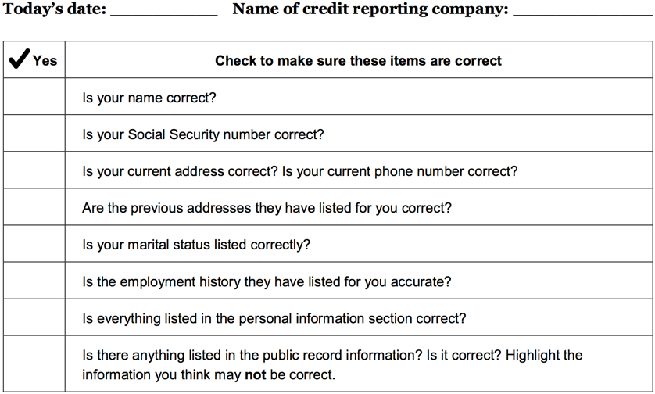
Tool 2: Credit report review checklist
Notes:
Module 7: Understanding Credit Reports and Scores
Presentation (Module 7, Tool 2: Credit report review checklist) (Page 253)
Review Tool 2.

Slide 93
Module 8: Money services, cards, accounts, and loans: finding what works for you
Your Money, Your Goals takes a financial empowerment approach to financial products and services. Rather than directing people to a particular type of provider or service, this module starts with an assessment of your needs or priorities and – based on those needs – helps you choose from among your options. With this information, you can make the choices that are best for you and your family.
Notes:
Instructions for Presenter:
Present slide content.
Note to trainer: Prior to your training, review the slides on this topic in the Your Money, Your Goals training deck and copy and paste slides that you wish to cover into this PowerPoint file. In particular, consider whether interactive exercises from the Your Money, Your Goals training deck fit would support your coverage of this topic. Feel free to adapt activities as needed, especially to make them work for everyone, making adjustments to accommodate participants that have disabilities.

Slide 94
Many types of products and services
Module 8 helps people understand how to find and choose financial services, products, and providers that meet their needs.
Many types of financial products and services can help people:
  Protect their money and financial resources.
  Better manage their money.
  More efficiently pay for their current living expenses.
  Set aside money for their goals or for future generations.
Notes:
Instructions for Presenter:
Present slide content.
Note to trainer: The section on Module 8 in the Focus on People with Disabilities does not have any specific text or tools for people with disabilities. For more information on this subject, refer to the Your Money, Your Goals toolkit.

Slide 95
More on money services, cards, accounts, and loans
In the Your Money, Your Goals toolkit:
Tool 1: Know your options: Money services, cards, accounts, and loans
Tool 2: Ask questions: Choosing where to get what you need
Tool 3: Money services and banking basics
Tool 4: Opening an account checklist
Tool 5: Money transfers and remittances: What you need to know
Notes:
Instructions for Presenter:
Share that the Your Money, Your Goals toolkit offers additional tools on this topic:
Use Tool 1: Know your options: Money services, cards, accounts, and loans to help you figure out which financial products or services will meet your needs
Use Tool 2: Ask questions: Choosing where to get what you need to help you compare financial service providers based on their characteristics as well as the features and benefits of the products and service they offer.
Use Tool 3: Money services and banking basics to help you learn about the different financial products and services offered at banks, credit unions, and other financial service providers.
Use Tool 4: Opening an account checklist to understand the specific steps for opening an account including information you may want to have before opening an account.
Use Tool 5: Money transfers and remittances: What you need to know to learn more about using these products and services.

Slide 96
Module 9: Protecting your money – Page 77
When it comes to protecting your money and financial resources, there are laws that give you rights.
Module 9: Protecting your money provides an introduction to some of these laws as well as an overview of how to protect your identity and how to be alert for red flags.
This module also covers how to submit a complaint to the CFPB.
If someone feels uncomfortable submitting a complaint without assistance, another individual can submit a complaint on their behalf, with their consent.
Notes:
Instructions for Presenter:
Present slide content.
Note that:
When you submit a complaint, the CFPB forwards it to the company and works to get a response. After the CFPB forwards a complaint, the company has 15 days to respond to you and the CFPB.
You’ll be able to review the response and give feedback to the CFPB.
If it finds that another agency would be better able to assist, CFPB will forward your complaint and let you know.
Note to trainer: Prior to your training, review the slides on this topic in the Your Money, Your Goals training deck and copy and paste slides that you wish to cover into this PowerPoint file. In particular, consider whether interactive exercises from the Your Money, Your Goals training deck fit would support your coverage of this topic. Feel free to adapt activities as needed, especially to make them work for everyone, making adjustments to accommodate participants that have disabilities.

Slide 97
Module 9: Focus on People with Disabilities
“Financial exploitation is the illegal or improper use of an individual’s funds, property, or assets.”
While many people are at risk of having their identity stolen, people with disabilities may face a higher risk of identity theft, financial abuse, and financial exploitation.
This can occur through fraud or scams, or when caregivers, family members, or others improperly use an individual’s financial resources.
Notes:
Instructions for Presenter:
Present slide content.

Slide 98
Disability: Risks for financial exploitation
The following circumstances or conditions may make a person at risk for financial exploitation:
Having regular income and accumulated assets
Being trusting and polite
Being lonely and socially isolated
Being reluctant to report exploitation by family member, caregiver, or someone they depend on
Fearing rejection or more retaliation by the exploiter
Being unfamiliar with managing financial matters
Having cognitive impairments that affect financial decision-making and judgment
Notes:
Instructions for Presenter:
Present slide content.
These are presented as disability-specific risks in Module 9.
Other factors may include:
Being dependent on support from a family member or caregivers to remain independent.
Receiving care from a person with substance abuse, gambling or financial problems, or mental health issues.

Slide 99
Resources
Financial abuse and exploitation
Financial exploitation often goes unreported because people do not know which steps to take.
List of resources that may help if you suspect financial abuse or exploitation:
  Contact your Adult Protective Services agency.
  Report financial fraud to your state’s attorney general’s office.
  Seek legal assistance for help with getting back money or property that was taken or to get protection from additional exploitation.
  Contact your local Area Agency on Aging if the individual is an older individual.
Notes:
Instructions for Presenter:
Present slide content.
Remember, you do not need to prove that financial exploitation or abuse is occurring to report it. It is up to the professionals to take action if you suspect abuse.
A full list of resources and other details is available in Module 9 of Focus on People with Disabilities.

Slide 100
Tool: Identifying financial abuse and exploitation
Identifying financial exploitation may be difficult.
Individuals may be reluctant to say anything about what is happening to them out of:
  embarrassment and shame,
  fear of reprisal,
  dependency on the perpetrator of the offense, or
  fear of further straining a family relationship.
Family members or close friends may be unaware of the situation or they may be the individuals committing financial exploitation or abuse.
Notes:
Instructions for Presenter:
Use this tool to educate others and to identify financial abuse and exploitation.
The checklist can be used one-on-one if someone expresses concern about an individual and his or her living conditions, care provision, or financial situation.
Responses to the questions included in the checklist can help you or the individual you are working with get assistance.

Slide 101
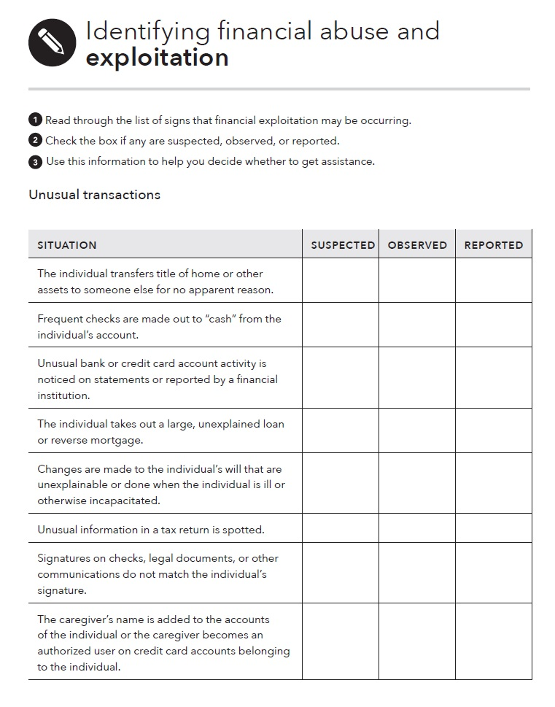
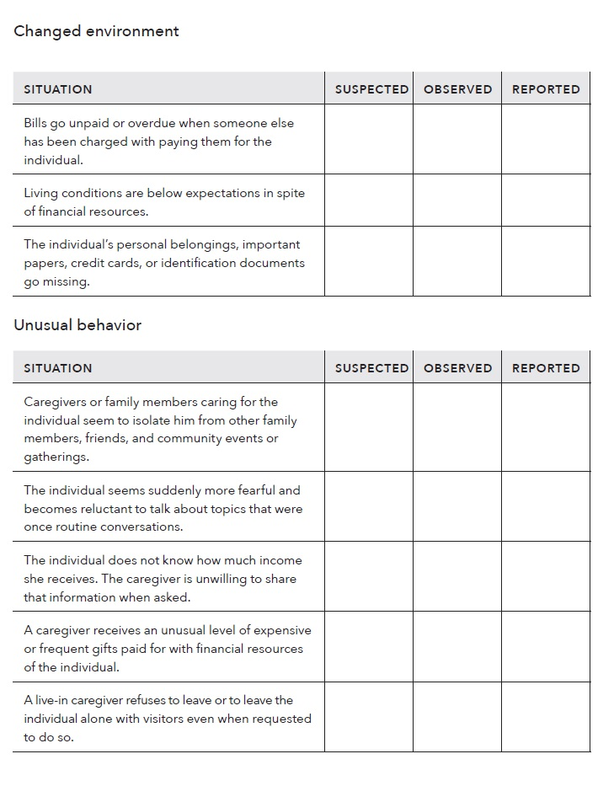
Tool: Identifying financial abuse and exploitation – Page 82
Notes:
Instructions for Presenter:
Present slide content.
Read through the list of signs that financial exploitation may be occurring.
Check the box if any are suspected, observed, or reported.
Use this information to help you decide whether to get assistance.
List sections:
Situation, i.e. The individual takes out a large, unexplained loan or reverse mortgage.
Changed environment, i.e. Living conditions are below expectations in spite of financial resources.
Unusual behavior, i.e. The individual seems suddenly more fearful and becomes reluctant to talk about topics that were once routine conversations.
Note that a full list is available in the guide under the “identifying financial abuse and exploitation” tool of Module 9 in the disability companion guide. The full list has 16 bullet points.
Situation:
The individual transfers title of home or other assets to someone else for no apparent reason.
Checks are frequently made out to “cash” from the individual’s account.
Unusual bank or credit card account activity is noticed on statements or reported by a financial institution.
The individual takes out a large, unexplained loan or reverse mortgage.
Changes are made to the individual’s will that are unexplainable or done when the individual is ill or otherwise incapacitated.
Unusual information in a tax return is spotted.
Signatures on checks, legal documents, or other communications do not match the individual’s signature.
The caregiver’s name is added to the accounts of the individual or the caregiver becomes an authorized user on credit card accounts belonging to the individual.
Changed environment:
Bills go unpaid or overdue when someone else has been charged with paying them for the individual.
Living conditions are below expectations in spite of financial resources.
The individual’s personal belongings, important papers, credit cards, or identification documents go missing.
Unusual behavior
Caregivers or family members caring seem to isolate the individual from other family members, friends, and community events or gatherings.
The individual seems suddenly more fearful and becomes reluctant to talk about topics that were once routine conversations.
The individual does not know how much income they receive. The caregiver is unwilling to share that information when asked.
A caregiver receives an unusual level of expensive or frequent gifts paid for with the financial resources of the individual.
A live-in caregiver refuses to leave or to leave the individual alone with visitors even when requested to do so.

Slide 102
More on protecting your money
In the Your Money, Your Goals toolkit:
Tool 1. Submitting a complaint
Tool 2: Protecting your identity
Tool 3: Red flags
Tool 4: Learning more about consumer protection
Notes:
Instructions for Presenter:
Share that the Your Money, Your Goals toolkit offers additional tools on this topic:
If you do feel like you have a complaint with a financial product, service or provider, use Tool 1. Submitting a complaint to the CFPB
Your identity is one of the most important assets you must protect. Use Tool 2: Protecting your identity to ensure you are taking all steps possible to keep your identity safe.
When applying for financial products or services, be aware of red flags. Use Tool 3: Red flags to become familiar with common red flags.
If you are interested in learning more about consumer protection laws, use Tool 4: Learning more about consumer protection.

Slide 103
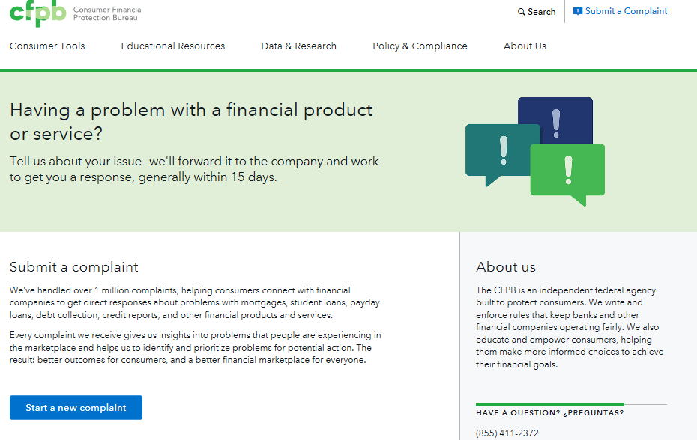
YMYG Module 9, Tool 1: Submitting a complaint
Notes:
Training Section 9: Using and Protecting Your Money CONTINUED
Refer participants to the CFPB complaint contact information on slide and in their toolkit, Module 9, Tool 1.
Explain the following:
An empowered consumer understands their rights. When you know you have rights, you can take steps to protect yourself. There are many laws that protect your rights when it comes to financial products and services. It is the CFPB’s job to enforce these laws and handle consumers’ complaints about financial products and services.
The CFPB has to date handled more than 1,000,000 of consumer complaints about:
Credit cards
Mortgages
Bank accounts and services
Student loans
Vehicle loans or leases
Payday loans
Other consumer loans (including installment loans, pawn loans, and title loans)
Debt collection
Money transfers or virtual currency
Credit reporting
Prepaid cards
Other financial services (including check cashing, money orders, cashier’s checks, credit repair, debt settlement, refund anticipation loans, foreign currency exchange, and traveler’s checks)
Every complaint the CFPB receives gives them insights into problems that people are experiencing in the marketplace and helps them to identify and prioritize problems for potential action.
Explain that you can submit a complaint on behalf of someone else following the directions on the site.
Explain that, you can also submit a complaint over the phone by calling the CFPB at 855-411-CFPB (2372), toll free. U.S.-based call centers can help you in over 180 languages and can also take calls from consumers who are deaf, have hearing loss, or have speech disabilities. Live operators in Spanish are available.

Slide 104
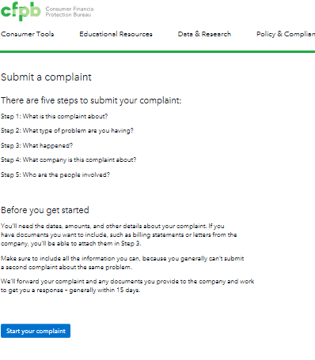
Submitting a Complaint
Five steps for submitting
a complaint
Notes:
Training Section 9: Using and Protecting Your Money CONTINUED
Review the complaint process, explain there are five steps involved to submitting a complaint:
Step 1: What is this complaint about?
Step 2: What type of problem are you having?
Step 3: What happened?
Step 4: What company is this complaint about?
Step 5: Who are the people involved?

Slide 105
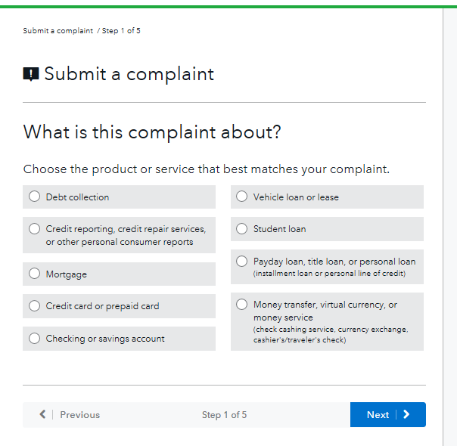
Complaint process
Starting with
step 1 ….
Notes:
Training Section 9: Using and Protecting Your Money CONTINUED
This shows the first step in the complaint submitting process.

Slide 106
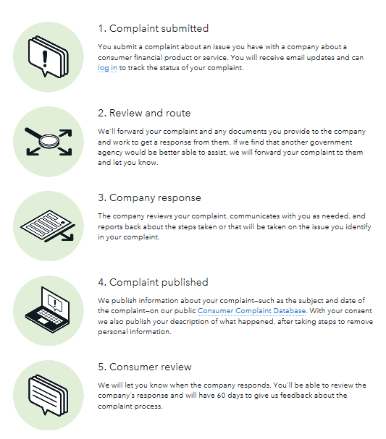
Complaint process
Notes:
Training Section 9: Using and Protecting Your Money CONTINUED
Explain the complaint process:
Complaint submitted: You will receive email updates and can log in to track the status of your complaint.
Review and route: The CFPB will forward your complaint and any documents you provide to the company and work to get a response from them. If they find that another government agency would be better able to assist, the CFPB will forward your complaint to them and let you know.
Company response: After your complaint is sent to the company, the company reviews your complaint and communicates with you as needed. The company should report back to you in 15 days, sometimes it may take longer.
Complaint published: The CFPB publishes information about your complaint – such as the subject and date of the complaint – on their public Consumer Complaint Database at http://www.consumerfinance.gov/data-research/consumer-complaints/. With your consent they also publish your description of what happened, after taking steps to remove personal information.
Consumer review: The CFPB will let you know when the company responds. You can review that response and give feedback.
By coming to us, you aren’t just helping yourself. Your complaints play a role in everything we do, helping us to identify problems and prioritize our work. We turn your complaints into action to improve the marketplace.

Slide 107
Closing
Notes:
Instructions for Presenter:
Introduce closing section

Slide 108
Closing Reflections
How do you think you will use this information for the people you serve?
What is the most important thing you are taking away from this training?
Notes:
Instructions for Presenter:
Ask: How do you think you will use this information for the people you interact with?
Ask: What is the most important thing you are taking away from this training?

Slide 109
Post Survey
Please complete the survey before leaving! Thank you!

Slide 110
Thank you!
Notes:
Instructions for Presenter:
Thank participants and adjourn.

Slide 111
Terry Donovan
Senior Outreach Program Manager
Stout Vocational Rehabilitation Institute
donovant@uwstout.edu
715.232.5527
Notes:
Instructions for Presenter:
Thank participants and adjourn.

