Slide 1
Project E3: Educate, Empower, and Employ
Vocational Rehabilitation Technical Assistance Center: Targeted Communities (VR-TAC-TC)
Updated October, 2016
Notes:
Project E3: Educate, Empower, and Employ (fall 2016)
Vocational Rehabilitation Technical Assistance Center: Targeted Communities (VR-TAC-TC)

Slide 2
Project E3: Educate, Empower, Employ
VOCATIONAL REHABILITATION TECHNICAL ASSISTANCE CENTER: TARGETED COMMUNITIES (VR-TAC-TC)
The Vocational Rehabilitation Technical Assistance Center: Targeted Communities (VR-TAC-TC) is established under a grant from the Department of Education, Rehabilitation Services Administration (RSA) award CFDA 84.264F. The opinions expressed in this presentation are those of VR-TAC-TC, not of RSA.
Notes:
Welcome to the Vocational Rehabilitation Technical Assistance Center for Targeted Communities, or VR-TAC-TC. We call ourselves “Project E3,” and provide technical assistance to State VR agencies so they can better educate, empower, and employ individuals with disabilities within targeted communities.

Slide 3
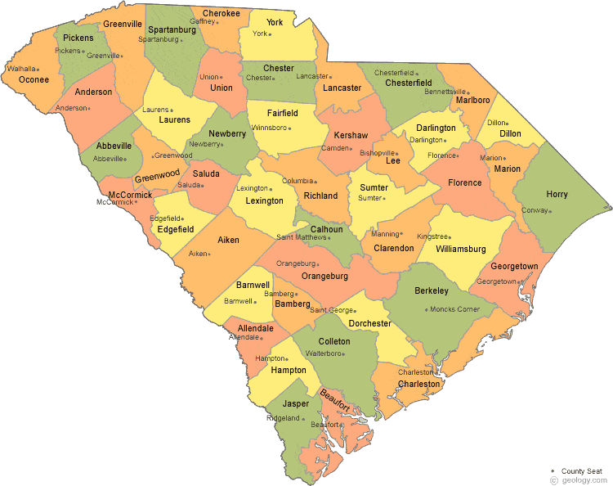
Intensive Technical Assistance Project: South Carolina
Notes:
Project E3 activities will include knowledge development; targeted community identification by State VR agencies; and intensive, targeted, and universal technical assistance (including information dissemination via a state-of-the-art website, and National-State VR agency forums and meetings).

Slide 4
High Leverage Groups with National Applicability
Specific groups of interest are:
African-American males with blindness or other severe vision impairments
Women over the age of 18 who are receiving Temporary Assistance for Needy Families (TANF), Supplemental Security Income (SSI), or Social Security Disability Insurance (SSDI)

Slide 5
TC 1- Pee Dee region

Slide 6
Community Partners
South Carolina Commission for the Blind
Florence Darlington Technical Colle- Rhonda Tuten
Lighthouse Ministries
South Carolina Vocational Rehabilitation Division (emerging)

Slide 7
Barriers to Employment
Impact of rural environment on transportation, job opportunities, job diversity
Geographic barriers to service provision and employment opportunities
Limited awareness in the community of the services SCCB and other service providers
Limited capacity to maintain engagement early in the process toward completing the IPE, and subsequent to IPE development, engaging in their plans to take the steps supportive of obtaining employment;
Limited engagement in VR services over concerns of loss of benefits
Limited awareness of the distributed local labor market, employer expectations, and opportunities to develop home-based or self-employment jobs.
Limited successful employment histories,
Anchoring to geographic community that limits migration for work
Seasonal employment opportunities associated with tourism

Slide 8
Project Goals
Improve outreach to community and awareness of VR services
Increase working alliance between VR clients and counselors
Increase self-determination of VR clients
Maintain or increase health and function of VR clients
Increase client engagement in vocational rehabilitation services
Increase outcome expectations regarding employment
Increase capacity to obtain integrated, competitive employment
Increase capacity to retain integrated, competitive employment

Slide 9
Intensive TA Services
Identification and Outreach
Counselor training in motivational interviewing
Motivational interviewing group curriculum
Self-employment strategies

Slide 10
Intensive TA Services (Cont’d)
Job Club development
Social Skills training
Bridges out of Poverty
Trauma-informed care

Slide 11
TC2- Midlands region

Slide 12
Initial outreach – Midlands
First meetings were with representatives of South Carolina State University under the leadership of Dr. Cassandra Sligh-Conway, professor
Dr. Sligh-Conway brought together representatives from:
South Carolina Vocational Rehabilitation Division
John de la Howe School
Multiple departments from SCSU including nursing, social work, counselor education, English, communications, disability services, research
Pastors and faith-based communities
Persons with disabilities
Focus of meetings was to identify leaders of different organizations providing services to populations of interest

Slide 13
Initial meetings
Meetings were held to bring these different individuals together to:
Identify community needs
Identify community barriers
Determine what intensive technical assistance would be the most beneficial to the local population
Outreach activities most likely to reach HGLNAs
Program supports necessary to achieve project goals

Slide 14
Current Efforts in TC2
Develop intensive technical assistance plan
Develop outreach plan and corresponding budget to reach these HGLNAs
Develop community collaboration mechanisms to promote project sustainability

