Slide 1
Project E3 Leadership Academy

Slide 2
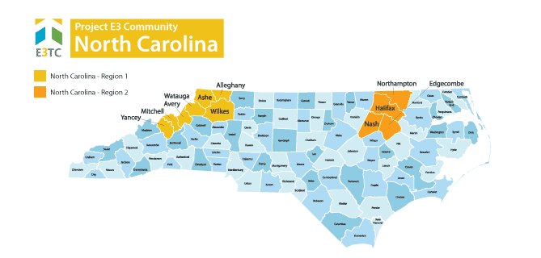
UNEMPLOYMENT
18%
BOONE (WAUTAGA COUNTY)
22% NORTH WILKESBORO (WILKES COUNTY)
POVERTY RATE
SNAP PARTICIPATION
69% BOONE (WAUTAGA COUNTY)
45% NORTH WILKESBORO (WILKES COUNTY)
16% WEST MOUNTAIN REGION
28% EAST COUNTIES REGION

Slide 3
Project E3 Challenges
Lack of enough resources to choose and offer to a client
Poor cell reception as well as clients often use phones with specific minutes and change phones and hence phone numbers when minutes expire
Transportation to and from VR offices as well as to/from jobs
While some job growth, tending towards part-time and at minimum wage. See trends in reducing all employee hours to a level where benefits don’t need to be provided

Slide 4
Project E3 Innovations
Training
Community Needs Assessments
Financial Empowerment
Trauma Informed Care
E3 Webinars
Opportunity To Share Successful Practices with Colleagues in My Region
The applicability of the training – learn skills and tips which can be used immediately

Slide 5
Opportunities
Training
Motivational Interviewing
Self-Employment
Mental Health First Aid
Draw on Knowledge Translation research to better incorporate training into daily practice
Further enhance partnerships and collaborations with community partners, i.e., NC Works, community providers, libraries, health centers, Chamber of Commerce, etc.

