Slide 1
RSA Project E3: Educate, Empower, and Employ: Applications of Community-based Participatory Research (CBPR) in Targeted Communities in 12 States
Madan M. Kundu, PhD, FNRCA, CRC, NCC, LRC, Southern University, Baton Rouge
Kenneth C. Hergenrather, PhD, CRC, The George Washington University
Cayte Anderson, University of Wisconsin-Stout
Malachy Bishop, Ph.D., CRC, University of Kentucky
David R. Strauser, PhD, CRC, University of Illinois, Urbana-Champaign
Timothy Tansey, Ph.D., CRC, University of Wisconsin-Madison

Slide 2
VOCATIONAL REHABILITATION TECHNICAL ASSISTANCE CENTER FOR TARGETED COMMUNITIES (VR-TAC-TC) PROJECT E3: Educate, Empower, and Employ
Notes:
Welcome to the Vocational Rehabilitation Technical Assistance Center for Targeted Communities, or VR-TAC-TC. We call ourselves “Project E3,” and provide technical assistance to State VR agencies so they can better educate, empower, and employ individuals with disabilities within targeted communities.
The Vocational Rehabilitation Technical Assistance Center: Targeted Communities (VR-TAC-TC) is established under a grant from the Department of Education, Rehabilitation Services Administration (RSA) award CFDA 84.264F. The opinions expressed in this presentation are those of VR-TAC-TC, not of RSA.

Slide 3
Acknowledgement
The contents of this presentation were developed with support from the Technical Assistance Center for Targeted Communities (TC TAC Project E3) at the Department of Rehabilitation and Disability Studies, Southern University, Baton Rouge, LA funded by the U.S. Department of Education, Rehabilitation Services Administration (Grant # H264F150003). The ideas, opinions, and conclusions expressed, however, are those of the authors and do not represent recommendations, endorsements, or policies of the U.S. Department of Education.
Notes:
The Vocational Rehabilitation Technical Assistance Center: Targeted Communities (VR-TAC-TC) is established under a grant from the Department of Education, Rehabilitation Services Administration (RSA) award CFDA 84.264F. The opinions expressed in this presentation are those of VR-TAC-TC, not of RSA.

Slide 4
The Project
Developed with support and input from Louisiana Rehabilitation Services (LRS)
Project E3 is a strategic partnership of 6 institution of higher education, 1 Non-Profit Organization, and 3 Sub-contractors:
One Historically Black College and University: Southern University, Baton Rouge, Louisiana
University of Wisconsin-Madison
University of Wisconsin-Stout
George Washington University, Washington, D.C.
University of Illinois at Urbana-Champaign
University of Kentucky, Lexington
Council of State Administrators of Vocational Rehabilitation (CSAVR)
Virginia Commonwealth University
Employment Resources, Inc.
A national network of expert consultants
Notes:
Project E3 was developed with support and input from Louisiana Rehabilitation Services (LRS) and is a strategic partnership of Southern University in Baton Rouge, a Historically Black College and University.
Six other institutions of higher education are included in the partnership; the University of Wisconsin-Madison; University of Wisconsin-Stout; George Washington University in Washington, D.C., the University of Illinois at Urbana-Champaign, the University of Kentucky in Lexington, and Virginia Commonwealth University.
The Council of State Administrators of Vocational Rehabilitation, or CSAVR, and Employment Resources, Inc. are also partners, along with a network of expert consultants.

Slide 5
The Purpose
Provide technical assistance (TA) to State VR agencies and their partners, addressing barriers to VR participation and competitive, integrated employment of historically-underserved groups of individuals with disabilities.
Intensive TA will be provided onsite through long-term service delivery relationships with local VR agency personnel and community-based partners in economically disadvantaged communities identified by the VR agencies.
Notes:
The purpose of Project E3 is to provide technical assistance (TA) to State VR agencies and their partners, to address barriers to VR participation and competitive integrated employment of historically underserved groups of individuals with disabilities. Intensive TA will be provided on-site through long-term service delivery relationships with local VR agency personnel and community-based partners in economically disadvantaged communities identified by the VR agencies themselves. Targeted and universal TA will also be provided.

Slide 6
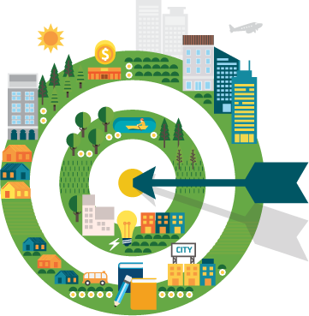
Targeted Communities (TCs)
Defined as any economically disadvantaged community that qualifies as an Empowerment Zone:
The median household income is under 200% of the Federal poverty level;
The unemployment rate is at, or above the national average;
As a group, individuals with disabilities have historically sought, have been eligible for, or have received Vocational Rehabilitation (VR) services at less than 65% of the average rate of VR Agency, or achieved competitive integrated employment at 65% or less of the State VR agency’s employment outcome level.
Notes:
Targeted Communities are defined as any economically disadvantaged community that qualifies as an Empowerment Zone. In order for a community to qualify as an empowerment zone:
The median household income is under 200% of the Federal poverty level;
The unemployment rate is at, or above the national average;
As a group, individuals with disabilities have historically sought, have been eligible for, or have received Vocational Rehabilitation (VR) services or have achieved competitive integrated employment at 65% or less of the State VR agency’s employment outcome level.

Slide 7
High Leverage Groups with National Applicability (HLGNAs)
Defined as groups of individuals with disabilities who are frequently identified by State VR agencies throughout the Nation in their statewide comprehensive needs assessments as groups comprised of individuals that are either underserved or who have achieved substandard performance. For example,
Residents of rural and remote communities;
Adjudicated adults and youth;
Youth with disabilities in foster care;
Individuals with disabilities receiving Federal financial assistance through TANF;
Culturally diverse populations, e.g., African Americans, Hispanic Americans,
Native Americans, and non-English speaking populations;
High school dropouts and functionally illiterate consumers;
Persons with multiple disabilities, e.g., deaf-blindness, HIV/AIDS, substance abuse; and
SSI and SSDI recipients, including subminimum-wage employees.

Slide 8
Project activities
I. Knowledge development:
Technical assistance needs assessment survey of 80 state VR agencies
Literature review of emerging, promising, and evidence-based practices
Active involvement of targeted community experts and representatives
Focus groups, structured interview, interactions via webcasts/teleconferences, etc.
II. Targeted community selection with input from state VR agencies:
Surveyed state agencies to identify at least 2 underserved groups located in targeted communities
Selected 12 targeted communities and develop intensive TA proposals in 12 states:
- CA, IL, KY, LA, MT, NM, NC, NH, OR, SC, TX, and VA.
III. Intensive Technical Assistance:
12 Targeted Communities and 12 Replication Sites
receive long-term, on-going, and on-site TA to increase Competitive Integrated Employment (CIE) outcomes and community integration of people with disabilities in TCs.

Slide 9
Project activities (Cont’d)
IV. Targeted and Universal Technical Assistance:
Provides products and services to state VR agencies and rehabilitation professionals representing SRCs, ILCs, CRPs and CBOs.
- Information developed collaboratively and disseminated through
Communities of Practice (CoPs), Project E3 website, NCRTM, and CSAVR.
A relationship is established between the TA recipient and one or more TA center staff. This category of TA includes one-time, labor-intensive events, such as facilitating strategic planning or hosting regional or national conferences.
It can also include episodic, less labor-intensive events that extend over a period of time, such as facilitating a series of conference calls on single or multiple topics that are designed around the needs of the recipients.
Facilitating Communities of Practice can also be considered targeted, specialized TA.

Slide 10
Project activities (Cont’d 2)
V. Knowledge Dissemination via Information Technology Platform:
Website (Webinars, teleconferences, video conferences, and other virtual methods of dissemination of information and technical assistance)
Two communities of practice (state VR agencies and all management/ staff serving members of the targeted communities)
VI. Platform: National State VR Agency Forums: Year 3 and Year 5 to share progress and lessons learned from targeted communities.
VII. National Results Meeting: to State VR agencies to review the data collected, best practices developed, and lessons learned from the intensive intervention sites served within the 12 targeted communities and 12 replication sites.

Slide 11
Project E3 Engagement with VR Agencies
Objective 1:
Involve state VR agencies in the development of knowledge and identification of targeted communities.
Objective 2:
Design modules and strategies to provide intensive, targeted, and universal technical assistance and coordination activities.
Objective 3:
Provide technical assistance to state VR agencies, partners, employers, and community leaders designed to maximize community services.
Objective 4:
Measure and track effectiveness of on-going technical assistance, training, and alliance-building activities.
Notes:
Project E3 has four primary objectives for State VR agencies. They are:
First, to involve State VR agencies in the development of knowledge and identification of targeted communities;
Second, to collaboratively design modules and strategies for provision of intensive, targeted, and universal technical assistance and coordination activities to VR stakeholders that serve economically disadvantaged persons with disabilities in high-leverage groups with national applicability. Modules and strategies will be provided via field-based and in-office technical assistance, a state-of-the art website, and two communities of practice.
Third, to provide technical assistance to state VR agencies, their partners, employers, and community leaders that is designed to maximize community support services in targeted communities;
And fourth, to measure and track the effectiveness of on-going technical assistance, training, and alliance building activities.

Slide 12
Project E3 Outcomes
Increase the participation in State VR programs;
For individuals with disabilities in low-income communities:
Increase the number and percentage who complete their VR program and enter into competitive integrated employment.
Increase the amount of community support services provided;
Develop collaborative, coordinated service strategies among State VR programs and community support service agencies to provide more comprehensive services to consumers.
Notes:
Project E3’s desired outcomes for individuals with disabilities in low-income communities are to:
Increase their participation in State VR programs;
Increase the number and percentage served through the State VR programs who complete their VR program and enter into competitive integrated employment;
Increase the amount of support services provided through community agencies and support systems to those who are participating in a VR program; and
Project E3 activities will develop collaborative, coordinated service strategies among State VR programs and community support services agencies and systems to provide more comprehensive services to those who are engaged in a VR program.

Slide 13
Community-Based Participatory Research (CBPR)

Slide 14
More about CBPR
CBPR has emerged as an approach designed to promote community well-being through the establishment and maintenance of partnerships.
Rather than assuming what is best for a community, CBPR utilizes community partnerships to establish full and equal participation in research by three groups:
community members,
organizational representatives, and
academics.
The following slide presents the CBPR process

Slide 15
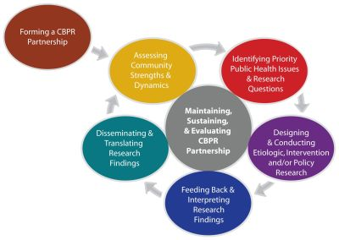
The CBPR Process

Slide 16
The foundation of CBPR is the collaborative partnership
Community members
Provide academics with authentic perspectives on the real lived experiences of the affected community
They draw on their own experiences and the experiences of others in the community
Invaluable

Slide 17
Organizational Representatives (the community gate keepers)
Provide academics with access to community members and monitor the academics to ensure that no harm is done in the community
Have profound understanding of community life
Have perspectives about service and programmatic uptake, what works and does not work during service delivery to meet needs, and valuable experiences trying to meet community needs

Slide 18
14 Partnership Principles
Mutual respect and genuineness
Establishing and utilizing formal and informal partnership networks and structures
Committing to transparent processes and clear and open communication
Roles, norms, and processes evolving from the input and agreement of all partners
Agreeing on values, goals, and objectives of the project and practice
Building upon each partner’s strengths and assets
Offering continual feedback among members
Balancing power and sharing resources
Sharing credit for the accomplishments of the partnership
Facing challenges together
Developing and using relationships and networks outside of the partnership
Incorporating existing environmental structures to address partnership focuses
Taking responsibility for the partnership and its actions
Disseminating conclusions and findings to state agencies, community members, and policy makers

Slide 19
Networking, Building Trust, & Negotiation: are key in partnership development Networking:
The foundations of CBPR require the development of a network with individuals having similar areas of interest or concern
Becoming familiar with the resources within one’s geographic area is likely to yield beneficial outcomes
Networking facilitates trust

Slide 20
Building Trust
Often agencies and communities are inundated by academics who conduct research studies that may not benefit the consumers or organization they serve.
Many organizations and communities have felt exploited as research labs, when research was academic-driven and not conducted in a respectful manner.
Among underrepresented populations, including persons with disabilities, histories of exploitation and neglect have facilitated mistrust.
It is not uncommon for communities to be apprehensive about developing research partnerships.
To become a trusted partner within the community, the academics must make time to interact with community members and organizational representatives and build rapport.
Academics bring with them the reputation of their academic institution that may facilitate or impede trust building.
Academics must share relevant experiences, both personal and professional, and articulate overlapping interests and perspectives with community members.

Slide 21
Negotiation
Academics work shoulder to shoulder with community members and organizational representatives to identify priority issues and community perspectives.
If an issue is not identified as a community priority, yet data suggests the issue contributes to community well-being, academics present what they perceive as important data to increase community awareness.
Academics are flexible throughout the process. The community-identified priority is an important foundation on which to further build trust and maintain the relationship.
Nothing more quickly dissolves or impedes trust than a person with their own non-negotiable agenda, going into a community to “fix” something, without gaining community input, buy-in and participation.

Slide 22
Seven components of CBPR
1. Identify issue(s) and community
What does the research suggest?
Does the community agree that the issue is important?

Slide 23
Seven components of CBPR - 2
2. Assess community challenges, assets, and strengths(community forum)
Partnership facilitates a community assessment to identify or assess the support of, implementation, and participation.
“Meet the community where they are”
Includes training needs
Members may serve as informal guides and provide important perspectives on issues.
Community risks and holding a community forum
Assessment is shared with the partnership
This creates a shared commitment to CBPR by:
Acknowledging the wealth of knowledge that community members, organizational representatives, and academics bring to a process
Promoting unity and more informed understanding of phenomena to create change

Slide 24
3. Define priorities
Assessment provides a wealth of community data
Strengths
Assets
Challenges
Well facilitated discussions about the assessment data and other extant data help to identify priorities, which in turn become the basis to enhance the project

Slide 25
4. Develop project and data collection methodologies (e.g., training, outcomes)
Involves all partners and includes
Mutual understanding of the project, including the foundations and applications of data
Project integrity
Providing in-service training and skills-building identified by
Investment in, and use of, the project outcome results

Slide 26
5. Collect and analyze outcome information
Using a CBPR approach, community members, organizational representatives, and academics together determine how best to recruit consumers
Building on community assets and pre-existing structures may be key to successful recruitment and/or consumer retention
Building upon counselor and service provider knowledge to identify training needs and how to assess the utility of training to enhance service provision

Slide 27
6. Interpret findings
Upon completion of data review, community members, organizational representatives, and academics rely on experiential learning methods to interpret summarized data
Preliminary project findings may then be presented in a format to meet the needs of all organizational and community members, including those with disabilities being served (e.g., visually impaired, hearing impaired)
Organizational and Community meetings are one venue in which to present the interpretation of the preliminary project findings and build improved understanding and applications of findings
Community members, organizational representatives, and academics react to the findings, suggest alternate interpretations, reach consensus on project findings, determine utilization of findings to further address community needs, and create plans of action to enhance community well-being

Slide 28
7. Disseminate findings
Community members, organizational representatives, and academics, reach consensus on how to disseminate findings
Often options include data sheets; booklets; press releases; local, region, national and international presentations.
They also must determine the person(s) responsible for dissemination in the various formats and the resources (e.g., financial support, professional organizations) to disseminate the study findings.
Disseminate study findings in a language that is respectful and understandable to community members, organizational representatives, and academics, while maintaining data integrity

Slide 29
Targeted Communities in 12 States
and 12 Replication Site

Slide 30
High Leverage Groups of National Applicability (HLGNA) for the NJ proposal are adult residents of economically disadvantaged rural and remote communities.
HLGNA 1: Consumers with Drug Abuse/Dependence and Alcohol Abuse and Dependence and SSI
Targeted Community: Newark, New Jersey
Replication site: Trenton, New Jersey
HLGNA 2: Persons with Mental Illness (i.e. Anxiety Disorder, Depressive and Other Mood Disorders, Mental Illness, Mental Illness Not Listed, Personality Disorders, Schizophrenia/Psychotic Disorders) and SSI.
Targeted Community: Newark, New Jersey
Replication site: Trenton, New Jersey

Slide 31
Community-based Participatory Research (CBPR) activities to date: New Jersey
Worked with key stakeholders to identify populations and challenges to be addressed (August 2017)
Worked with key stakeholders to identify potential partners for participation in Advisory Council (September 2017)
Met with key stakeholders and additional partners to provide overview of project, including CBPR and role advisory council, to solicit interest from partners for participation in Advisory Council (​December 2017)
First Advisory Council Meeting - Overview of CBPR provided, challenges confirmed and ​additional challenges, identified training and technical assistance strategies discussed consensus reached and initial plan for moving forward created (Scheduled for March 2018)

Slide 32
Virginia
High Leverage Groups of National Applicability(HLGNA) for the VA proposal are adult residents of economically disadvantaged rural and remote communities.
HLGNA 1: Consumers with Drug Abuse/Dependence
Targeted Community: Martinsville and Henry County, Virginia
Replication site: Hampton Roads Region, Virginia
HLGNA 2: Persons with Mental Illness (i.e. anxiety disorder, attention deficit hyperactivity disorder, depressive and other mood disorders, eating disorders, mental illness not specified, personality disorders, schizophrenia/psychotic disorders)
Targeted Community: Martinsville and Henry County
Replication site: Hampton Roads Region

Slide 33
CBPR activities to date : Virginia
Worked with key stakeholders to identify populations and challenges to be addressed (August 2017)
Worked with key stakeholders to identify potential partners for participation in Advisory Council (September 2017)
Met with key stakeholders and additional partners to provide overview of project, including CBPR and role advisory council, to solicit interest from partners for participation in Advisory Council (November 2017)
Advisory Council formed (November 2017)
Key stakeholders and community partners identified additional community sectors and proposed partners to participate in first official Advisory Council Meeting scheduled for January 2018 (December 2017)
First Advisory Council Meeting - Overview of CBPR provided, challenges confirmed and additional challenges identified, training and technical assistance strategies discussed; consensus reached and initial plan for moving forward created (January 2018)
Second Advisory Council Meeting - Reviewed and reached consensus for overall project strategy, with year 1 focused heavily on training and year 2 focused on outreach, engagement and implementation of skills and strategies acquired in year 1 (March 2018)
Third Advisory Council Meeting - Review of Work Plan and Overview of Project Evaluation (Scheduled for May 2018)

Slide 34
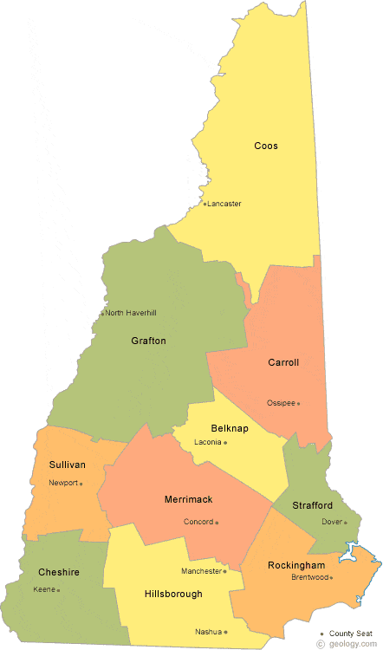
New Hampshire
HLGNA 1: Residents of economically disadvantaged rural and remote communities who:
Are transition-age students or youth between the ages of 14-24 years old,
Have one or more mental impairments (cognitive and/or psychosocial/emotional), based on the following RSA 911 Impairment Source (IS) Codes that collectively fall within the Mental Impairments domain, OR
Have historically applied and engaged with VR at lower rates, and attained lower competitive, integrated employment outcomes than their peers,
May receive Supplemental Security Income (SSI) and/or involvement with the Foster Care system.
HLGNA 2: Same as HLGNA 1 but 25 y/o+
Targeted Community: North Country (Coos, Grafton, Carroll Counties)
Replication Site: Strafford County
Notes:
HLGNA 1: RSA 911 Inclusion
(08) Autism
(12) Cerebral Palsy
(13) Congenital Condition or Birth Injury
(21) Epilepsy
(25) Mental Retardation (i.e., intellectual disability)
(04) Anxiety Disorders
(07) ADHD
(15) Depressive and Other Mood Disorders
(24) Mental Illness (not listed elsewhere)
(29) Personality Disorders
(33) Schizophrenia and Other Psychotic Disorders
3) Have historically applied and engaged with VR at lower rates, and attained lower competitive, integrated employment outcomes than their peers.
4) May receive Supplemental

Slide 35
CBPR Activities to Date: New Hampshire
Spring/Summer 2017: worked collaboratively with state VR leadership to identify geographic regions and populations (HLGNA)
August 2017: initial site visit to Concord (meeting with state leadership) and North Country (meetings with local VR and Area Agency staff)
October 2017: two-day meeting in North Country focusing on initial elements of CBPR; assessing strengths, challenges, priorities
Targeted Outreach, Financial Empowerment, Poverty Awareness/Culture, Work Incentives Benefits Counseling & Alignment with Financial Empowerment, Soft Skills, Interagency Collaboration, Improve Performance with WIOA
January 2018: Advisory Council identification, collaborative Practice Profiles, finalize Action Plan, meeting with local community (North Country) and state leadership
March 2018: AC meeting, training implementation (poverty, financial empowerment)
June: AC meeting, regional training, integrate DCF staff

Slide 36
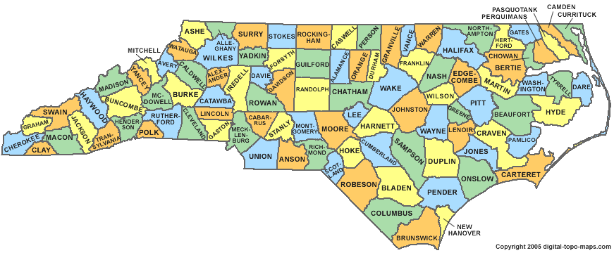
North Carolina
HLGNA 1: Residents of economically disadvantaged rural and remote communities who:
Are transition-age students or youth between the ages of 14-24 years old,
Have one or more mental impairments (cognitive and/or psychosocial/emotional), based on the following RSA 911 Impairment Source (IS) Codes that collectively fall within the Mental Impairments domain, OR
Have Blindness or Other Visual Impairments
Have historically applied and engaged with VR at lower rates, and attained lower competitive, integrated employment outcomes than their peers,
May receive Supplemental Security Income (SSI) and/or TANF benefits.
HLGNA 2: Same as HLGNA 1 but 25 y/o+
Targeted Community: Rocky Mount VR (Edgecombe, Halifax, Nash, and Northampton); Greenville DSB
Replication Site: Boone VR (Allegheny, Ashe, Avery, Mitchell, Watauga, Wilkes, and Yancey); Ashville and Winston Salem DSM
Notes:
HLGNA 1: RSA 911 Inclusion
(08) Autism
(12) Cerebral Palsy
(13) Congenital Condition or Birth Injury
(21) Epilepsy
(25) Mental Retardation (i.e., intellectual disability)
(04) Anxiety Disorders
(07) ADHD
(15) Depressive and Other Mood Disorders
(24) Mental Illness (not listed elsewhere)
(29) Personality Disorders
(33) Schizophrenia and Other Psychotic Disorders
3) Have historically applied and engaged with VR at lower rates, and attained lower competitive, integrated employment outcomes than their peers.
4) May receive Supplemental

Slide 37
CBPR Activities to Date: North Carolina
Spring/Summer 2017: worked collaboratively with state VR leadership to identify geographic regions and populations (HLGNA) to focus on
September 2017: initial site visit to Raleigh (meeting with state leadership) and Region 1(meetings with local VR and DSB staff)
Fall/Winter 2017-18: regular calls with state leadership to plan early 2018 site visit
March 2018: will be meeting with VR staff in Region 1 to identify strengths, challenges, priorities, and develop Advisory Council and Action Plan

Slide 38
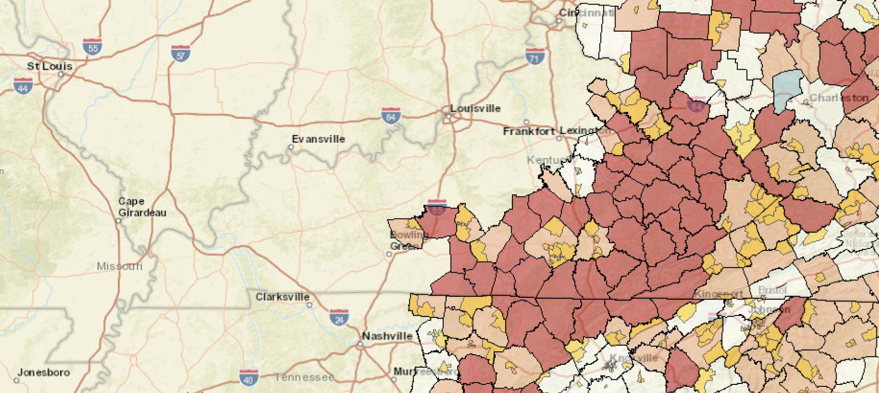
University of Kentucky Human Development Institute TC-TAC
The Appalachian Regional Commission, based on national averages on unemployment rates, income, and poverty rates identified the dark counties as ‘distressed counties’ (those that rank in the worst 10 percent of the nation's counties
(Appalachian Regional Commission, 2016)
High Leverage Group 1.
Students or transition-aged youth (aged 16-24) with commonly identified developmental disabilities (e.g., Autism, Cerebral Palsy, Epilepsy, Intellectual Disability)
High Leverage Group 2.
Individuals with Mental Health diagnoses (including Depressive and Other Mood Disorders, Personality Disorders, Schizophrenia and Other Psychotic Disorders.

Slide 39
General and Intensive Technical Assistance Specific to High-Leverage Groups of National Significance
Extensive Outreach to Partners (Schools, Partnering Agencies, Employers/Referral sources, Interfaith groups, parents and educators)
High Leverage Group 1
Implementation of Community Work Transition Program
Parent and Youth Educational and Focus Groups
High-Leverage Group 2
Implementation of Individual Placement Support Program
Counselor Trainings in Motivational Interviewing and Impression Management
Combined TA
Benefits Counseling Assistance
Employer Education Groups
Transportation
Communities of Faith Outreach through collaboration with interfaith groups.
Exploring effective and acceptable methods of information dissemination with Physicians, Mental Health and Behavioral Health agencies, and state Extension Department

Slide 40
Community-Based Participatory Research (CBPR) activities to date: Kentucky
In the development of the Program Plan, worked with Kentucky General VR and Blind Agency Directors and Counselors in the counties to identify community partners and barriers
Established relationships with Special Education Directors, Mental Health agency and community partners (NAMI, IL, County Government)
Established and maintained relationships with the Chamber of Commerce leadership and employers, Interfaith Groups, Media, and community members, and participated in community and transition events.
Established and communicated early and consistently with Advisory Council, including employers, SPED, VR and Blind Agency Counselors, agency representatives (Regional Behavioral Health, NAMI, Workforce Development, Advocates.
Actively revised plans based on feedback (information dissemination methods, individuals who should be invited to participate, messaging).
Conducted trainings with VR/OFB, employment specialists; Parents and youth; teachers and SPED Directors.
Community Engagement consultant

Slide 41
Community-Based Participatory Research (CBPR) activities to date: Oregon
In the development of the Program Plan, met with Oregon Blind Agency Directors, Counselors, and client groups to identify community partners and barriers
Community Engagement consultant
Included TA specifically addressing client requests, Peer Mentoring Program
Established relationships with Education District staff, Chamber, IL
Establishing Advisory Council, including employers, VR and Blind Agency Counselors, Teachers, Agency representatives, Workforce Development, Advocates, IL
Having materials reviewed for local relevance and validity

Slide 42
Targeted Community: California
Targeted Community: Central Valley
Region 1: Fresno
Region 2: Kern Counties
HLGNA 1: Young adults (18-30) who receive public assistance and are
Hispanic with a disability or chronic illness
HLGNA 2: Young adults (18-30) who receive public assistance and are
Hmong with depression and PTSD.

Slide 43
CBPR Activities: Central Valley
Targeted Outreach
Informal Community Needs Assessment
Counselor Training in Motivational Interviewing
Counselor Training in Financial Empowerment

Slide 44
Targeted Community: Illinois
Targeted Community: Chicago (Cook and Winnebago Counties)
HLGNA 1: Incarcerated young adults
HLGNA 2: Aging out of foster care young adults

Slide 45
CBPR Activities: Chicago
Targeted Outreach
Focus Groups Needs Assessment
Counselor Training in Motivational Interviewing
Counselor Training in Financial Empowerment
Advisory Board Meeting
Brief Inventory Screener-Initial Assessment

Slide 46
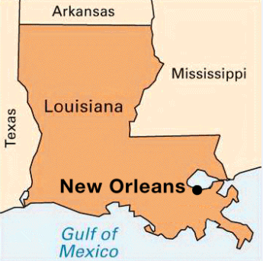
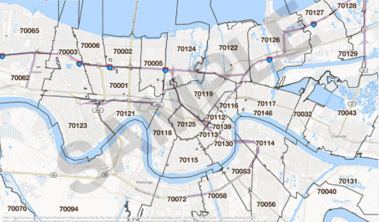
HLGNA 1: African Americans with HIV/AIDS ( primary or secondary disability). HLGNA 2: African Americans with Mental Health Diagnosis (E.g., Anxiety Disorder and Depressive and Other Mood Disorders only and with no HIV/AIDS diagnosis). REPLICATION SITE : Baton Rouge, LA
Targeted Community (TC): New Orleans, LA 70112, 70113, 70117, and 70119

Slide 47
CBPR Activities in New Orleans 1. Community Outreach, Needs Assessment, and Problem-Solving (groups and individuals): Leadership Plenary Sessions 1 HIV/AIDS (March 23, 2017: N=32) and 2 (May 23, 2017: N=35). Leadership Plenary Session 1 MI (February 1, 2018: Expected N=26) Brainstorming sessions with CBO and VR administrators to identify barriers and facilitators of collaborative service delivery; and modes of jointly outreaching underserved communities 2. Comprehensive Supports Capacity Building: Focused meeting with Project Lazarus staff and residents (August 25, 2017: N=14) Focused Group Discussion and Capacity Building of Communities with HIV/AIDS (September 21, 2017: N=22) Exploration of modes of incorporating CBPR among providers and communities that serve and host PLWH 3. Employment Opportunity Expansion, including Business Engagement: New Orleans PLWH Employment Advisory Panel Meetings (July 6, 2017: N=6; September 22, 2017: N=6; November 2, 2017: N=6; February 22, 2018: N=6) 4. VR Professional Training and TA: Three sessions were designed to improve awareness among professionals regarding populations with HIV/AIDS and MI; importance of CBPR; proven modes of implementing CBPR; and program ethical perspectives.

Slide 48
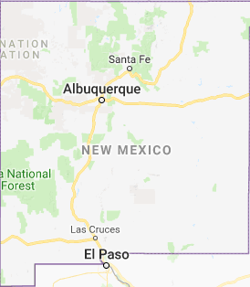
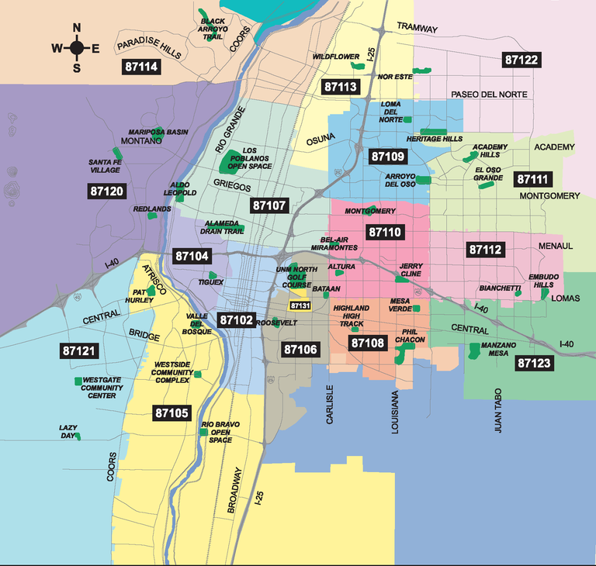
HLGNA 1: Persons with a primary disability of anxiety disorder, depressive disorder, personality discords, and/or other mood disorders. HLGNA 2: Persons with a primary disability of alcohol abuse or drug dependence.
Targeted Community (TC):
Albuquerque, NM 87102, 87105, 87106, 87108, 87121

Slide 49
CBPR Activities in Albuquerque
Community Outreach, Needs Assessment, and Problem-Solving (groups and individuals): Leadership Plenary Sessions 1 (October 23, 2017: N=14) and 2 (December 14, 2017: N=19). Brainstorming sessions with CBO and VR administrators to identify barriers and facilitators of collaborative service delivery; and modes of jointly outreaching underserved communities
VR Professional Training and TA: One session was designed to improve awareness among professionals regarding populations with HIV/AIDS and MI; importance of CBPR; proven modes of implementing CBPR; and program ethical perspectives.

Slide 50
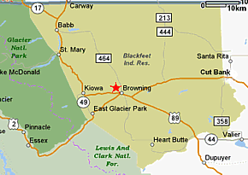
Targeted Community: Glacier and Pondera counties, Montana
Group 1: Persons with psychosocial impairments attributed to alcohol abuse or
dependence
Group 2: Persons with Cognitive, mobility or psychosocial impairments attributed to
traumatic brain injuries (TBI)
Group 3: Persons with psychosocial impairments attributed to depression or anxiety
Replication site: Big Horn County, Montana

Slide 51
CBPR Activities in Glacier and Pondera counties
Met with state VR leadership, local VR providers, and key stakeholders to identify populations, barriers and challenges to be addressed (June 2016)
Identified partners for participation in Advisory Council (September 2016)
Met with key stakeholders and additional partners to provide overview of project to develop commitment from partners to serve on the Advisory Council including local and statewide resource personnel (​November 2016)
First Advisory Council Meeting – Confirmed initial findings regarding challenges, training and technical assistance needs (January 2017)
Monthly advisory council meetings to evaluate technical assistance plan, evaluate current activities, and identify new opportunities or barriers
Technical assistance has covered 12 different areas based on needs identified by local community

Slide 52
Targeted Community: Pee Dee region, South Carolina
Includes:
Horry County
Georgetown County
Florence County
Marion County
HLGNA 1: Women over the age of 18 who have specific sensory impairments including (1) Blindness or (2) Other visual impairments, who are receiving Temporary Assistance for Needy Families (TANF), Supplemental Security Income (SSI), or Social Security Disability Insurance (SSDI)
HLGNA 2: African-American males over the age of 18 who have specific sensory impairments including (1) Blindness or (2) Other visual impairments
Replication area: Midland area

Slide 53
CBPR Activities in Pee Dee Region, SC
Met with state VR leadership and local VR providers to identify populations, barriers and challenges to be addressed (September 2017)
Worked with key stakeholders to identify potential partners for participation in Advisory Council (September 2017)
Identified additional potential partners through development of community resource guide that includes social services, educational institutions, community rehabilitation providers, and employment services (December 2017)
Met with key stakeholders and additional partners to provide overview of project, including CBPR and role advisory council, to solicit interest from partners for participation in Advisory Council (​January 2017)
Conducted initial technical assistance activity to demonstrate project activities (March 2017)

Slide 54
Project E3 Evaluation Strategies

Slide 55
Project Evaluation Overview
Across the 12 intensive TA sites (e.g., Targeted Communities) and the general and targeted TA, a range of evaluation components applicable to each site have been developed.
The evaluation components are organized across three principal areas:
A. Project Performance Metrics: GPRA measures consistent with the RSA 911 Case Services Manual
B. Community Based Participatory Research Metrics: non-GPRA measures that evaluate community engagement and implementation toward sustainability and replication
C. Community Capacity - Outcome measures: non-GPRA measures of efforts to increase the skills and knowledge of the community

Slide 56
A. Project Performance Metrics - Outcomes
Applications from HGLNAs in TCs - Total number of applications received
IPE completion- (Acceptance and retention)
Services provided (Traditional)
Case dollars per client
Competitive integrated employment (CIE) outcome
Competitive integrated employment during the 2nd quarter after exit
Competitive integrated employment during the quarter 12 months after exit
Primary source of support at closure
Weekly hours at closure; Q2 post-CIE, Q4 post-CIE, end of project
Hourly wage at closure
2nd quarter after exit, median earnings of those in CIE
4th quarter after exit, median earnings of those in CIE
Credential Rate
Measurable Skills Gains

Slide 57
Project Performance - Outcome Comparisons
Reporting on outcomes in Targeted Communities is insufficient to demonstrate the effectiveness of the project.
The initial comparison will be focused on comparing outcome data for the HGLNAs in the targeted community to:
HGLNA baseline data in Targeted Community
The secondary analysis will compare outcome data for the HGLNAs in the targeted community to:
HGLNAs in comparable community in other part of the state
HGLNAs across the state
Aggregate performance of state VR

Slide 58
B. Community Based Participatory Research - Metrics
Compared to baseline assessments prior to commencing services:
Number of community groups or stakeholders involved in TC
Number of community groups making referrals
Number of community groups or stakeholders providing services to HGLNAs as part of the plan
Qualitative analysis of policies of state VR and stakeholders regarding MOUs stating formal collaboration and service coordination

Slide 59
C: Community Capacity - Outcome Measures
Number of distinct strategies or interventions implemented in TC either focused on counselor or client skill acquisition on knowledge development
Costs of strategy or intervention for both implementation and sustainability (based on cost estimates provided by VRTAC-TC partners)
Number of TCs using a specific strategies or intervention implemented in TC
Number of trainings offered in a specific strategies or intervention implemented in TCs
Community stakeholder satisfaction with training (based on Technology Acceptance Model constructs)
Relevance
Ease of Use
Utility

Slide 60
Questions and Answers

Slide 61
Project E3: VR TAC TC web: projecte3.com email: contact@prjecte3.com
Dr. Madan M. Kundu Dr. Alo Dutta
Project Director Principal Investigator
Department of Rehabilitation and Disability Studies
Southern University
231 Blanks Hall
Baton Rouge, LA 70813
Phone: 225-771-2325 Phone: 225-771-2335
Fax: 225-771-2293 Fax: 225-771-2293
E-mail: kundusubr@aol.com E-mail: alodutta1992@aol.com

